Slide 1
Lean:
5 Why Method & Root Cause
Toyota Production Systems Lab
Grade 6-8

Slide 2
Root Cause of Problems
Problems happen everyday and it is up to Industrial Engineers to understand why!
Problems are not solved properly unless you understand why they are occurring.
The reason for a problem is called the problem’s root cause.
The root cause can be found by utilizing a method called the 5 whys.

Slide 3

5 Why Method
The 5 Why Method does not solve the problem, rather it identifies the root cause of the problem!
The root cause will allow us to understand why the problem happened and from there we can develop solutions to fix it.

Slide 4
5 Why Method
Like the title state we must ask Why? 5 times in order to get to the root cause.
This is a deep analysis. Usually we do not realize what the real cause of the problem is because we do not investigate it enough.
In order to solve a problem correctly we must know how is happened.

Slide 5
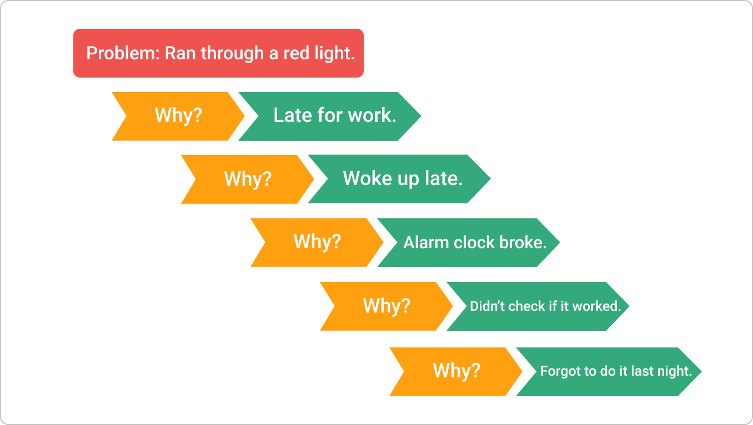
Example - 5 Why Method
Here is a simple example.
Problem is at the top.
Why is asked 5 times and the responses are recorded in descending order.
The last response is the root cause!

Slide 6
Activity
5 Why Analysis
Think about an instance in your life where you had a problem that you needed to get to the root cause. Write it down and conduct a 5 Why Analysis to see if you can identify the root cause of the issue.
See worksheet for details.

