Slide 1
Lean:
Introduction to Lean
Toyota Production Systems Lab
Grade 6-8

Slide 2
Lean Philosophy
Lean is a way of thinking. It it is all about continuous improvement with a focus on eliminating all forms of waste in a process.
Here is a great video to introduce you to the lean philosophy.
https://www.youtube.com/watch?v=psTNv1blsCU

Slide 3
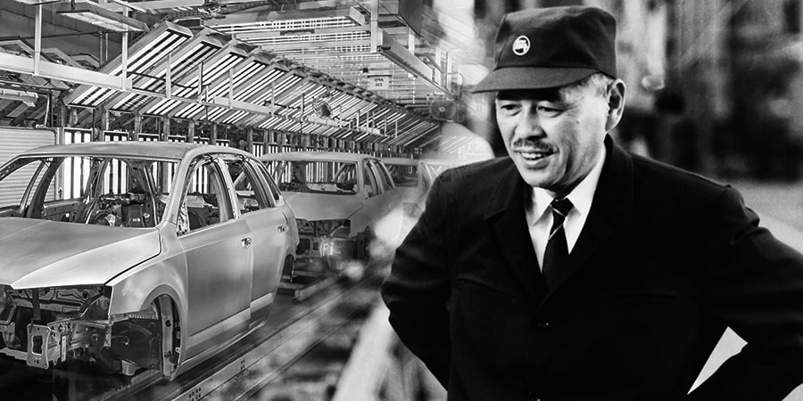
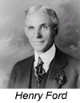
History of Lean
Started out with Henry Ford’s assembly line in the early 1900’s. First person who continuously worked to make sure his process was as efficient as possible.
Then shortly after WWII Taichi Ohno and Kiichiro Toyoda took aspects of Ford’s work with new ideas for continuous improvement and created the Toyota Production System.
https://www.lean.org/whatslean/history.cfm

Slide 4
Difference between Lean, Six Sigma & Lean Six Sigma

Slide 5
Lean Manufacturing
Lean Manufacturing is all about making a product in the most efficient and effective manner, while looking for ways to continuously improve.
Continuous Improvements:
Decrease Cycle Time
Eliminate sources of waste in a process
Increase Throughout

Slide 6
Activity
Crossword Puzzle Lean Terminology
Lean Manufacturing has a lot of terminology. These words are important to know and understand. Complete the crossword puzzle to become familiar with the lean terminology.
See worksheet for instructions.

