Slide 1
Lean:
Mistake Proofing
Toyota Production Systems Lab
Grade 6-8

Slide 2
Mistake Proofing
Industrial engineers want to make things better by preventing problems before they start.
In order to prevent problems, first we must identify problems or areas of waste.
The Japanese word for waste is Muda which is a term that is used a lot when talking about Lean.

Slide 3
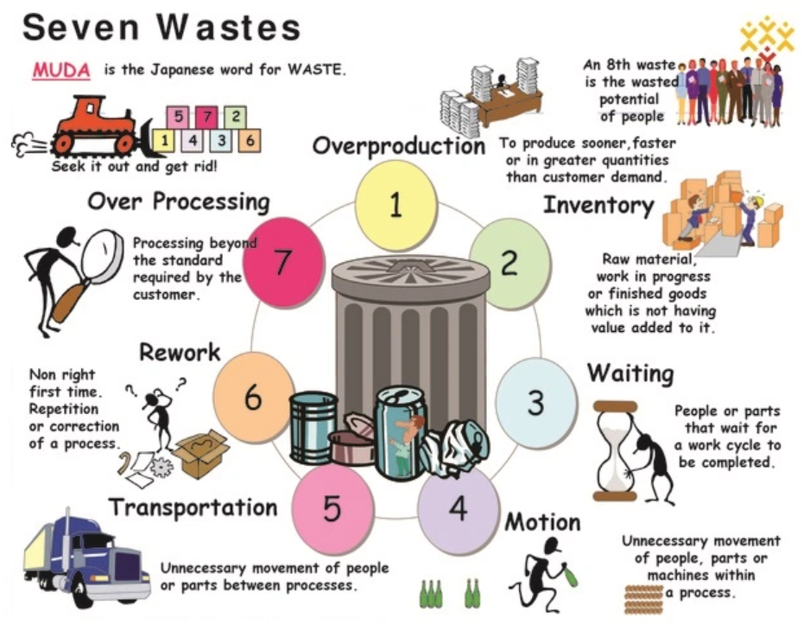
7 Types of Waste
Remember the Acronym TIMWOOD
Transportation
Inventory
Waiting
Overproduction
Overprocessing
Downtime

Slide 4
Waste Makes Mistakes!
When we let waste occur it creates problems that we now must go and fix.
By eliminating sources of waste we prevent problems!
We eliminate waste through Kaizen bursts and process improvement activities like 5S.
Then, we need to make sure it does not happen again, that’s where Mistake Proofing comes in.

Slide 5
Mistake Proofing
Mistake Proofing methods help to prevent mistakes from happening.
So no matter who does the job or task, they can all do it the same way and not create any problems.
There are many different types of Mistake Proofing.

Slide 6

Mistake Proofing Method - 5S
5S is a method allows us to organize, and clean our workstation, and eliminate unnecessary mistakes by….
Sort
Set in order
Shine
Standardize
Sustain

Slide 7
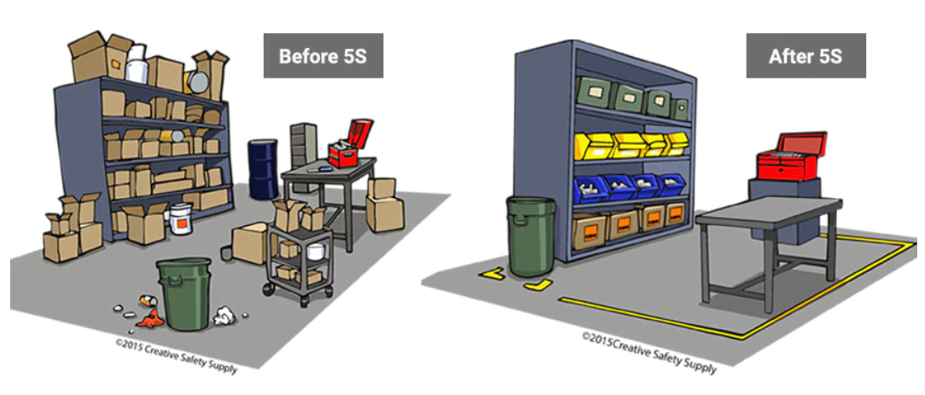
5S Example: Workstation
5S makes sure everything is clean, organized and easy to find. For example, the picture below shows a very messy workstation and a 5S workstation.

Slide 8
Questions: 5S Workstation Examples
The 5S workstation is very organized and everything in the area is where it should be. What forms of waste do you think organizing this area gets rid of?

Slide 9

Mistake Proofing Method – Standard Operating Procedure (SOP)
Standard operating procedures list the steps needed to complete a task.
Having this list available to the worker at their workstation helps them do their task correctly every time since the instructions are always there if they need to check!

Slide 10
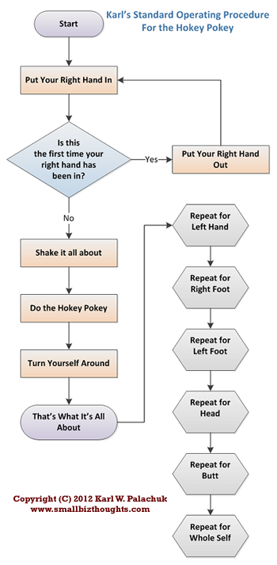
SOP Example
Here is a fun example, where a Standard Operating Procedure was created for the Hokey Pokey Dance!
See how all the steps are listed in a way that is easy to understand and anyone can follow along?

