Slide 1
Lean:
Introduction to Lean
Toyota Production Systems Lab
Grade 9-12

Slide 2
Lean Philosophy
Lean is a way of thinking. It it is all about continuous improvement with a focus on eliminating all forms of waste in a process.
Here is a great video to introduce you to the lean philosophy.
  https://www.youtube.com/watch?v=psTNv1blsCU

Slide 3
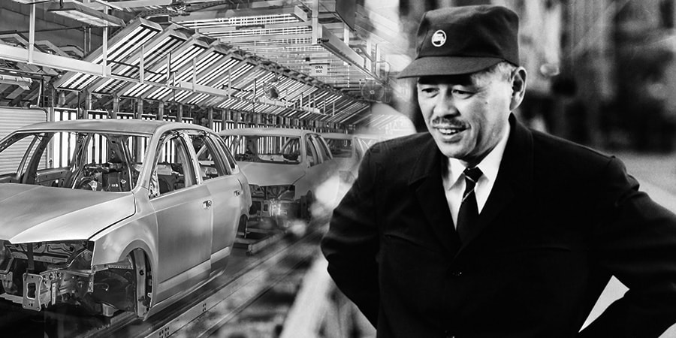
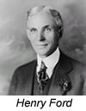
History of Lean
Started out with Henry Ford’s assembly line in the early 1900’s. First person who continuously worked to make sure his process was as efficient as possible.
Then shortly after WWII Taichi Ohno and Kiichiro Toyoda took aspects of Ford’s work with new ideas for continuous improvement and created the Toyota Production System.
https://www.lean.org/whatslean/history.cfm

Slide 4

Lean Manufacturing
Lean Manufacturing is all about making a product in the most efficient and effective manner, while looking for ways to continuously improve.
Continuous Improvements:
  Decrease Cycle Time
  Eliminate sources of waste in a process
  Increase Throughout

Slide 5
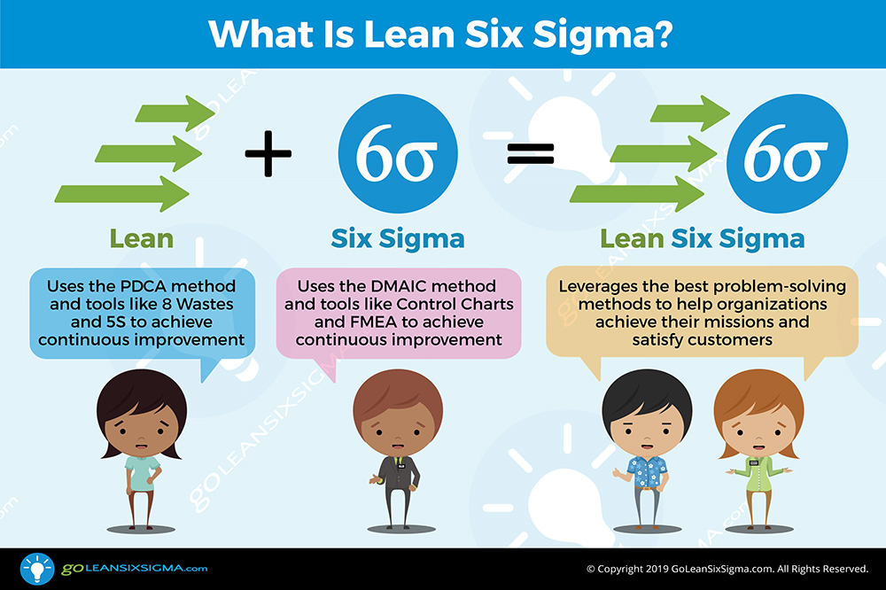
Difference between Lean, Six Sigma & Lean Six Sigma

Slide 6
Lean Manufacturing
Lean Manufacturing is a significant aspect of being an Industrial Engineer.
At RIT, students spend time learning about all aspects of lean and how it can apply to various fields and settings.
Today will be an overview of Lean Manufacturing, giving you some background and information about the importance of lean in industry today.

Slide 7
Lean Manufacturing – A Pathway to Success Paul Akers
Paul Akers is a successful business owner, TED Talker, International Speaker, Innovator and Author talks about the important aspect of lean and how he applies it to his life and every aspect of his business. These videos give a great overview of the lean concepts in action in a real lean manufacturing setting.

Slide 8
Activity
Watch Lean Manufacturing: A Path to Success with Paul Ackers (Part 1)
Lean Manufacturing: The Path to Success with Paul Akers (Pt. 1)
Complete the Crossword Puzzle
  The terminology is important to fully understand lean manufacturing. Throughout the week, these terms will be utilized.
  See worksheet for details.

