Slide 1
Lean:
5S & TPM
Toyota Production Systems Lab
Grade K-5

Slide 2
Sustaining Improvement
When we fix problems, we are happy that they are not an issue anymore, but we do not want them to occur again in the future.
In order to make sure that the value from our work is sustained we need to ensure it does not happen again.
How do we do that?
Answer…Mistake Proofing, 5S and TPM

Slide 3
Mistake Proofing
Industrial engineers want to make things better by preventing problems before they start.
In order to prevent problems, first we must identify problems or areas of waste.
The Japanese word for waste is Muda which is a term that is used a lot when talking about Lean.

Slide 4

Mistake Proofing Method - 5S
5S is a method allows us to organize, and clean our workstation, and eliminate unnecessary mistakes by….
Sort
Set in order
Shine
Standardize
Sustain

Slide 5
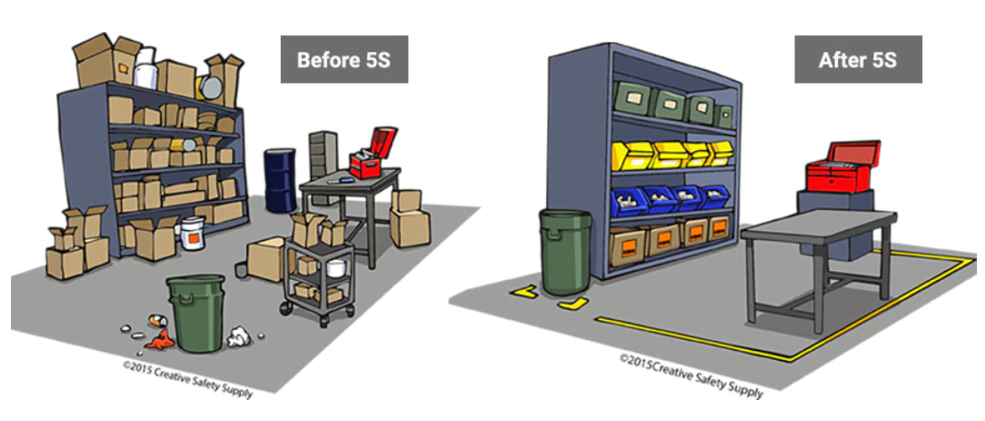
5S Example: Workstation
5S makes sure everything is clean, organized and easy to find. For example, the picture below shows a very messy workstation and a 5S workstation.

Slide 6
Questions: 5S Workstation Examples
The 5S workstation is very organized and everything in the area is where it should be. What forms of waste do you think organizing this area gets rid of?

Slide 7
Total Preventative Maintenance (TPM)
Maintenance on tools and machines is important so they do not break down, wear out and create issues over time.
Therefore, TPM creates a procedure that all workers must complete before and after each shift to keep all the equipment and tools looking brand new.
This is done on ALL levels of the organization

Slide 8
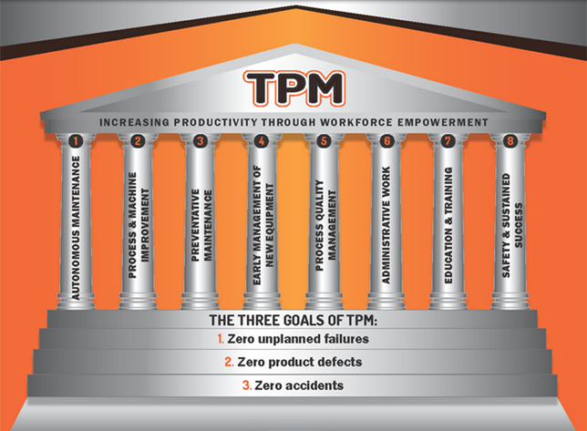
Total Preventative Maintenance (TPM)
Ensures safety and success of all employees.
3 Goals:
0 Unplanned Failures
0 Product Defects
0 Accidents

Slide 9
Activity
Watch Lean Manufacturing: A Path to Success with Paul Ackers (Part 2)
Lean Manufacturing: The Path to Success with Paul Akers (Pt. 2)
Both videos had A LOT of fantastic examples of the improvements that were made. Answer and/or think about the following questions while you are watching the videos. Record your thoughts.

