Slide 1
Project Methods- Waterfall and Agile
STEM and Industrial Engineering
Toyota Production Systems Lab
Project Management & Leadership

Slide 2
What does it mean to plan?
Planning is laying out what you are going to do, before you do it. How it will be done is also important!
It’s very helpful with big, important tasks but it helps a lot with small ones too

Slide 3
Who uses Planning?
Everyone uses planning!
Your friends, parents, and even your teachers use planning almost daily
Can you think of any times you use it?
  The next slides have some examples

Slide 4

How You Might Use Planning
You know that feeling when you’re at school and you really want to play a game with your friends. You want to reach your goal, and you plan out what you need to do first.
In this situation, your goal is to play games with friends.
First you have to get home
Next you have to finish your homework
Then you reach your goal!

Slide 5
How Your Parents Use Planning
You’ve probably noticed, but your parents are usually pretty busy (even busier than you)!
Planning helps adults organize their week, so they don’t fall behind or forget about anything.
If they plan their week, they can make time for dropping you off at practice, getting groceries, and relaxing for a few minutes.

Slide 6
Why is planning so important?
Planning things out saves so much time!
If you try to do everything without planning, you’ll be way more stressed out.
Think about this: What would happen if you started working on a school project before you knew all the details?
  There’s a chance that you did the project wrong and have to start over!

Slide 7
How planning is used
With projects, planning becomes very important
If you plan properly, you set yourself up to succeed in the end
Projects often have many moving parts, and there are different methods that are used to help reach the end goal. We’ll cover 2 of them.

Slide 8
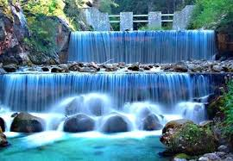
The Waterfall Method
What is the Waterfall Method?
It’s a type of methodology that is used for projects that usually have a rigid structure from start to finish.
  The next task is dependent on the one before it being complete
    Ex: A must be done before B can be started
It got its name because it has steps that flow down like a waterfall

Slide 9
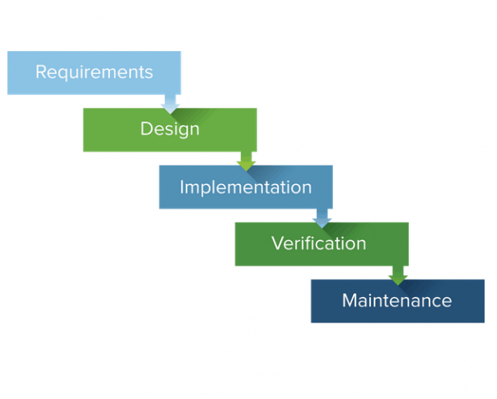
The 5 steps of Waterfall

Slide 10
How Can You Use it?
Let’s use an example: Getting a 100 on a math test
Requirements:
  There is a math test next week and you aren’t prepared at all, so you have to study.
Design:
  Here, you’ll make flashcards or get practice problems to study.
Implementation:
  In this phase, you will study using the tools that you have and prepare yourself
Verification:
  This is when you make sure you know the material and take the test
Maintenance:
  After the test, you might practice what you learned in class to keep it fresh, or make your skills even better

Slide 11
Limitations of Waterfall
You studied for the math test in the last example
  What if you get there, and the test isn’t what you studied for?
In waterfall, once you get the requirements, you don’t check back to make sure you’re working on the right thing until you get to the end
  This means if you make a mistake in the beginning, you won’t know until it’s too late!
In this case, Agile could be used

Slide 12
Agile
Agile is an iterative process that checks progress and adds on requirements slowly
  Project progress is checked with the customer frequently
In the example, with Agile, you would make some flashcards and ask the teacher if you are studying the right way.
  Once he/she says yes, you would start studying.
  You might even check with them again to make sure you’re getting the right answers

Slide 13
Benefits of Agile
Agile is more flexible
  This means if changes are made, it’s easier to adjust to them
The customer can tell you how to make changes from where you currently are in the process
  This is like how you check in with your teacher when you’re doing projects

Slide 14
Waterfall Vs. Agile
Activity: Which would be better for each scenario?
Fill out the associated worksheet named “ProjMan_6-8_Waterfall&Agile”

Slide 15

Thank you!

