Slide 1
Project Management Concepts
Toyota Production Systems Lab
Grade 9-12

Slide 2
Agenda
What is a project
Project Trade-offs
Minimizing / Mitigating Risk
Project Lifecycle

Slide 3
Accompanying worksheet
Please follow along with the worksheet titled “ProjMan_9-12_ConceptsWS”
Please answer question 1 before going to the next slide.

Slide 4
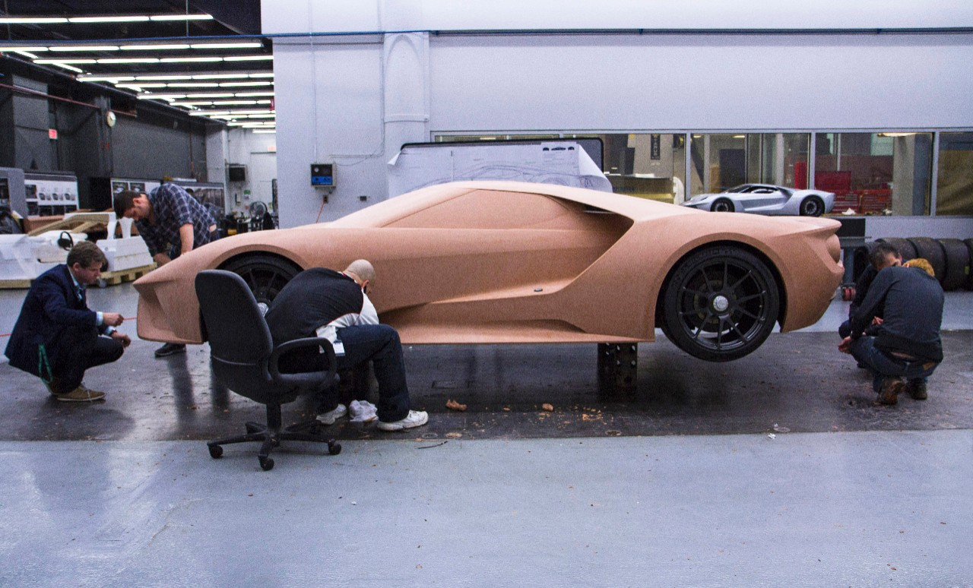
What is a Project?
“A temporary endeavor undertaken to create a unique product, service, or result”

Slide 5
Project Characteristics
Has a goal / purpose
Has performance requirements (form, fit, function)
Has a defined scope, schedule, and end date
Has uniqueness
Notes:
Question:
Which of these are a project?

Slide 6
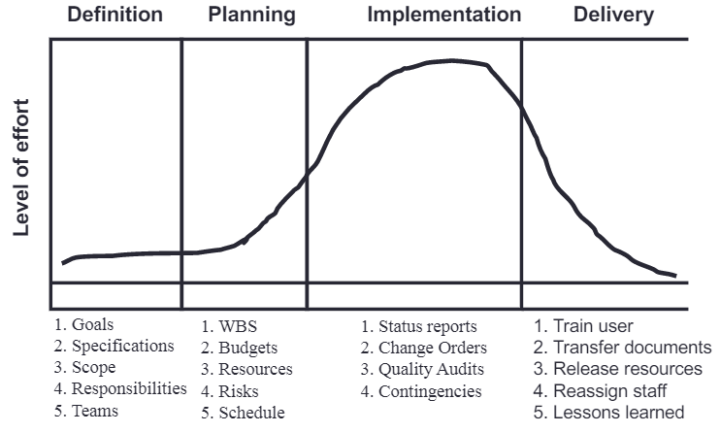
Lifecycle of a project
Four Phases
Definition
Planning
Implementation
Delivery
Notes:
Might archive this slide for a future module

Slide 7
Project Examples
Are Projects:
Developing a vaccine
Designing a new car
Making a group presentation
Are not Projects:
Placing a weekly order
Making lunch for yourself

Slide 8
Scope
Scale of the project
What is the project going to accomplish?
How long will it take?
How much will it cost?

Slide 9
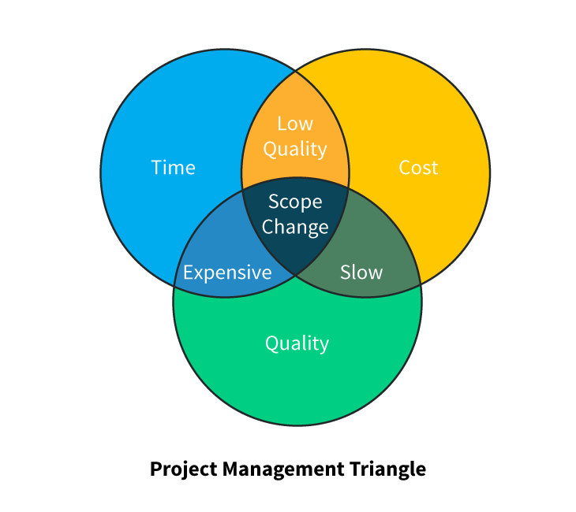
Project Trade Offs
Pick 2 of time, quality, or cost
Also need to include Uncertainty / Risk

Slide 10
Uncertainty
How long will it take?
How will we do this?
Will we have everyone we need?
Uncertainty is one of the reasons that a project is a project, and not “business as usual”. It cannot be eliminated, only minimized.

Slide 11
How to Minimize Risk
Risk Prioritization matrix
Takes into account:
Cause
Likelihood: how likely is the risk to happen
Severity: how bad would it be if it happened
RPN = Likelihood x Severity
Just a relative number
Address higher RPN’s first
Aim to lower total RPN
Issues with getting to making a new kind of cookie
Issue | Cause | Likelihood (1-10) | Severity (1-10) | RPN = LxS
Need to go to the store | Out of ingredients | 7 | 3 | 21
Burn the cookies | Cooked too long | 5 | 10 | 50
Cookies don't taste good | Bad recipe | 3 | 5 | 15
Total | NA | NA | NA | 86
Notes:
Question to fill in more blanks
For 6-8, ask for continuation of cookie theme
For 9-12, ask for new project, (topic on WS)

Slide 12
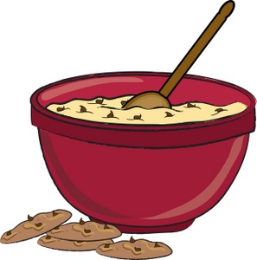
Mitigating risk
Respond in one of four ways:
Avoid
Ex: avoid running out of ingredients by buying right before baking
Transfer
Mitigate
Ex: use a timer so the cookies don't burn
Accept
Ex: recipe is bad, won’t know until I try it
Notes:
Ask question here for the issues / risks that they came up with previously

