Slide 1
Project Management Styles
Toyota Production Systems Lab
Grade 9-12

Slide 2
Agenda
What is a Project?
What is Waterfall?
Waterfall activity
What is Agile
Agile vs Waterfall

Slide 3
Accompanying worksheet
Please follow along with the worksheet titled “ProjMan_9-12_AgileWS”

Slide 4
What is a Project?
“A temporary endeavor undertaken to create a unique product, service, or result”

Slide 5
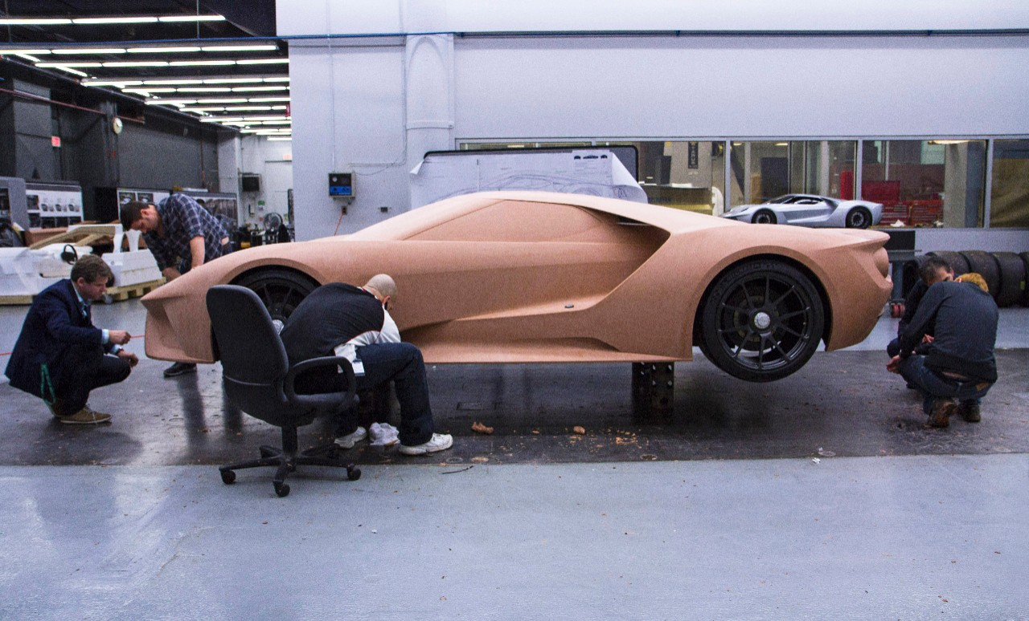
Examples of projects
Making a video game
Designing a new car
Making a bridge
Planning a vacation

Slide 6
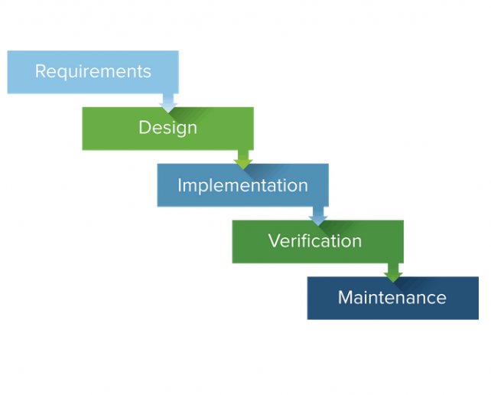
What is Waterfall
Linear process going from initial requirements to delivery.

Slide 7
Baking cookies with Waterfall
Requirements:
We want some cookies next week
Design:
Write out some of the steps that you will take to make the cookies, and how long you think they will take
Implementation:
This is where you would bake the cookies (no need to do that here)
Verification:
At this point, you have your cookies, and would give them to your parents or the customer
In this “Project”, there is no maintenance step
Notes:
Add no help note on the WS for design

Slide 8
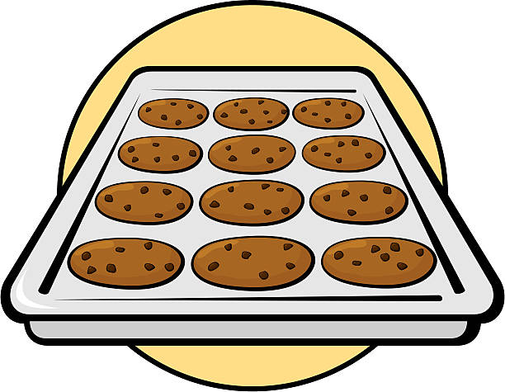
What could go wrong?
We were only told that the customer wanted cookies
What if they wanted a different kind?
We made the process ourselves
What if the customer already had a recipe, or was allergic to one of the ingredients?
In short, we only talked to the customer at the beginning and end of the process

Slide 9
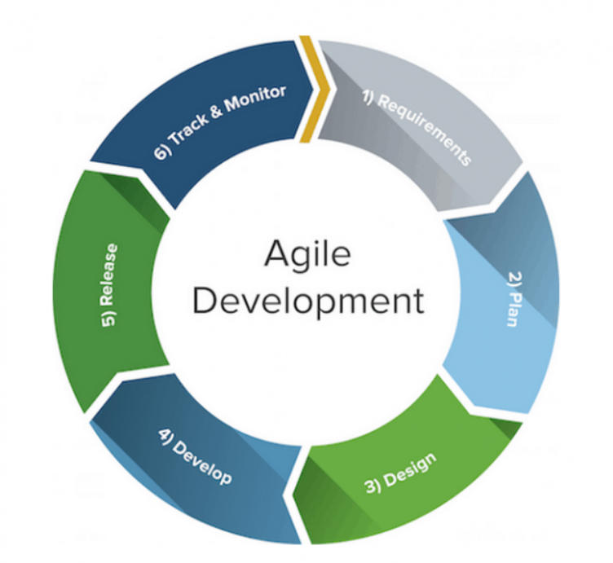
What is Agile?
Many smaller “cycles”
Slowly adding on features
In a car, this may mean designing a basic model then adding to it over time
Work more closely with the customer to build up the product

Slide 10
Baking cookies with Agile
Initial Requirements:
We want some cookies next week
Design (1)
Choose a type of cookie, and ask the customer (your parents or siblings) if this is the direction they want to go in.
Design (2)
Use the process that you wrote out earlier, and present it to the customer for feedback
Revise and repeat until the customer is satisfied
Notes:
Add no help note on the WS for design

Slide 11
Pros and Cons
Waterfall
Pros | Cons
More predictable process | Less room for creativity
More focus on documentation | Can be costly, even for small projects
Very well defined
Agile
Pros | Cons
Very flexible process | Outcome and timeline are unpredictable
Faster time to market | Documentation is usually very light
More room for learning | Re-work is inevitable
Notes:
Ask question here for what method they would use various projects

