Slide 1
How Teams Work
STEM and Industrial Engineering
Toyota Production Systems Lab
Project Management & Leadership

Slide 2
What is a team?
Teams are formed for various reasons:
Project teams are formed to finish a certain task
Friend groups are formed when people are around each other and have fun together

Slide 3
Friend Groups
When you’re in class, you and your friends usually do work and play together
You work together because you like working with them!

Slide 4
Why are groups important?
Different projects need people with different skills
Picking the right members helps make successful projects

Slide 5
Everyone is good at something
Think about 3 of your friends and what they’re good at!
They’re all probably good at different things.
One of them might be good at math and another one might be good at talking to people
That’s okay! It’s completely normal for people to be good at different things

Slide 6
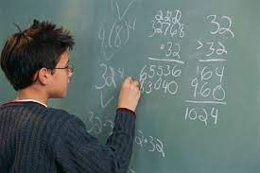
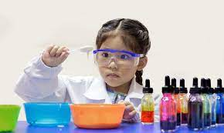
Putting it all together
Each team member does the thing they are good at
When everyone is good at different things, the whole team can get way more done!

Slide 7
Specialized groups
Sometimes it’s a good thing for all the team members to be good at the same thing.
When there are really hard problems to solve, a special group might come together and solve them together.
They give each other ideas when they talk all together!

Slide 8
Group Sizes
Different group sizes are better for certain tasks
Small groups might be used when there are only a couple different parts to a project
A larger group might be used when there are many parts with a lot of different sections

Slide 9
Picking Groups Activity
Let’s practice picking teams!
The worksheet named “Activity K-5 Picking Groups” has some exercises that you can practice with!

Slide 10
What Did We Learn?
Everyone is good at different things!
Different types of teams are used for different projects
There can be small and large teams
Some teams have people who are really good at the same thing. These are called specialized teams.

Slide 11
Thank you!

