Slide 1
Project Management
STEM and Industrial Engineering
Toyota Production Systems Lab
Project Management & Leadership

Slide 2
What is a project?
A project is a task that one person or many people work on
They are usually done to achieve a goal
Sometimes there is a time limit too
Example: Baking a cake for a party

Slide 3
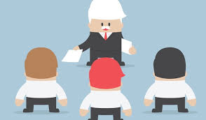
What is management?
Management is when one person (or a group) directs other people on what should be done
The person in charge of saying the tasks is called the project manager

Slide 4

The project manager
Project managers are usually good leaders
They are able to make decisions quickly
They are good under pressure

Slide 5
Have you seen project management before?
Have you ever cooked with your family?
Baking cookies or making dinner are fun examples!
Your mom or dad was probably telling you what to do and getting ingredients ready. That means they were the project manager for that!
So what was the project you were all working on?
Answer: Baking cookies!

Slide 6



Project Characteristics
There are ways to measure how successful a project was.
Some of them are:
How well the team worked together
How happy the customer is
If the project was done on time

Slide 7
Teamwork
An important part of completing a project is teamwork. If a team works well together, projects are more successful.
When a team works well together, the project can get done even faster than normal
It can turn out even better too!
A good leader can help make teamwork better

Slide 8

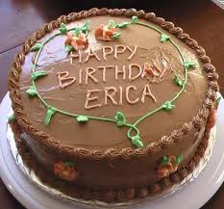
Customer Satisfaction
A project is usually done for a customer
The customer can be your teacher, your parents, or yourself!
A happy customer will get the thing they wanted when they wanted it. BUT it also has to be how they wanted it.
If you deliver a cake for a birthday and you deliver it on time, that’s good. BUT the customer will still be unhappy if the name on the cake is wrong!
Brianna
Wrong name!

Slide 9
Time
Time is also a good way to see if a project was successful
What if you don’t have your homework done on time?
Your teacher might get mad at you!
What happens if dinner is ready at 10pm instead of 6pm?
Everyone in the house will be so hungry!

Slide 10
Project Management Activity
What are some small projects you could do by yourself or with your family?
Come up with some projects on your own and click to see some examples!

Slide 11
Project Management Activity
Family activities:
Organizing the food cabinet, making meals, plan a vacation
Activities for yourself:
Cleaning your room, reorganizing your clothes
These are all projects that require multiple steps and some careful thinking to finish

Slide 12
What did we learn?
Projects can be done alone or in groups
The person who leads a group is a project manager
You can measure how successful a project is!

Slide 13

Thank you!

