Slide 1

Presentation Title
Author’s Name
Program Name
College Name
April 5, 2023

Slide 2

Slide Title is Arial Bold/36 Points
Title of Presentation
Body Text Font = Arial
Body Text Size = 24
Website links = orange, underlined, remove all www. Or http://
E.g. rit.edu/academicaffairs/graduateshowcase/

Slide 3
Text Hierarchy
Title of Presentation
Bullet text as much as possible
Main bullet point is at 24 points
Smaller square bullets for indented points
Sub-font for indented text is at 20 points
Indented text size – 18, maintain square bullets

Slide 4
Two-column Text Slide
Title of Presentation
Text Alignment for Two Columns
Bullet text as much as possible
Second Column of text
Follow previous slide formatting

Slide 5
Image and Text Slide
Title of Presentation
If you use an image, align the top of the image with the top of the heading text.
Provide enough white space between the bottom of the image and the URL
Align the right side of the image with the RIT and showcase logo’s right edge.
Maximum image height = 540 pixels.

Slide 6
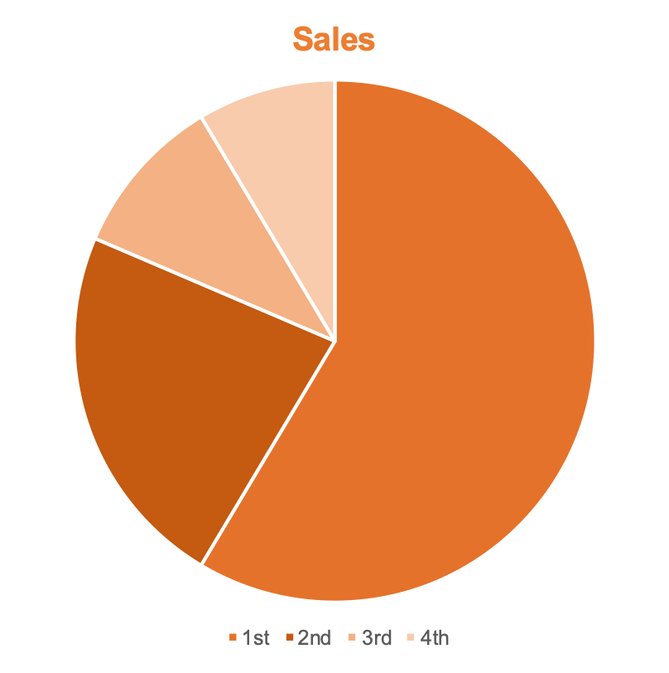
Chart and Text Slide
Title of Presentation
Smart Art or graphic display options within .ppt, all captions remain in Arial.
If you use chart, align the top of the chart with the top of the heading text.

Slide 7
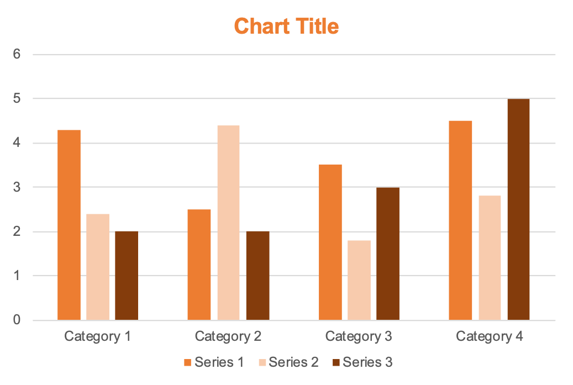
Chart Only Slide
Title of Presentation

Slide 8
Media (Video)
Title of Presentation

Slide 9
Thank you!
Questions?

