Slide 1
Establishing Guidelines for Access of STEM Resources Online
Wade Kellard
Center on Access Technology, RIT.
RIT Undergraduate Research Symposium
8/10/12
Notes:
Story of Relation
“First, let me introduce myself (Introduction) How is everyone today?”
*Response
“Has anyone here ever experienced problems distinguishing announcements waiting to board a waiting to board a plane or bus?” For example, terrible speakers, or loud conversations going on nearby.”
*Response
“This is a familiar experience to someone who is hard of hearing. Even with my hearing aids there are times where everything sounds like that to me. Lets go back to the airport or bus station. Have you ever sat next to someone who didn't speak English?. You want to start a conversation, to find out about the person. They might be really interesting, but you can't get past that language barrier. You are left out from the conversation. You are now the one with the disability.”
“This research symposium directly correlates with this concept of resolving problems of “accessibility” for people who have alternative needs. Most people who go to a Web site for use of scholarly resources have the privileged ability to understand everything that is available in the world wide web today. This presentation will discuss how we can create a more inclusive and connected World Wide Web, and how that applies to deaf and hard of hearing students in STEM Majors.”

Slide 2
Affiliations
Deaf STEM Community Alliance
National Science Foundation (NSF)(HRD-1127955)
Notes:
Affiliations
“I am working with the deaf stem community alliance which is funded by a grant from the national science foundation.”

Slide 3
Overview
Science, Technology, Engineering, and Mathematics (STEM)
Accessibility
3 Groups
Digital Libraries
Good vs. Bad
Curation
Recommendations
Virtual Academic Community (VAC)
Notes:
Overview
“My presentation will cover four topics. A discussion of stem, web accessibility, digital libraries, and my research for the Virtual Academic Community conducted over the course of the summer.”

Slide 4
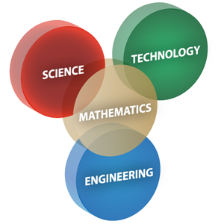
STEM
Description
Deaf STEM Community Alliance
Virtual Academic Community (VAC)
Notes:
Description
“As most of us probably know, STEM is short for Science, Technology, Engineering, and Mathematics. This is a very broad umbrella of all the sciences that are being taught across the World today. From Sociology to Astrophysics, STEM courses are critical to furthering ones knowledge.”
VAC
“The deaf stem alliance is building a virtual academic community to provide access to resources for deaf and hard of hearing students in stem. STEM courses often have a variety of intricate resources all of which have an abundance of information. Videos, Text, and Interactive Media need to be accessible for persons who require specific accommodations.”

Slide 5
Accessibility
“The power of the Web is in its universality. Access by everyone regardless of disability is an essential aspect.”
– Tim Berners-Lee, inventor of the World Wide Web
Groups
Deaf & Hard-of-Hearing
Blind & Low Vision
Mobility Impaired
Tools
Web site testing
Browser accessories
Notes:
Read Quote
Groups
“Online accessibility requirements can be broken down into 3 categories; Deaf & Hard of Hearing – Users who face problems with hearing, Blind & Low Vision – Users who face problems with sight, and Mobility Impaired – Users who face problems with bodily movements. Each of these groups require certain accommodations when accessing the Web. Understanding these 3 groups help us in building the VAC as a fully accessible resource. ”
Tools
“Tools are a big part of maintaining accessibility. Web site testing and browser accessories are will ensure that a resource runs smoothly and stays accessible.”

Slide 6
Accessibility
Deaf & Hard-of-Hearing
ASL users must be presented with information that is easily understood.
Users must be presented with content that is very visual.
High Frames Per Second Rates (FPS) are required when communicating via teleconferencing.
Mild: 26-45 db.
Moderate: At 46-65 db.
Severe: At 66-85 db.
Profound: Anything over 85 db.
Notes:
Description
“Deaf & Hard of hearing users require information that is easily understood, content that is very visual, and also high quality video when using asl online. A person with mild hearing loss can use assistive listening devices, wheras someone with profound hearing loss is considered to be completely deaf.”
Mild: At 26-45 db, a little difficulty hearing speech.
Moderate: At 46-65 db, more difficulty hearing speech.
Severe: At 66-85 db, a lot of difficulty hearing speech. It is at this level that we begin to use the term "deaf.”
Profound: Anything over 85 db. With this level of hearing loss, hearing aids may or may not help; cochlear implants are often an option.

Slide 7
Accessibility
Blind & Low Vision
Users require computer programs and accessories
Users face unique challenges in approaching visual media
Partially sighted: Mild vision problems.
Low vision: Severe visual impairment.
Legally Blind: Very limited field of vision.
Totally Blind: No vision
Notes:
Description
“Blind & Low vision users are faced with difficult challenges when approaching visual media. Computer programs such as screen readers that describe text, context, and tabs are very helpful in facing these problems. Partially sighted Indicates some type of visual problem has resulted in a need for accessibility options. Totally blind users must must access information via braille keyboards or other non-visual media such as audio transcriptions.”
Partially sighted: Indicates some type of visual problem has resulted in a need for accessibility options.
Low vision: Generally refers to a severe visual impairment, must use a combination of vision and other senses to access information, although they may require adaptations in lighting or size of print, and, sometimes, braille.
Legally Blind: Indicates that a person has less than 20/200 vision or a very limited field of vision.
Totally Blind: Students must access information via braille or other non-visual media (audio transcriptions).

Slide 8
Accessibility
Mobility Impaired
Users typically have limited or no ability to use a mouse.
The users must be able to access all parts of a web page using something other than the mouse, such as the keyboard.
Level 1: Slightly impaired mobility.
Level 2: Intermediate impaired mobility.
Level 3: Severe impaired mobility.
Notes:
Description
“Mobility impaired users are limited in movement. Users must use computers in the simplest possible way to perform tasks that would be difficult with traditional technology. Level 1 users have slightly impaired mobility, such as with trembling hand. Level 3 users have severe impaired mobility, such as users with locked-in syndrome who are prisoners in their own bodies.”
Categories
Level 1: users with slightly impaired mobility, such as users with trembling hand.
Level 2: users with intermediate impaired mobility.
Level 3: users with severe impaired mobility, such as users with locked-in syndrome who are prisoners in their own bodies.

Slide 9
Tools
Web Site Testing
Accessibility Rating
Browser Accessories
Deaf & Hard-of-Hearing
Subtitles, Captions, Improve Readability
Blind & Low Vision
Screen Readers, Change Font Size, Keyboard Shortcuts
Mobility Impaired
Tabbing, Voice Recognition Software
Notes:
Web Site Testing
“ In order to determine if a resource is suitable for the VAC, we need to determine its accessibility rating. There are a variety of Web sites that will rate a link by running it through a series of tests, determining its accessibility rating which ranges from poor to excellent.”
Browser Accessories
“Here are some example of tools that can be used for each the three groups”

Slide 10
Digital Libraries
Good Design vs. Bad Design
Curation
Notes:
“Almost any Web site that we go on to today contains or connects to some form of a digital library. Some are good and contain accessible information, and some are not. Proper curation is required to compile accessible resources to have a successful digital library.”

Slide 11
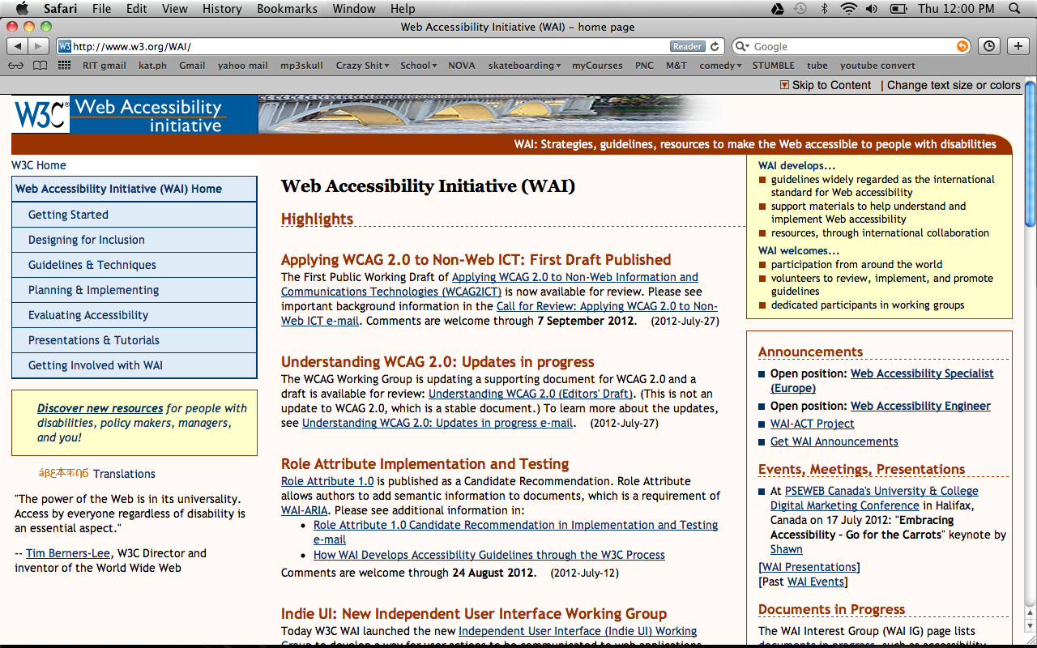
Good Design (Accessible)
Notes:
“This is an example of a good website that is accessible for users with vision problems as well as mobility impairment. Upon entering the website the first thing that is noticeable is the change font and skip to content options. Features such as these are essential to maintaining a fully accessible website.”

Slide 12
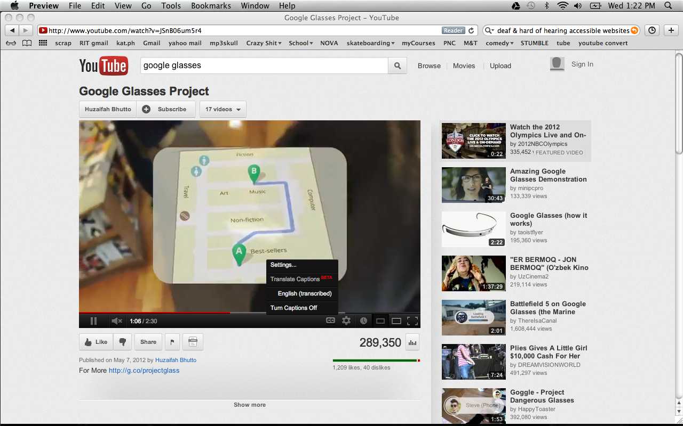
Good Design (Accessible)
Notes:
“Here is another good example of a website that is accessible. Youtube offers closed captions for videos, and also transcribing audio. Features such as these are a big requirement for someone like myself who have hearing problems.”

Slide 13
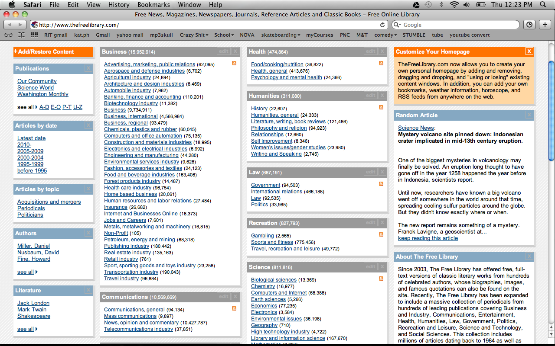
Bad Design (Not Accessible)
Notes:
“This is an example of a bad design that is not very accessible. Upon entering the website you are faced with an information overload. This is problematic for anyone entering the website, even more so for persons who require specific accommodations.”

Slide 14
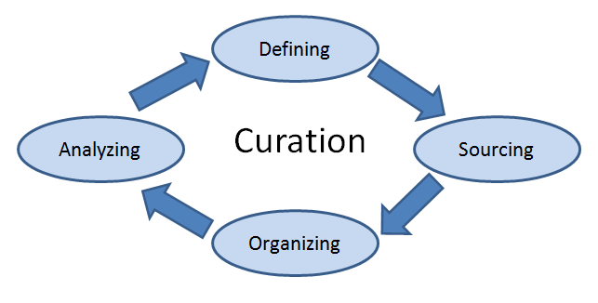
Curation
“A curator is an information chemist. He or she mixes atoms together in a way to build an info-molecule. Then adds Value to that molecule.” – Robert Scoble
Notes:
“Digital curation is the selection, preservation, maintenance, collection and archiving of digital assets. The World Wide Web today is a huge cluster of information. How much of this information is really reliable? It is necessary to curate information with a system so we can successfully compile resources.”

Slide 15
Design Recommendations
Full Accessibility: Satisfy needs of all 3 groups
Curate a design that utilizes common accessibility tools
Use open source Web development platform
Notes:
“ After researching digital libraries I have surmised the following recommendations. Full accessibilty in the design is extrememly important. Without an all inclusive design, users will not be able to efficiently use the resources available. To accomplish this, we must curate the information and devise a system for each of the resources that we put into the VAC. Another recommendation that I have, is to be able to use open source software in our web development. This means that our website will be a social atmosphere where people can communicate and interact with one another.”

Slide 16
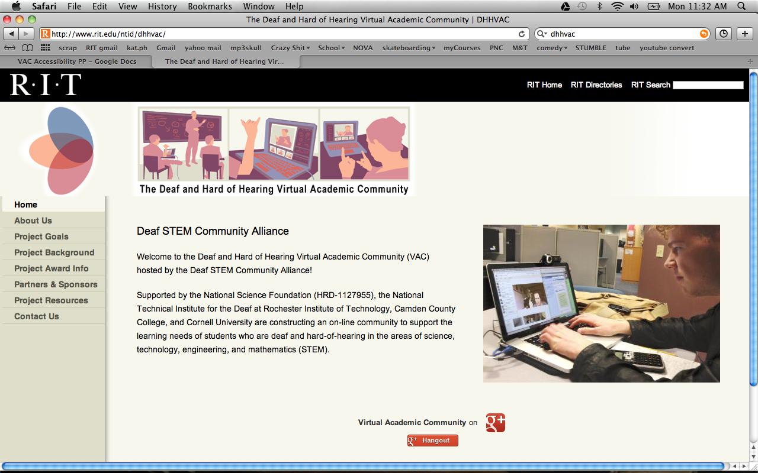
Virtual Academic Community
Notes:
“ Understanding the 3 groups of accessibility and how to properly structure a digital library is key to the development of the Virtual Academic Community.”

Slide 17
Conclusion
Requirements
Accessibility
Appealing
Curation
Efficient organization of information
Applications to the VAC
www.dhhvac.org
Notes:
Requirements
“ The VAC must meet all accessibility requirements, and must be appealing as well.”
Curation
“ All of our resources must sufficiently organize information and resources. It must also run smoothly and be easy to use.”
Applications to the VAC
“ The VAC is a project that is ongoing. All of the information that I have researched and validated this summer will be applied to ongoing
Process of this Web site.”

Slide 18
Additional Information
Researcher:
Kellard, Wade. wak8572@rit.edu. Center on Access Technology, RIT.
Mentor/Supervisors:
Elliot, Lisa. lbenrd@ntid.rit.edu. Center on Access Technology, RIT.
Rubin, Ben. bwrubin@gmail.com. Center on Access Technology, RIT.
VAC WEB
http://www.rit.edu/ntid/dhhvac/

Slide 19
Q & A

Slide 20
Abstract
This presentation will describe the development of guidelines for an online academic community which is designed specifically to accommodate persons with diverse communication and access needs. The online community is a project of the Deaf Science, Technology, Engineering, and Mathematics (STEM) Community Alliance, that is funded by the National Science Foundation (NSF).
Persons with diverse access and communication needs include individuals who are Deaf & Hard-of-Hearing, Blind & Low Vision, and Mobility Impaired. Team members are developing an online community that compiles information and resources for topics involved in STEM. The goal is to make learning and communication easy for people who face challenges accessing STEM resources and learning online. Many of the Web sites and resources available today don’t provide the necessary tools for learning. Ultimately, we are designing a website that incorporates all of the necessary tools and resources to meet our accessibility requirements.
The process of discovering and compiling this information is ongoing. This presentation will describe Internet access needs for diverse groups of users, examples of accessible websites, and examples of accessible STEM resources. Documentation of required guidelines is being created for future team members to follow in the next 4 - 5 years. The outcome of this research project will create an online community that can benefit anyone with diverse access and communication requirements.

