Slide 1
Videoconference Communication Support
Bill Clymer
Christine Monikowski
Benjamin Rubin
February 27, 2013
A presentation at the CSUN 28th Annual International Technology & Persons with Disabilities Conference, San Diego CA

Slide 2
Goals
Description of RIT and NTID
Use of Web-based Video for Instruction and Support
NSF Funded Research
Series of interrelated grants
Cisco Funded Research
Initial Findings
Ongoing Research & Reporting
Discussion

Slide 3
Rochester Institute of Technology http://www.rit.edu/overview/at-a-glance
Nine Colleges
17, 652 Students
3,756 Faculty Staff
Technology Programs
Diverse Community

Slide 4
NTID Background http://www.ntid.rit.edu/about
Founded in 1965 by Congress
1,281 Students
200 Faculty, 300 Staff
Communication Support

Slide 5
NTID Instruction
Direct Instruction
Approximately 500 students
Faculty sign and teach
Small classes
Supported Instruction
Approximately 600 students “cross registered”
“Mainstreamed” classes with other RIT Colleges
Interpreters, Captioning, Notetaking, Tutoring

Slide 6
NSF Cyber Community Grants
Cyber Community
IIS-0915268
Summit
OCI-0749253
Enrichment
HRD-0927586
Alliance
HRD-1127955

Slide 7
DHH Cyber Community http://dhhcybercommunity.cs.washington.edu/
ClassInFocus
ASL-STEM Forum

Slide 8
DHH Cyber Community http://dhhcybercommunity.cs.washington.edu/
ClassInFocus
ASL-STEM Forum
Lead to an investigation in systems and technology to support remote services.
Online video forum
http://aslstem.cs.washington.edu/

Slide 9
DHH Cyber Community http://dhhcybercommunity.cs.washington.edu/

Slide 10
Summit http://www.rit.edu/ntid/cat/summit
“Summit to Create a Cyber-Community to Advance Deaf and Hard-of-Hearing Individuals in STEM (DHH Cyber-Community)”
The goal of the Summit was to conduct a conference with 50 leaders in the field of support service provision for postsecondary deaf students in STEM programs
The primary outcome was to report on the current state of online remote interpreting and captioning, and to identify the benefits and challenges associated with creating a multimedia application and network

Slide 11
Enrichment http://www.rit.edu/ntid/cat/enrichment
“Enrichment : Testing the Concept of a Virtual Alliance for Deaf and Hard of Hearing STEM Students at the Postsecondary Level”
The goal was investigate the creation of a virtual support network for deaf/hard-of-hearing college students around the country enrolled in science, technology, engineering, and mathematics (STEM) programs
The primary outcome was a successful NSF Alliance Proposal!

Slide 12
Alliance dhhvac.org
Model for Provision of Remote Tutoring and Mentoring
NTID/RIT, Camden County College, and Cornell University are constructing an on-line community to support the learning needs of students who are deaf and hard-of-hearing in the areas of science, technology, engineering, and mathematics (STEM).

Slide 13
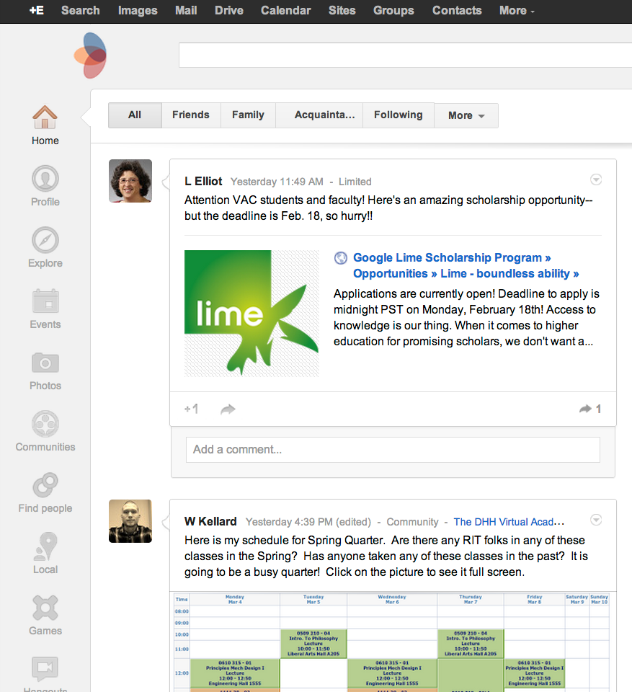

Slide 14
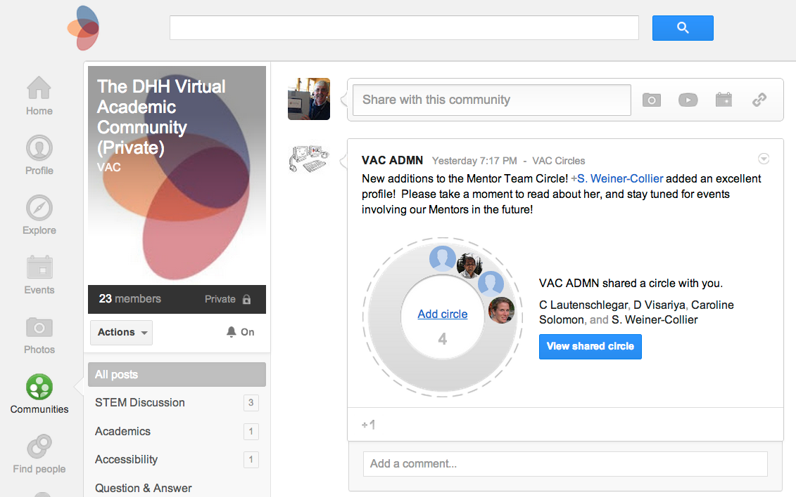

Slide 15
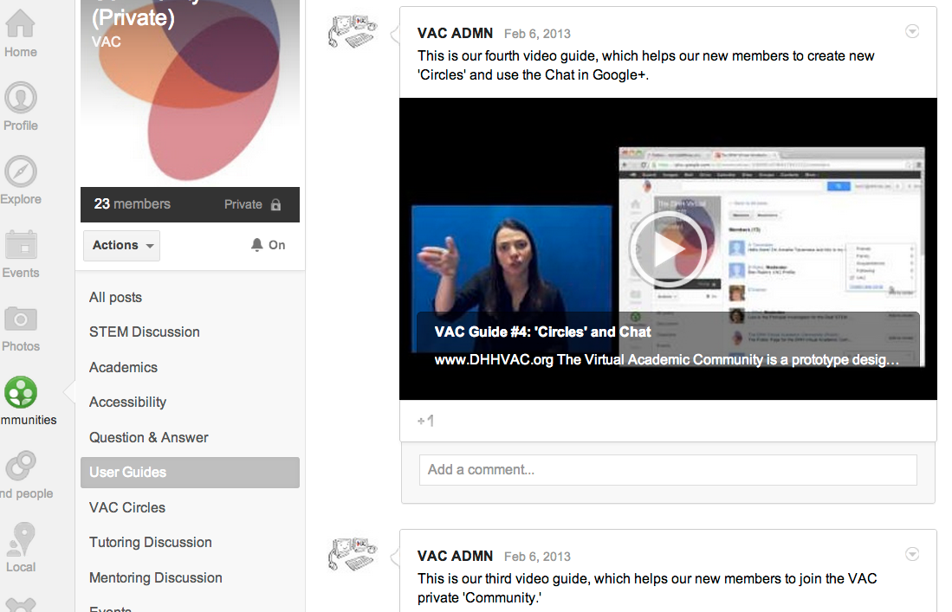

Slide 16
Video Guides http://www.youtube.com/channel/UC3jz2bVv7WkWJAxCOsOV30Q/videos

Slide 17
RemoteTutoring

Slide 18
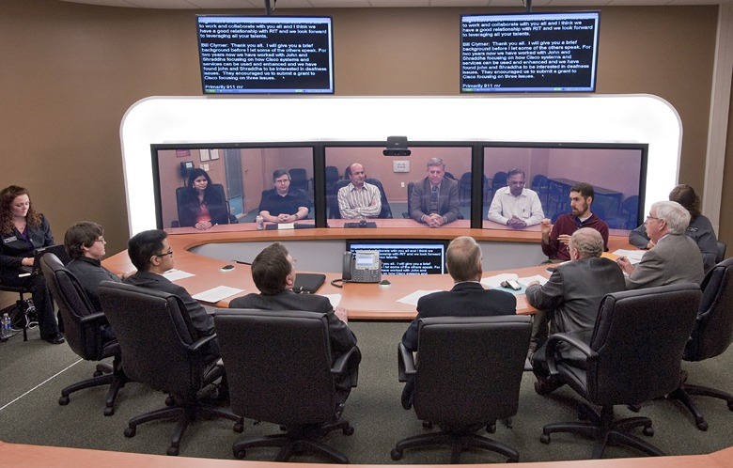
Cisco Research
Three Strands
Equipment Donation
TelePresence

Slide 19
Variables Within Interpreted TelePresence Scenarios
Determine “best practices” when working with TP and interpreters
Face-to-face within the TP system
Remote with the TP system

Slide 20
9 Scenarios/4 Days/Summer 2012
Variables:
Number of Deaf/Hearing participants
Level of interaction among all participants
Level of technology within the TP system
Different kinds of TP systems
Location of interpreters
When IN the environment and when REMOTE

Slide 21
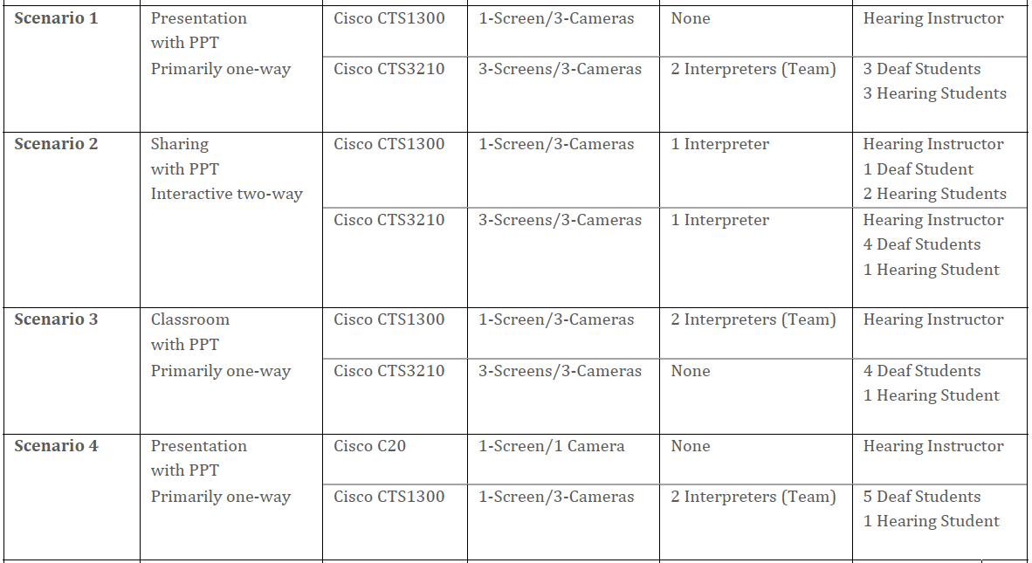

Slide 23
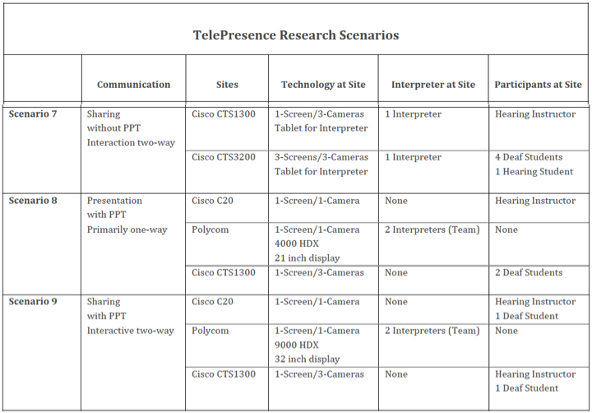

Slide 24
Our Goals for Participants
Interpreters:
To have the same interpreters across scenarios
Nationally certified
Flexible
Deaf participants:
To have the same “students” across scenarios
Experience with interpreters
Willing to give feedback
Hearing participants:
To have the same “presenters” across scenarios
Some knowledge/experience working with interpreters

Slide 25
What We Did
Assigned everyone a “role”
Ran the scenario, with 2 working interpreters and a third one observing/advising
Distributed written feedback forms to all
Conducted approx. 15 minute de-briefings with all participants
Two interpreters now participated and third did the interpreting
Made minor adjustments from feedback, took a short break, moved on to next scenario

Slide 26
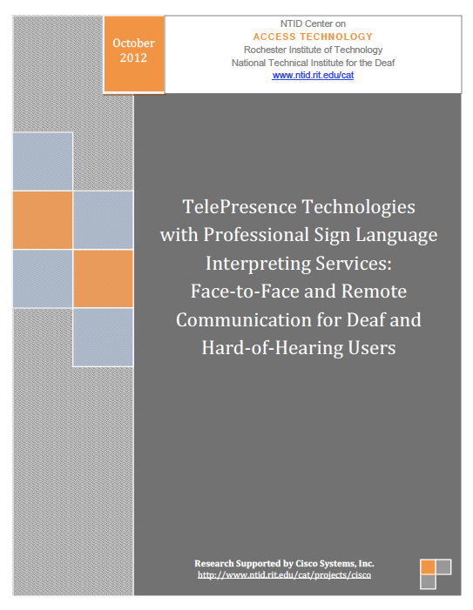
Report
http://www.rit.edu/ntid/cat/sites/default/files/NTID-TelePresence_Oct2012_Final.pdf

Slide 27
Report of Each Scenario

Slide 28
Report on Each Scenario

Slide 29
Results - Primary Themes
Cameras are voice-activated
Problems for Deaf participants
Problems for interpreters
Actual positioning of interpreters
In the room, near the screen
In the other room, near the presenter
Interpreters cannot communicate with Deaf participants
Remote
Problems with lack of eye contact, re-adjusting tiles on the screen
Quality – wow!!
Future – lots of possibilities!!

Slide 30
Discussion
Questions
Comments
Resources

