Slide 1
Panel discussion: Classroom disruptions and effective management tips
Moderator: Stacey Davis
Friday, December 9, 2016
9:00 – 11:00 a.m.
CSD 1310

Slide 2
Agenda:
Panel Introductions
Ground Rules
Disruptions
Panel Comments
Questions

Slide 3
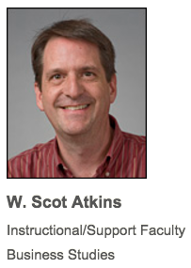
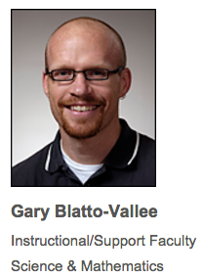
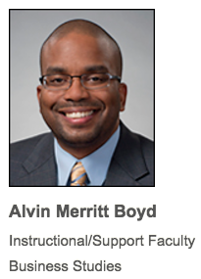
Meet the panel – Slide 1
2014 Pre-tenure Teaching/Tutoring Award Winner

Slide 4
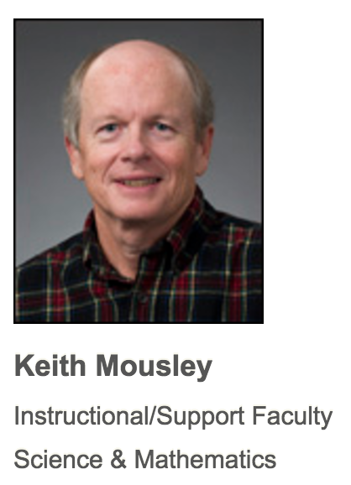
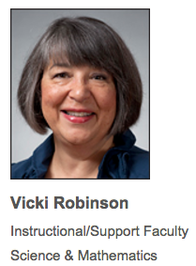
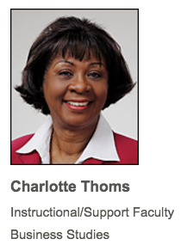
Meet the panel – Slide 2
2016 Tenured Teaching/Tutoring Award Winner

Slide 5
There will be time at the end for questions from the audience. Please ask questions between disruptions. Video segments will be posted on the PD website. (ntid.rit.edu/pd/workshops)

Slide 6
Disruptions
Environmental
Electronic Devices
Student Centered
Internal
External
Consecutive Event Situation

Slide 7
Environmental
Temperature
Construction Noise
Other

Slide 8
Electronic Devices
Cell Phones
In-class Computers
Headphones

Slide 9
Student Centered
Internal
Sleepiness
Hunger
Worry
Other Emotions
External
Chatting
Seeing other students’ internal struggles
Not prepared
Arriving late

Slide 10
Consecutive Event Situation
Student
Falls asleep
Falls asleep
Cell phone
Reads book
Refuses
Faculty
Wakes up
Wakes up again
Enforces ban
Asks to leave
?????

Slide 11
Questions from the audience

