Slide 1
Starfish Academic Alert:
NTID Power Workshop

Slide 2
Agenda
Background Info
Academic Alert Process and Expectations
Comments
Additional Training and Support

Slide 3
Background Info
Structure of Advising at RIT
Connections in Starfish
Network of Support
Instructors
NTID Counselors/Academic Advisors
Support advisor(s)
Faculty advisor
Receive updates on their students
Major Contact
Department Contact
College Contact
Slide 3

Slide 4
Academic Alert Process
Student talks to instructor
Instructor sends alert to student
(via “Academic Progress Survey” or “Raise Flag”)
Communication continues between instructor, advisor and student
Student talks to advisor
Instructor/ Advisor adds comments to flag
Student does not respond
Slide 4

Slide 5
Progress Survey Video
How to Complete a Progress Survey

Slide 6
Expectations
Raise flags for any students who are at-risk in your course
Raise flags via academic progress surveys during both campaigns
Submit surveys even if you have no concerns during the campaign
Raise flags outside of the survey if a student’s status has changed or there is a new concern
When raising flags, always add comments addressed directly to the student

Slide 7
Comment Parameters
Comments:
Write them directly to the STUDENT!
Clear, factual, and supportive
Information included should be specific to the alert and academic progress
Any related information should be very general in nature
Avoid evaluative language
Disclosable under FERPA
Students may request to view all records within Starfish

Slide 8
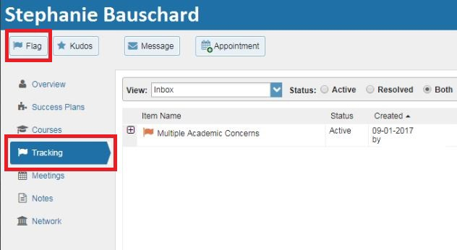
Alerts Between Surveys
Find student(s) you want to alert
Click the “Flag” button

Slide 9
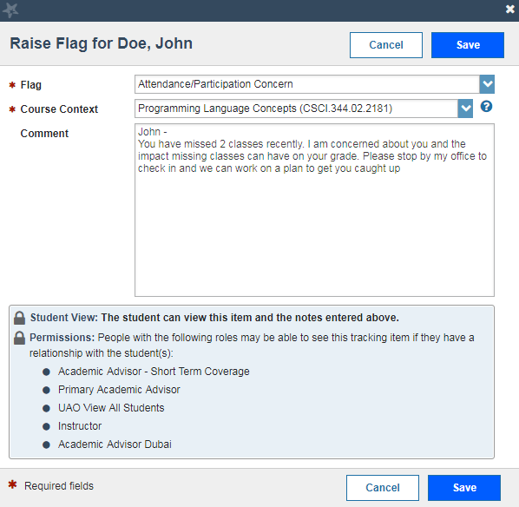
Alerts Between Surveys
Choose appropriate flag
Select the course
Add a personalized comment
Click “Save”

Slide 10
Tips & Tricks
Conversation starter
Address comments to the student directly
Submit surveys, even if you have no feedback at the time
Alerts and Kudos can be sent throughout the semester
Keep standard comments in a Word doc for copy & pasting

Slide 11
Academic Alert: Training, Resources, and Support
Training:
User Guide: Questions:
Wednesday 10/17/18 @10-11am CIMS 2160 By Appointment
www.rit.edu/starfish
starfish@rit.edu

