Slide 1
NCCL: Sign Language Lab
NTID Center on Cognition & Language
ASL ASSESSMENT PROJECT
FUNDED BY THE NTID OFFICE OF THE PRESIDENT 2016 – 2019
PETER HAUSER PHD – DIRECTOR OF CENTER ON COGNITION AND LANGUAGE
KIM KURZ PHD – DIRECTOR OF SIGN LANGUAGE LABORATORY
CORRINE OCCHINO PHD – RESEARCH ASSISTANT PROFESSOR
SUSAN RIZZO - RESEARCH PROGRAM COORDINATOR

Slide 2
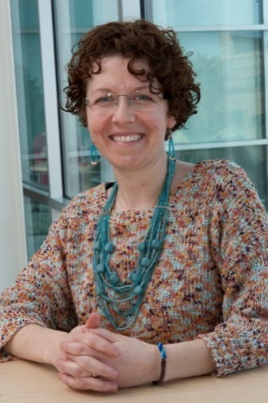
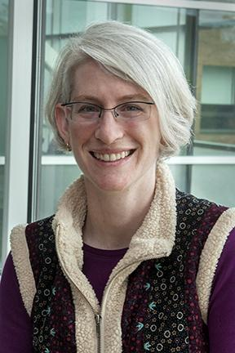
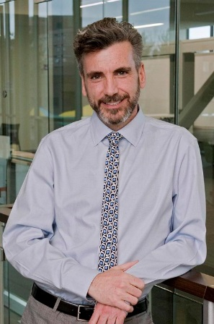
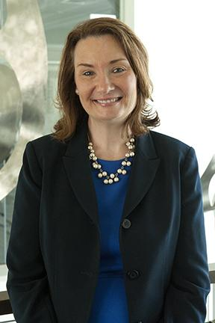
NCCL Sign Language Assessment Team
Research
Assistant Professor
Corrine Occhino PhD
Research Program Coordinator
Susan Rizzo MA;MS
Director
Center on Cognition and Language
Peter Hauser PhD
Director
Sign Language Laboratory
Kim Kurz PhD
NCCL
Sign Language Lab

Slide 3
CURRENT POLICY:
NTID FACULTY SIGN LANGUAGE SKILLS ASSESSED USING ONE MEASURE
NCCL
Sign Language Lab

Slide 4
CURRENT GOALS:
DEVELOP NEW ASL PROFICIENCY TESTS FOR ASSESSING SIGN LANGUAGE SKILLS AT NTID
CREATE A BATTERY OF ASSESSMENTS TO TRACK DEVELOPMENT & MONITOR SKILL IMPROVEMENT
NCCL
Sign Language Lab

Slide 5
Currently Available Assessment Options
Classroom Sign Language Assessment (CSLA)
Group Communication Observation Tool (GCOT)
NCCL
Sign Language Lab
Notes:
In the classroom in group options for communication in a more realistic setting.

Slide 6
New ASL-L2 Assessments at NTID
ASL Comprehension Test (ASL-CT) (Hauser et al. 2016)
ASL Discrimination Test (ASL-DT) (Bochner et al. 2015)
NCCL
Sign Language Lab
Notes:
New tools developed specifically for L2 sign assessment

Slide 7
Current Project: Assessment Development
ASL Online Vocabulary Exam (ASL-OVE)
ASL Fingerspelling & Numeral Comprehension (ASL-FAN)
ASL Verb Expression Test (ASL-VET)
ASL Sentence Repetition Test for Second Language Signers (ASL-SRT-L2)
NCCL
Sign Language Lab
Notes:
New tools developed specifically for L2 sign assessment

Slide 8
ASL-OVE (Online Vocabulary Exam)
NCCL
Sign Language Lab
Notes:
First Test, Comprehension test, with 2 subparts picture matching and sign matching – this test identifies ability to use phonological cues to match semantic associations

Slide 9
ASL-OVE (Online Vocabulary Exam)
NCCL
Sign Language Lab
Notes:
First Test, Comprehension test, with 2 subparts picture matching and sign matching – this test identifies ability to use phonological cues to match semantic associations

Slide 10
ASL: Fingerspelling & Numeral Comprehension Test
1967
1993
1976
1896
NCCL
Sign Language Lab
Notes:
3rd test developing is the FAN-CT fingerspelling and numeral comprehension test – we added this test because fingerspelling and numbers and very important in the STEM fields – in classroom where students and teachers are communicating about science, engineering technology change fast, new words show up everyday – teachers rely on fingerspelling a lot to transfer information from highly technical fields to students – Fingerspelling is often the weak skill

Slide 11
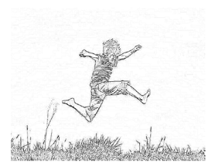
ASL-VET (Verb Expression Test )
NCCL
Sign Language Lab
Notes:
Test number two is a Production test. Similar to test one, we are looking at ability to understand semantics and phonology – in this task the test taker will see an action and product the sign which names the action. Responses are Recorded by video and scored using a computer vision algorithm together with a rater. BUT we are partner with the college of engineering, Dr. SAHIN to add an automatic computer recognition Software to score responses. Automatically without rater.

Slide 12
ASL- SRT-L2 (Sentence Repetition)
Watch the signed sentence. When the sentence is finished, sign the sentence back exactly as you saw it signed to you.
NCCL
Sign Language Lab

Slide 13
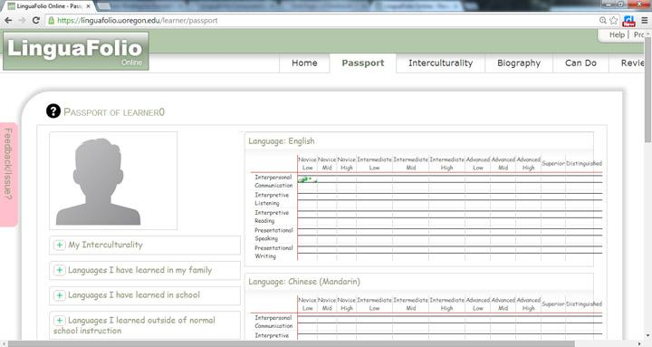
Creating a Language Dossier
NCCL
Sign Language Lab
Notes:
Utilize a 3rd party system to manage data for faculty and staff
Keep track of ongoing progress
set objectives/roadmap for language proficiency
Document & reflect on language learning both inside and outside the classroom setting.

Slide 14
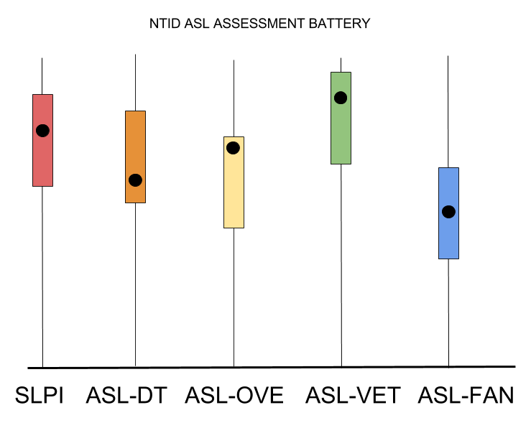
Tracking Your Skills
NCCL
Sign Language Lab
Notes:
Utilize a 3rd party system to manage data for faculty and staff
Keep track of ongoing progress
set objectives/roadmap for language proficiency
Document & reflect on language learning both inside and outside the classroom setting.

Slide 15
Questions?
THANK YOU!
For more information, contact the NCCL ASL Assessment Team:
Corrine Occhino
cokccl@rit.edu
-or-
Susan Rizzo
sprncp@rit.edu

