Slide 1
Classroom Management: Dos and Don’ts for Faculty
Dr. Heath Boice-Pardee
Associate vice president for student affairs
Distinguished lecturer, college of applied science and technology

Slide 2
Overview
Defining Disruptive Behavior
Managing Disruptive Behavior
Understanding your Personal Barometer
Identifying and Addressing Specific Disruptive Behaviors
Managing Dangerous Students
Dos and Don’ts

Slide 3
Defining Disruptive Behavior
A behavior that distracts from teaching and learning.

Slide 4
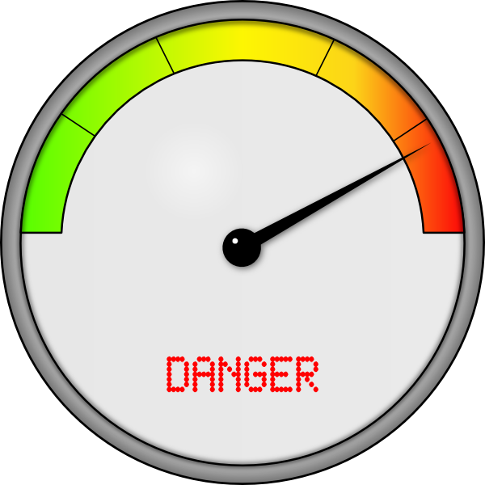
Defining Disruptive Behavior
What is your “Disruptive Barometer?”

Slide 5
Defining Disruptive Behavior
What is your “Disruptive Barometer?”
Classroom chit-chat.

Slide 6
Defining Disruptive Behavior
What is your “Disruptive Barometer?”
Late students.

Slide 7
Defining Disruptive Behavior
What is your “Disruptive Barometer?”
Students who are sleeping.

Slide 8
Defining Disruptive Behavior
What is your “Disruptive Barometer?”
Students who text.

Slide 9
Defining Disruptive Behavior
What is your “Disruptive Barometer?”
Students who are rude.

Slide 10
Defining Disruptive Behavior
What is your “Disruptive Barometer?”
Something else?

Slide 11
Managing Disruptive Behavior
So what can/should you do?

Slide 12
Managing Disruptive Behavior
Establish expectations during the first class.
No Texting Zone
Laptops Closed
Late = absence
Respect each other
Differing opinions are good…but….

Slide 13
Managing Disruptive Behavior: Specifics
Managing chit-chatters...
If you can, stand near them.
Make sure they see you.
Stop teaching.
Try to give them a signal before calling them out.
Ask them to stop.

Slide 14
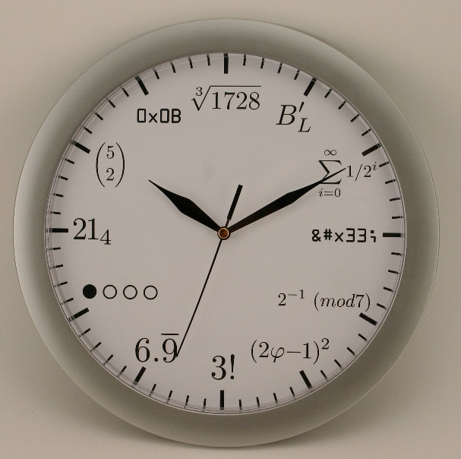
Managing Disruptive Behavior: Specifics
Managing Late Students...
Privately, after class, remind them of your expectations;
As them if there is a logistical reason for being late.
You may give them a pass the first time, but after, count an absence.

Slide 15
Managing Disruptive Behavior: Specifics
Managing Sleeping Students...
Move near them, if possible.
Ask the class to wake up sleeping neighbors.
Go up to them and touch them on the shoulder…
Discuss with them after class and remind them of your expectations.
Ask if there is a reason for them being so tired.

Slide 16
Managing Disruptive Behavior: Specifics
Managing Texting Students...
Move near them, if possible.
Get their attention and tell them to stop.
Discuss with them after class and remind them of your expectations.
If they say it was an emergency, ask if you can help (remind them that true emergencies are rare).

Slide 17
Managing Disruptive Behavior: Specifics
Managing Rude Students...
Remember your barometer… rude is subjective (some think over-participation is rude!)
Address the student, but then move on- don’t let them take over your class.
Ignore if possible.
Tell them that you will discuss with them after class.
Remind them of your expectations.
Ask them if there is something bothering them and offer support.
Telling the student to leave should be a last resort.

Slide 18
Managing Disruptive Behavior: Specifics
Managing Dangerous Students...
Remember your barometer… dangerous can be subjective.
Is it an outburst that you can manage, or something more?
Threats.
Physical aggression.
Other students backing away.
Student storming out.
Keep your safety in mind!

Slide 19
Managing Disruptive Behavior: Specifics
Remember:
You are responsible for facilitating a positive learning environment.
Remain calm.
Never show signs of anger.
Never engage in active physical contact.
Contact Public Safety ONLY in dangerous situations.
Discuss all unusual classroom situations with your supervisor.

Slide 20
Classroom Management: Dos and Don’ts for Faculty
Dr. Heath Boice-Pardee
Associate vice president for student affairs
Distinguished lecturer, college of applied science and technology

