Slide 1
InfoGuides
Joan Naturale, Librarian/Liaison for NTID
JXNWML@rit.edu
2 February 2017

Slide 2
Web 2.0 Landscape
Information
2.0
Library
2.0
User
2.0
Mobile Technology
Instant Feedback
Social Networking
Digital
Collaborative
Open
Platform-neutral
Participatory
User-oriented
Creative
Integrated
Mobile
Embedded
Scalable
Notes:
Students are 2.0 consumers and expect 2.0 technology services

Slide 3
What are InfoGuides?
Renamed LibGuides to InfoGuides
Use the latest Web 2.0 technologies
Create and customize user-friendly, subject specific and general research guides (CMS)
Offer a one-stop-shop of information to assist with the teaching, learning and research processes

Slide 4
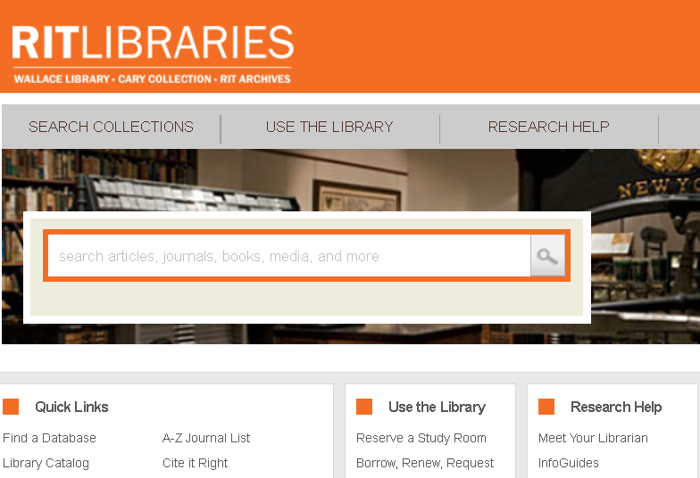
Where are InfoGuides?
Notes:
Go to the library home page http://library.rit.edu and click on either Meet Your Librarian or InfoGuides.

Slide 5
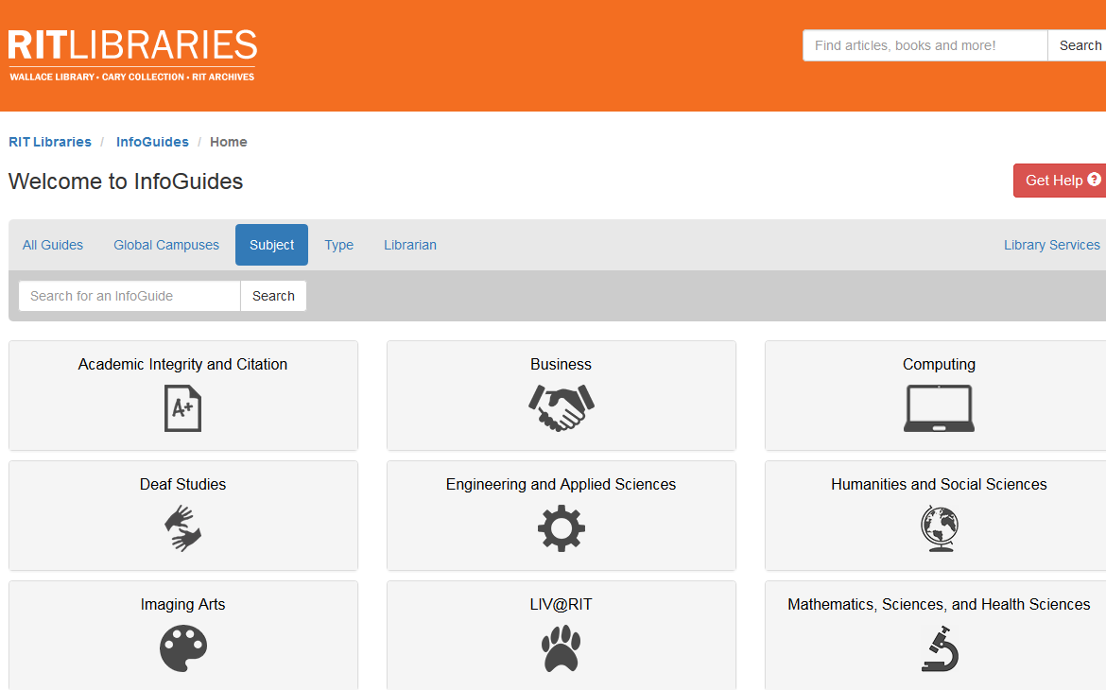
Notes:
Find different colleges and guides.

Slide 6
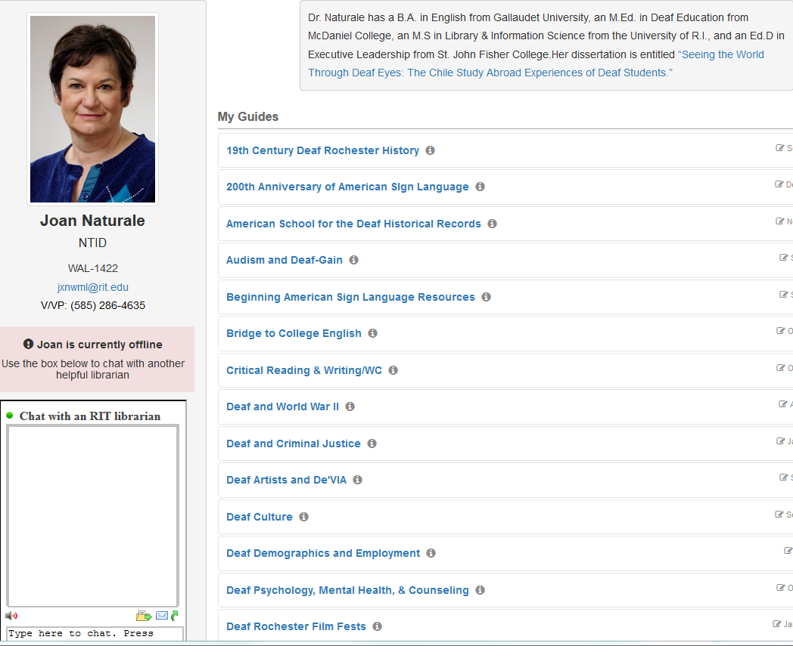
This is what the
InfoGuide page
looks like from
the “Meet Your
Librarian” page.
There are 9 class and 24 subject
InfoGuides shown today (a few guides are ‘hidden’ because the class is not taught this semester).
Notes:
We get statistics reports. 15,295 views for 41 guides this past year (2016). Most popular guides are: Noodlebib (1554), Critical Reading & Writing (1228), Interpreter Resources (1222), Diversity in the Deaf Community (850), Deaf Technologies (833), Audism & Deaf-Gain (789), MSSE (715), Deaf Artists (597), Zotero (581), and RIT/NTID Deaf Studies Archive (570).

Slide 7
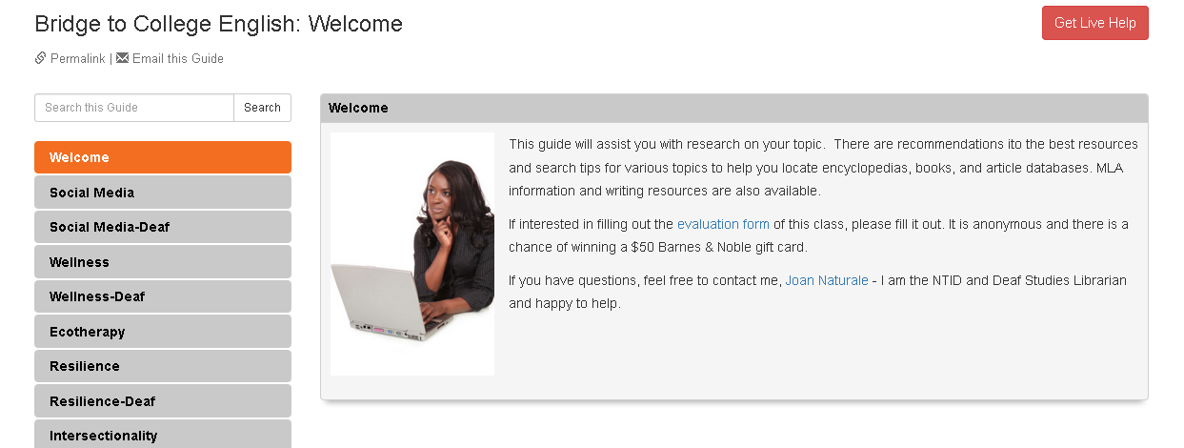
InfoGuide Example

Slide 8
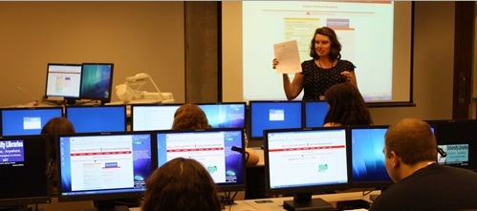
One Shot Library Instruction
For research sources, students want an online one-stop shop at time of need. Wahl, Avery, & Henry (2013). Studying distance students: Methods, findings, action. Journal of Library & Information Services in Distance Learning.
Notes:
One shot library instruction – students don’t retain the information and they like a one-stop-shop for online library resources and services (Wahl, Avery, and Henry, 2013).
When the midterm or final paper is due, they have an online guide for academic help.

Slide 9
Students’ View of InfoGuides
Want their library information:
to be subject related
all in one place
delivered to them
Can access support and communicate:
at point of need 24/7
wherever they are studying
Can use handheld devices
Understand better how to search tools more effectively
Make resources more visible with interactive guide
Notes:
learn how to use Boolean operators and keywords for topics rather than writing a sentence when looking for material—more specific for assignments …. Instruction on demand meeting students at their location

Slide 10
Instructors’ View of InfoGuides
“LibGuides provide a gateway for library research which reduces student apprehension” (Miner, 2010).
Like the online ‘subject librarian presence’
Like the focus on specific topics and tools
Add value to classroom teaching sessions
Support progression of information literacy skills
Links to subject resources and contextualized support
Collaborative opportunity to work with the librarian
Improved research competencies and written analysis
Note better quality research papers and citations
User friendly and easy to navigate
Notes:
Miner, J. & Alexander, R. (2010). LibGuides in Political Science: A Gateway to Information Literacy and Improved Student Research. Journal of Information Literacy, 4(1), 40.

Slide 11
Librarians’ View of InfoGuides
Easier to collaborate with faculty-reinforce library instruction
Clearer instructions for using library search tools
Enhance student learning
More contact with students re: research questions and citations
More use of our library resources
Students better understanding of peer-reviewed sources
Students better search skills
Can embed videos, pictures, media and widgets
Integrates with MyCourses
Librarian profile and contacts visible

Slide 12
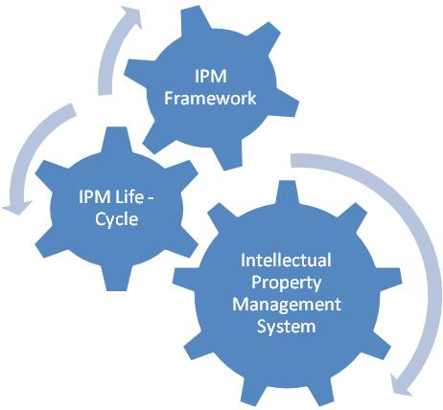
Conclusion
InfoGuides allow Librarians to connect and communicate better with:
Students
Researchers & Academics
Colleges/Faculties
Departments
Research Savvy Community!
Improve research experience
Improve research skills
Librarian
Students
Researchers &
Academics
Colleges/Faculties
Departments

Slide 13
I want an InfoGuide!!
Name of your course
Topics
Syllabus
Student population characteristics
Search tools you want students to use
At least 2 weeks’ notice
Best to combine with librarian visit to class
Notes:
Always best to invite the librarian to show the students the InfoGuide and to connect with the librarian so they can contact her when they need assistance. Face to face contact helps with relieving anxiety about meeting a librarian.

Slide 14
Questions / Comments?
InfoGuide Resources:
http://infoguides.rit.edu/
NTID InfoGuides
http://infoguides.rit.edu/prf.php?account_id=43304
Can send you the PowerPoint- just send me an email JXNWML@rit.edu

