Slide 1
Break from Tradition: A Campus-wide Approach to Student Distress Prevention and Early Intervention.
Presented by:
Megan H. Jaros, MS, LMFT, Office of Case Management
Kristina Walker, LMHC, Counseling and Psychological Services
Division of Student Affairs

Slide 2
Prevention and Early Intervention
Tiger Concern Reporting
Cultural Expectations
Organization
Common Language
Student Behavior Consultation Team
Wellness Education
Prevention
Intervention
Prepare for Critical Periods
Leverage Discrepancies
Engage Distress
Statement on Self-care
Early Referrals
Individual

Slide 3
The Challenge
Diverse Teaching Styles
Diverse Academic Content
Diverse Relationship Styles (cultural norms)

Slide 4
Faculty Tasks
Use only relevant material.
Keep course organized.
Maintain appropriate difficulty level of material.
Actively involve students.
Build rapport with students.
Use appropriate, concrete, and understandable examples.
Hold high but realistic expectations for your students.
Help students set achievable goals for themselves.
Tell students what they need to do to succeed in your course.
Strengthen students' self-motivation.
Avoid creating intense competition among students.
When possible, let students have some say in choosing what will be studied.
Design tests that encourage the kind of learning you want students to achieve.
Avoid giving in to students' pleas for "the answer" to homework.
Work from students' strengths and interests.
Emphasize mastery and learning rather than grades.
Give students feedback as quickly as possible.
Reward success.
Introduce students to the good work done by their peers.
Be specific when giving negative feedback.
Avoid demeaning comments.
Ask nonthreatening questions about the reading.
Assign study questions.
Prepare an exam question on assigned readings not discussed.
Avoid using grades as threats.
Use a variety of teaching methods.
Increase the difficulty of the material as the semester progresses.
Assign the reading at least two sessions before it will be discussed.

Slide 5
The Faculty Dilemma

Slide 6
Chris has been doing fine in your course, but has a few absences and fails to hand in assignments on time. Most recently Chris was absent for the mid-term exam. Later that day you receive an email from Chris that reads:
"I'm feeling totally overwhelmed by everything and not sure how much more I can take. My job is taking more time than I expected. I'm supposed to work 15 hours a week, but lately they want more hours from me, and now it's more like 25 hours a week. I'm behind in all my classes, not just this one, and I have another exam next week. Besides that, I had a fight with the person I’m dating, so I need to move out of my apartment and find another place. I've been busy trying to figure out how to move my stuff. Now, on top of everything else, I have this chest cold--I feel terrible. I just don't know where to start, or what to do next. I feel like dropping out of school. Can I please make up the exam?
Reactions? 2. Response?

Slide 7
NTID
Students Served in CaPS
Notes:
NTID students make up 5% of the total undergraduate population
NTID students make up 6.9% of the students served in CaPS

Slide 8
NTID Students Served in CaPS
Undergraduate
Graduate
Notes:
In 2017-2018 CaPS served 12.9% of the total undergraduate population
In 2017-2018 CaPS served 17.6% of the total NTID student population
In 2017-2018 CaPS served 6.0% of the total graduate student population
In 2017-2018 CaPS served 18.9% of the NTID graduate student population

Slide 9
Most Frequent Presenting Concerns in Counseling Centers

Slide 10
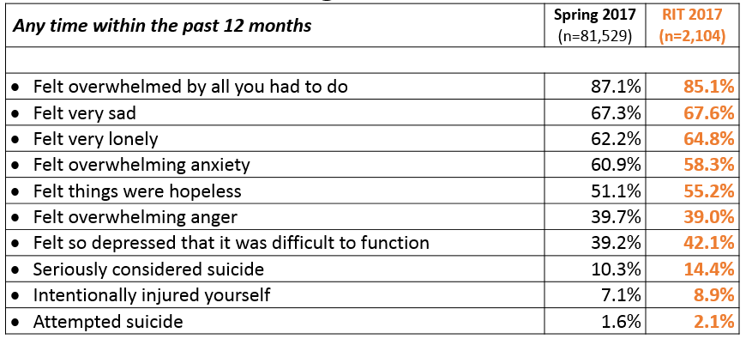
National College Health Assessment
American College Health Association. American College Health Association-National College Health Assessment II: Reference Group Executive Summary Spring 2017. Hanover, MD: American College Health Association; 2017.

Slide 12
Mental Health Outreach
Center for Leadership and Civic Engagement
Kate Gleason college of Engineering
Engineering Technology Exploration Course
Academic Support Services Insights Class
RA’s Orientation Leaders
Human Resources/New Employees
Advance RIT
Commuter Lounge
Graduate Student Services
Title IX
Special Interest Houses
Wellness Team
Health Promotion
Athletic Department
K-5 Program
Brick Hack
RIT Library
College Restoration Program
The Reporter
TransCare Team
Types of Outreach:
Suicide Prevention and Awareness Week
Mental Health Screening Days
Mock Intakes
What’s On Your Mind
Orientation workshops and training
Resource Tabling
Dessert and Dialogue
Workshops on specific Mental Health Topics
Presentations for classes
Student interviews
Peer Education Program
Lighting the Way
Next Year:
Out of the Darkness Walk
NTID Wellness Event and Mental Health Screening Day
Campus Partners
Residence Life
Campus Life
Religious and Spiritual Life
Center for Women and Gender
Q Center
International Student Services
Student Dietetic Association
Student Government
Student Health Center
Academic Advising
Career and Co-Op Services
The Maker’s Space
Greek Life
CAB ALANA MCAS Academic Support Services
OUTSpoken

Slide 13
Faculty/Staff Prevention and Early Intervention Training
College of Liberal Arts
College of Computing and Information Sciences
National Technical Institute for the Deaf
College of Engineering
College of Science
College of Business
College of Engineering Technology – In progress
College of Art and Design – In progress
School of Individualized Studies
Office of Graduate Education – In progress
University Advising
Residence Life Staff
Academic Support Center
Division of Diversity and Inclusion
New Faculty Orientation
RIT Global – Study Aboard – In progress

Slide 14
Faculty/Staff Prevention and Early Intervention Training
Case Management Trainings
New Faculty Orientation
Early Intervention for New Employees
Early Intervention - Ad Hoc
Engineering Professors
HUB/Postal Staff
Nutrition/Exercise Science Faculty
F&A Managers
Auxiliary Services
Access Services- Captioning Staff
Spirituality & Religious Life
empower/academic support center

Slide 15
Faculty/Staff Prevention and Early Intervention Training result
Across the Country: % of Students in Counseling reporting SI.
Spring 2018
47%
Spring 2016
38%
Percentage of students served endorsing:
College and University Counseling Centers
Center for Collegiate Mental Health
n=150 Counseling Centers
Notes:
David

Slide 16
Faculty/Staff Prevention and Early Intervention Training result
After services at CaPS, the percent of students who report thoughts of ending their lives decreased from 47% to 8%.
Percent of students who scored 1-4 on CCAPS: I have thoughts of ending my life.
At In-Take
Last Session
2017-18 n=1711

Slide 17
Student Behavioral Consultation Team- Utilization
Notes:
Mid year data SBCT generally services between 2 and 3 % of RIT’s general population. Our mid=year data this year is about what we saw for total of 2016
322 ind.
418 total

Slide 18
Time Spent Socializing with Friends (hrs/wk)
Eagan, M. K., Stolzenberg, E. B., Zimmerman, H. B., Aragon, M. C., Whang Sayson, H., & Rios-Aguilar, C. (2017). The American freshman: National norms fall 2016. Los Angeles: Higher Education Research Institute, UCLA.

Slide 19
The most significant innovation in higher education in the past 10 years

Slide 20
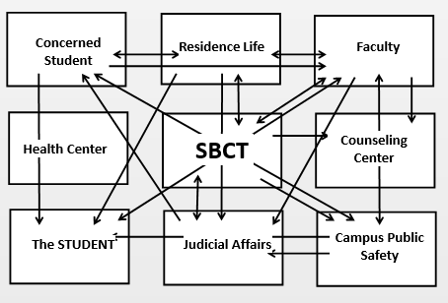
A Break from Tradition
Source: OIG Report #140-07: Investigation of the April 16, 2017 Critical Incident at Virginia Tech. Prepared by: Office of the Inspector General for the Mental Health, Mental Retardation and Substance Abuse Services- Commonwealth of Virginia.

Slide 21
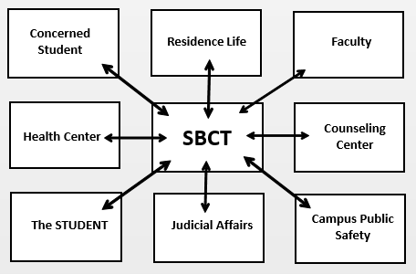
A Break from Tradition

Slide 22
Student Behavior Consultation Team (SBCT) Mission
Coordinate resources for the RIT Community
Provide a systematic, non-punitive response to students whose behavior is disruptive, disturbing, or distressing, to themselves or other members of the University community
Assist faculty and staff in addressing instances of student behavior which may be disruptive, disturbing, or distressing
Assist in protecting the health, safety, and welfare of the students and other members of the RIT community.

Slide 23
SBCT Composition
Wendy Gelbard MD, FACEP
Chair, Associate Vice President for Student Health, Counseling and Wellness
Kiersten Blankley, MSW
Director of Student & Academic Services, NTID
Gary Moxley,
Director, Public Safety Department
Maureen Glegg
Student Affairs, Team Administrator
Megan Jaros, MS LMFT; Samantha N. Jeffries MS LMFT
Case Managers, Student Health, Counseling, and Wellness
Jennifer Newell, Director
Center for Student Conduct & Conflict Resolution
Sharon Kompalla-Porter
Associate Director-Support and Success, Center for Residence Life
Lynne Mazadoorian
Director, University Advising Office
David Reetz, PhD
Director, Counseling and Psychological Services

Slide 24
How to Contact SBCT
Search: “SBCT” Search: “Tiger Concern Report”

Slide 25
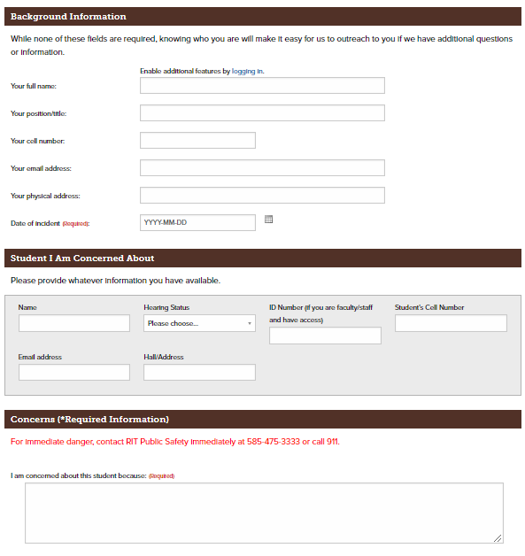
Tiger Concern Report
What happened & why you are concerned (outline the pattern)
What you did to address the situation
What is student’s knowledge of referral
Who have you communicated with about this (supervisor, academic advisor, dean, department chair, public safety.)
Confirmation # is generated and provided to you immediately upon submission

Slide 26
SBCT Process
Team member confirms report is received and shares a brief summary
Review of information in real time, then shared in weekly meeting
Team involves relevant campus resources as appropriate
Team may reconnect to confirm outreach has occurred/action has been taken
HIPAA
Confidentiality
Case closed
Not sure? Ask!

Slide 27
SBCT Limitations
RIT policies & procedures
Non-punitive approach
Unable to mandate treatment/force services
Unable to continuously monitor students
Can only work with current/past information
Submit new report for new concerns

Slide 28
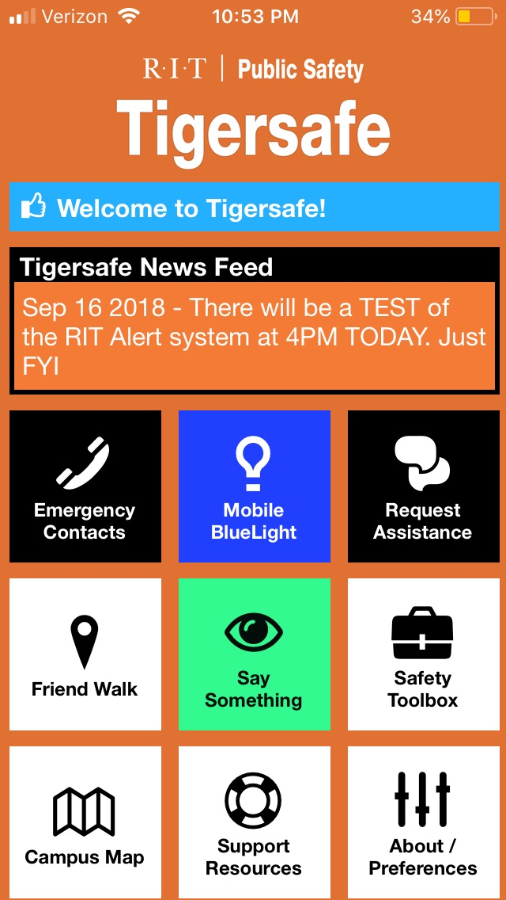
Concerns for RIT Community Members
Supervisor
Human Resources
Public Safety
Threat Assessment
“Say Something” – TigerSafe App

Slide 29
In Review
Public Safety
When you need/want an immediate response
In an emergency
To report a crime, violence, threats, etc.
Threat Assessment
When you are worried about an employee or a work environment but not for immediate risk/danger
SBCT
When you are worried about a student but not for immediate risk/danger
When you aren’t quite sure what is going on or what the student needs for support

Slide 30
SBCT
475-3963
Public Safety
475-3333 (emergencies)
475-2853 (non-emergencies)
205-8333 (text line)
Counseling and Psychological Services:
475-2261 (Business Hours)
1-855-436-1245 (After Hours)
Evenings, Weekends, Holidays
Student Health Center
475-2255 (Business and After Hours)

