Slide 1
Power Workshop: Incidental Learning
March 23, 2018
Mindy J. Hopper, PhD
Notes:
Based on my published dissertation study, 2011

Slide 2
Types of Learning | Environment | Audience | Agenda/Plan
Formal | Formal-Structured | Yes | Yes
Informal | Semi-Less Structured | Yes | Possible
Incidental | Ubiquitous | No | No
Hopper, 2011

Slide 3
Incidental Learning
Results from an external stimulus in surrounding interactions- audio, visual or kinesthetic- and we attune to it for second(s)
Information- stored consciously/subconsciously
Understanding of stimulus- comprehended immediately or later
Learning takes place when external stimulus is understood by associating it with prior/new knowledge
Hopper, 2011

Slide 4
“that’s mean!” (breakup)
… and stuff.”
“look at the peanut butter allergy table”
“don’t want to burden parents”
“… consider a CO2 detector…” (in bus)
“it’s the time of the year!” (yearbook survey)
“it’s contagious – they should stay at home!” (pink eye)
“… cuz they have smaller classes”
“polo shirts are in”
“use the ______ formula for #8” (math regents exam)
Hopper, 2011
Notes:
8th grade Discourse utterances Think about how information impact receivers
Can think about the 8th grade Discourse that surrounded you when you attended school

Slide 5
Implications
Negotiating skills
Financial management
College/career planning
Health and safety
Leadership skills
Critical thinking skills
Social maturity
Awareness of local- global Issues
Problem-solving skills
Relationships
Rhetoric analysis
Cultural learning
Notes:
Inconclusive
Choice of college – small classes, attention; don’t want to burden parents; major in environmental engineering
choice of college and major (education)
finance management (interest)
health (pink eye)
leadership (yearbook)
safety (peanut allergy table, terrorism)
self esteem (confidence)
social skills, etiquette (overlapping talk)
(Pj story; No no no don’t kill me story; complaining to teacher; Wicked; Math & Bye; peanut allergy table story; Sequel meaning)
Black shorts!
Applies to 2nd language learners/ELAs

Slide 6
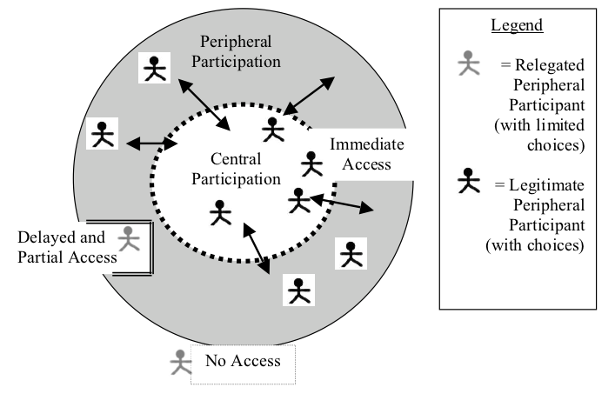
Access-Participation Theory: Legitimate and Relegated Periphery
Hopper, 2011
Notes:
The more immediate and full access you have, the more choices you have for participation. Accessible contexts do matter not only for physical, but also cognitive, social, and emotional mobility. Contexts are complex, dynamic, and fluid. The key is access.

Slide 7
In Theory…
ACCESS
Hopper, 2011
Notes:
Because IL is a social and academic lifelong phenomenon….
IL opps promote scaffolding opportunities (Vygotsky, 1978) – ; Increase funds of knowledge (Moll, 2004) = keep in backpack; to share information is being a part of a community
More options/choices for participation and opportunity for connectedness and knowledge reconstruction
Scaffolding enables one to make association between prior knowledge and new significant information
Influences self-esteem – sense of membership of community or citizenship

Slide 8
With Our Privileges, What Can We Do?

