Slide 1
Introduction to Predatory Journals and Conferences
Joan Naturale, jxnwml@rit.edu
Frances Andreu, fcatwc@rit.edu
Feb 25, 2019

Slide 2
Today’s Agenda
Definition of “predatory publishing”
Targeting Scholars
Characteristics of Predatory vs Non Predatory Journals
Impact of Predatory Journals
Journal Evaluation Tools

Slide 3
What is “Predatory Publishing”?
Term invented by Jeffrey Beall in 2010
Refers to practice of charging fees to authors to publish their articles without the standard editorial and peer review services provided by legitimate scholarly journals, though often with the pretense that there is.
This can apply to journals as well as conferences

Slide 4
What is “Predatory Publishing”
Predatory publishers have taken advantage of the Open Access movement, as it is a practice to charge authors publishing fees (APCs)
Traditionally published journals may also be “predatory”
Different from low-quality journals, which may not meet high standards for peer review, but do not seek to deceive authors

Slide 5
Characteristics of Predatory Publishers
Article acceptance to publication turn-around time are very quick
Notification of publishing fees given only after papers are accepted
Improper use of ISSN numbers, fake Impact Factor scores
Solicits submissions with spam emails

Slide 6
Characteristics of Predatory Publishers Cont.
Poor website design (random images, links that don’t work)
Journal is very broad—covers many topics; may have few articles per journal
Editorial board may be made up of fake scholars or existing scholars may be listed without knowing
Mimics name or design of a more established journal

Slide 7
Sample E-mail
From: Journal Scholarly <alexrogersy@yahoo.com>
Sent: Thursday, February 21, 2019 11:22 AM
Subject: Submission open for IJIER: March – 2019 Edition
Welcome to IJIER
International Journal for Innovation Education and Research
IMPACT FACTOR: 2015 - 4.565 (link to Cosmos which is not a reputable metrics company)
Last Date for Paper Submission: March 20, 2019
Last Date of Publication: March 31, 2019
Dear Author's
We are cordially invited you to submit your papers to the upcoming Edition of IJIER. Volume 7, Issue 3 – March - 2019.

Slide 8
Sample E-mail
Topics suitable for IJIER include but are not limited to:
• IJIER is cross-disciplinary. The topics are not limited to the list that is available.
The below-mentioned areas are just indicative:
Social science and Humanities: Social Science and Humanities, Sociology, Social Welfare, Anthropology, Religious Studies, Visual Arts, Political, Cultural Aspects of Development, Tourism Management, Public Administration, Psychology, Philosophy, Political Science, History, Education, Women Studies and so on.
Science and Engineering: All kind of Science and Engineering, Technology, and Innovation, Environmental Studies, Climate Change, Agricultural, Rural Development, Urban Studies, etc.
Business and Economics: Business and Marketing, Economics, Financial Development, Accounting, Banking, Management, Human Resources, etc.

Slide 9
Sample E-mail
Fast & Easy paper publishing process with OJS system.
Inclusion in all Major Bibliographic Open Journal Databases
Just because something is indexed in a database doesn’t make it a reputable journal

Slide 10
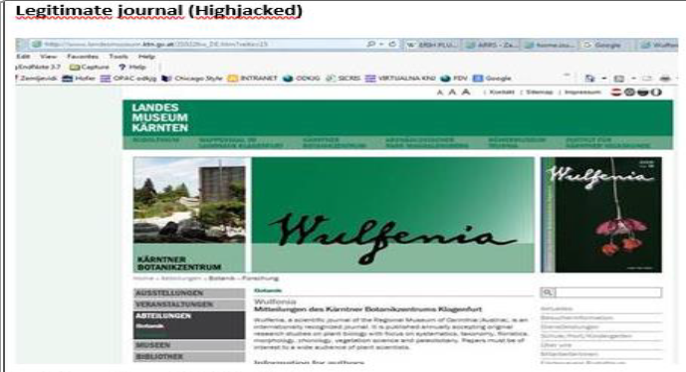
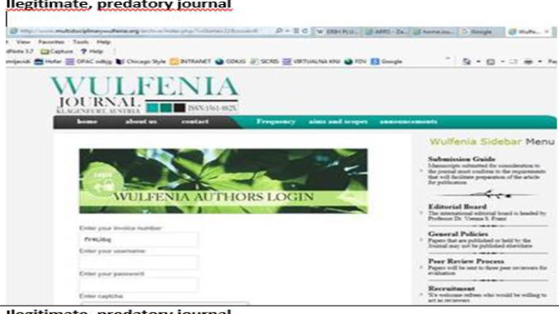
Hijacked Journals
Takes name of an existing legitimate journal

Slide 11
Why Scholars? Why Now?
Rising cost of subscription journals lead to expansion of the Open Access movement, in which content is available online for free, sometimes requiring a publishing fee from authors
Predatory journals take advantage of this movement as well as the pressure on scholars to publish
  Young scholars new academic publishing often targeted

Slide 12
Impact of Predatory Journals
Releases un-vetted scholarship under the impression it was reviewed
Reflects poorly on individual scholars
Floods academic publishing market

Slide 13
Predatory Publishing by the Numbers

Slide 14
Distribution of 2014 OA Articles by Discipline

Slide 15
Lawsuit against a Predatory Publisher
The U.S. Federal Trade Commission filed in 2016 a civil complaint in federal court against one of the largest publishers of online science journals, OMICS Group Inc.
Granted a preliminary injunction in 2017 – prohibits defendants from continuing to make false claims

Slide 16
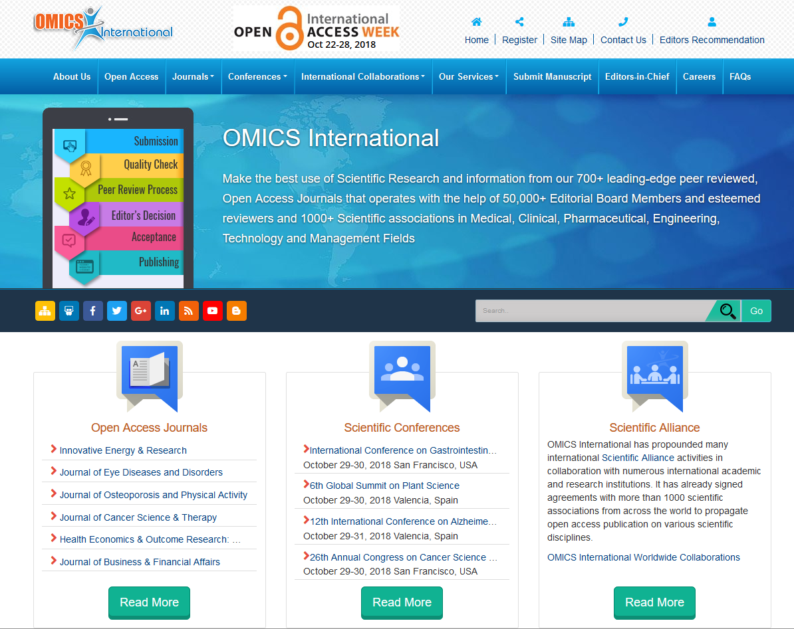

Slide 17
Characteristics of Reputable Journals
Published in a timely manner, on a regular schedule
Clear, easy to find statements on peer-review policies and procedures, publishing charges, copyright
Digital archiving policy or statement
Members of publishing groups such as the Committee on Publication Ethics (COPE)

Slide 18
Journal Evaluation Tools
https://thinkchecksubmit.org/ - Website with a range of tools and practical resources to help researches identify trusted journals, including a checklist for assessing the credentials of a journal or publisher.

Slide 19
Journal Evaluation Tools
Open Access Scholarly Publishers Association (OASPA)
Directory of Open Access Journals (DOAJ)
JournalGuide: compare publication speed, costs, etc.
Journal Quality List: collection of journal rankings
Retraction Watch: tracks retractions of papers
SHERPA/RoMEO**: lists copyright polices, but does not evaluate for quality

Slide 21
Journal Evaluation Tools
Academic Indexes (Web of Science)-Be aware that a few non-reputable journals have shown up in the database
Use Google Scholar judiciously as it indexes non-reputable journals. Use the Google tools to look up researchers, associations, and more to verify authenticity.

Slide 22
Journal Finder Tools
Elsevier: Find the Perfect Journal for Your Article
Springer Journal Suggester
Journal/Author Name Estimator (JANE)
PubMed PubReMiner
Journal Guide
Manuscript Matcher

Slide 23
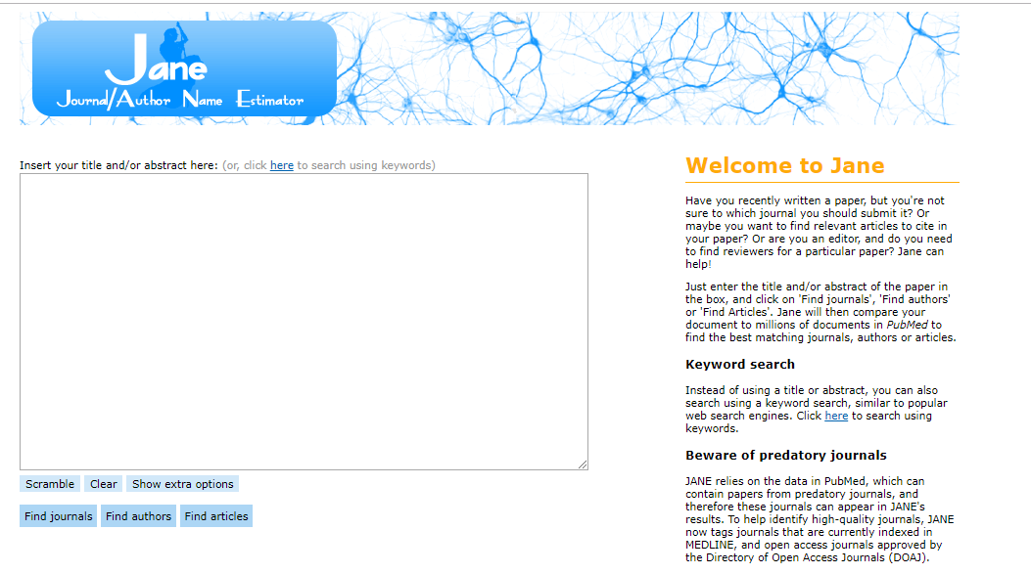

Slide 24
Journal Lists
MLA Directory of Periodicals
American Anthropological Association
American Psychological Association

Slide 25
What About Beall’s List?
2011 - Original Beall’s List of “Potential Predatory Scholarly Open-Access Publishers”
2017 - Official Beall’s List taken down (mirror/copycat sites remain)
2019 Beall’s List continued by anonymous contributors
Stop Predatory Journals continues Beall’s work

Slide 26
More Information
Predatory Publishing InfoGuide:
  https://infoguides.rit.edu/predatorypub

