Slide 1
Active Learning 2.0: Using it in Classrooms of all Subjects

Slide 2
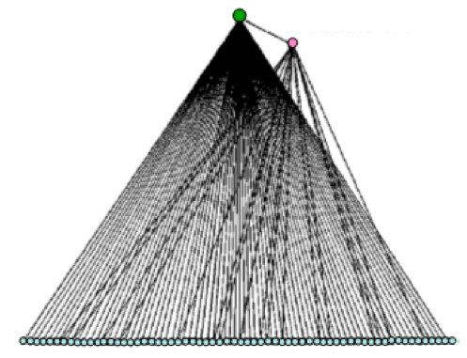
Traditional Instruction
Instructor
Information flows from instructor to students
Students physically passive, limited interactions
Framing of topics entirely instructor-driven
Assistant
Enrolled Students

Slide 3
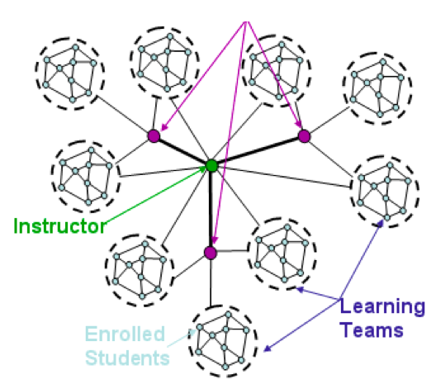
Interactive engagement
Assistant
Information flows between students, instructor, assistants
Students physically active (talking), frequent interactions
Students given opportunity to put topics in their own context

Slide 4
Principles of Interactive Engagement
Students talking to students about meaningful questions with the safety to be wrong
Time to reflect, discuss and engage
Deep reflection: consider difficult or counter-intuitive topics, or reflect/generalize across topics

Slide 5
What topics require the most thought by students?
Spend one minute thinking quietly about a topic in your class that is particularly difficult for students. What do they struggle the most with? What questions do you ask students in 1-on-1 discussions to guide them to understanding?
In small groups, discuss your issue. How would you imagine a discussion going about your question among a small group of students, w/o faculty intervention? (3 min/person)
Large group share-out

Slide 6
Think/Pair (group)/Share
Spend one minute thinking quietly about a topic.
In small groups, discuss your issue.
Large group share-out

Slide 7
Concept questions
At which location in the diagram below would the waves break closer to the beach?

Slide 8
Explicit metacognitive questions about problems
A car going 75 mph passes a police car at rest. The policeman takes 10 seconds to accelerate smoothly to 90 mph. How much time elapses between when the speeder passes the policeman and when the policeman catches up? Do not attempt to solve this problem. Rather, develop a plan for how you could solve the problem. Be specific in your plan.

Slide 9
Collaborative projects
(Foreign language): Develop a 2-minute group play that takes place entirely in the kitchen. Each group member must participate equally in the performance.

Slide 10
Tips and tricks (find what works for you)
don’t hesitate to allow conversations to go long if they seem productive
Explore practices to allow everyone to speak or participate (mini-sessions, randomly assigned roles, etc.)
Don’t have a question? Have students ask their own. (e.g., anonymous note cards re-distributed or shared)

