Slide 1
What is Active Learning or Interactive Engagement?

Slide 2
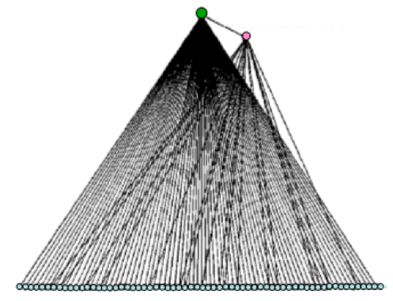
Traditional Instruction
Instructor
Information flows from instructor to students
Students physically passive, limited interactions
Framing of topics entirely instructor-driven
Assistant
Enrolled Students

Slide 3
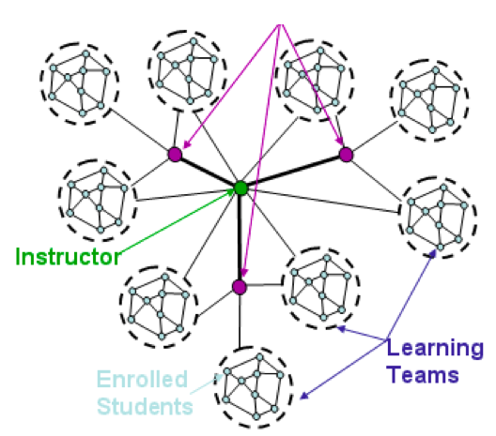
Interactive engagement
Assistant
Information flows between students, instructor, assistants
Students physically active (talking), frequent interactions
Students given opportunity to put topics in their own context

Slide 4
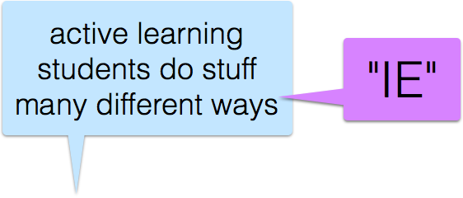
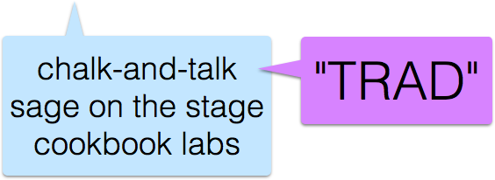
Interactive Engagement teaching is better than
Traditional teaching.
higher score on research-based assessments

Slide 5
Research-based Assessment Instruments
Generally multiple-choice surveys
Carefully crafted questions
Conceptual topics across physics, chemistry, biology, etc.
Additionally: beliefs, problem-solving skills, affect
Normalized gain
  0 < <g> < 1 (maximum possible improvement)

Slide 6
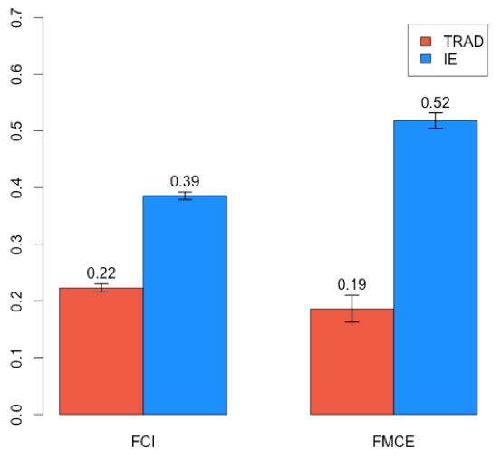
Trad. vs. IE: 50,000 student meta-study
Normalized gain

Slide 7
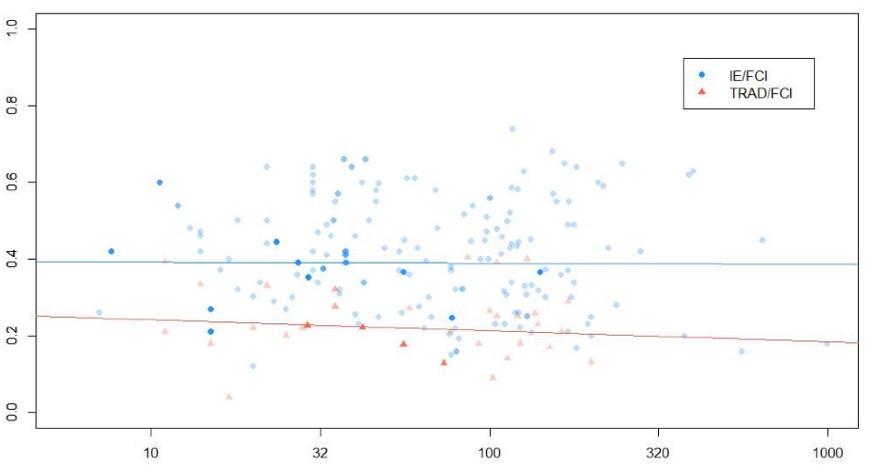
Class size doesn’t matter
Normalized gain
Class Size

Slide 8
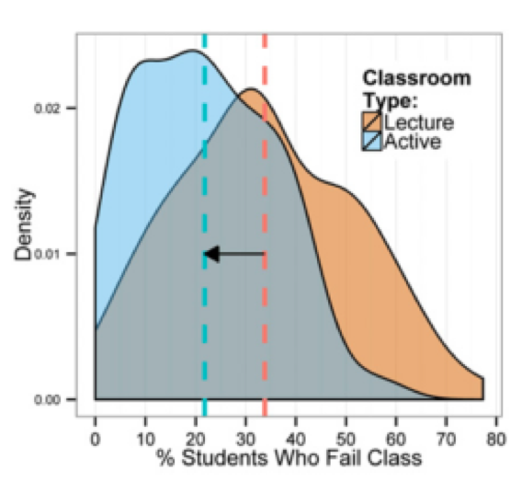
Fewer students fail

Slide 9
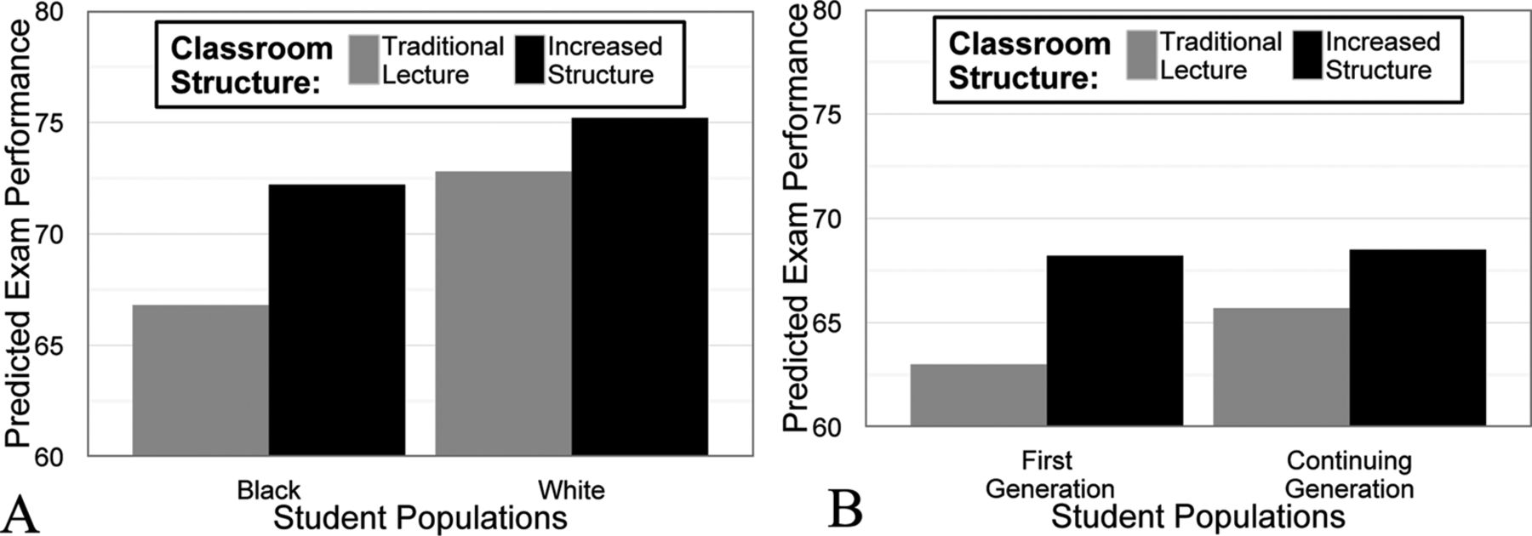
Reduces gender & other demographic gaps
Chemistry Exam Performance
Chemistry Exam Performance

Slide 10
Principles of Interactive Engagement
Students talking to students about meaningful questions with the safety to be wrong
Time to reflect, discuss and engage
Deep reflection: consider difficult or counter-intuitive topics, or reflect/generalize across topics

Slide 11
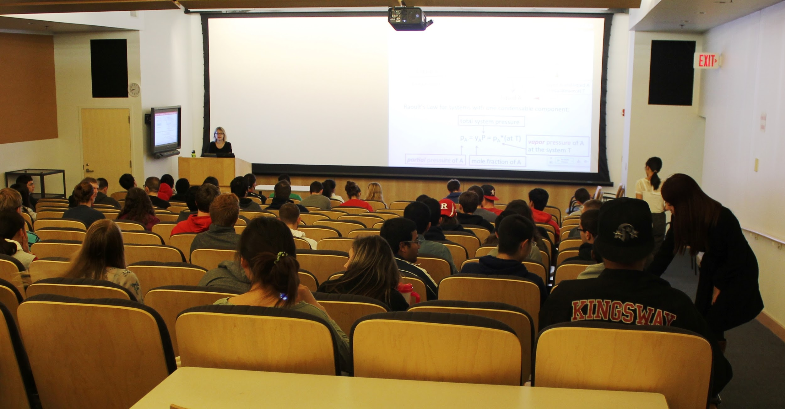
Inside the Classroom - Peer Instruction
Rutgers University: Chemical Engineering
students “think-pair-share” clicker questions during lecture
Notes:
Class meets T / F, for 80 minutes each day.
Typically shorter, easier conceptual clicker questions interspersed through beginning of lecture, with longer, harder clicker questions towards end of lecture (last question might take 10-15 minutes). Students are assigned to groups that switch after each of two midterm exams. Groups need to submit same answer to clicker question. LAs facilitate with instructor.

Slide 12
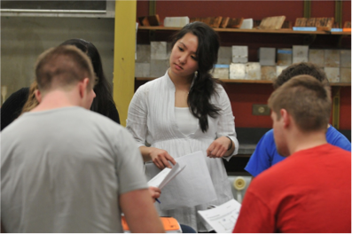
Recitation sections
University of Colorado-Boulder, Gen Chem
Rutgers University: Physics, Intro to Computers for Engineers, Intro to logic
small groups of students work on collaborative problem solving tasks

Slide 13
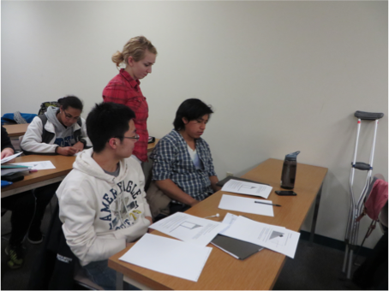
Flipped-Classroom
Rochester Institute of Technology: Elements of Multivariable Calculus & Differential Equations
Students watch videos before class, solve problems in small groups during class
Notes:
Mathematics (Courses: Intro to Statistics, graphic simulation with some linear algebra applied to gaming; multi-variable calculus-flipped lecture watch lecture video & slides at home, activities in-class),

Slide 14
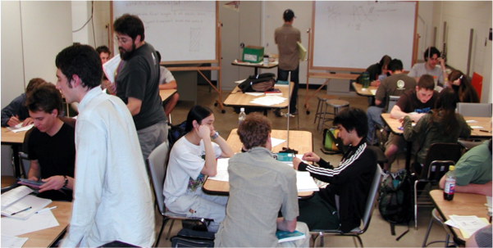
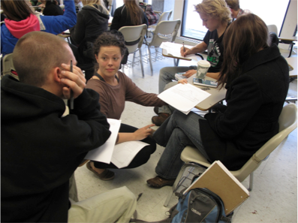
Tutorials
University of Colorado-Boulder: Calc, Physics
Instructor and LAs co-facilitate student groups of 3-4 students
Notes:
LAs used primarily to co-facilitate (with a graduate TA) four tutorial sessions each week.
Curricular materials are University of Washington Tutorials in Introductory Physics
LAs also do one or two help room hours each week.

Slide 15
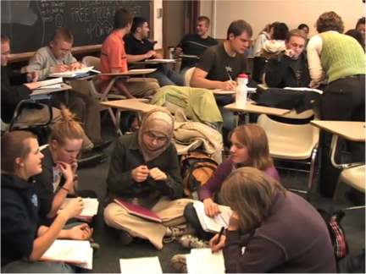
Class Break-Out Sessions
University of Colorado-Boulder: Physics
10-20 min “break- outs” in 75- minute class

Slide 16
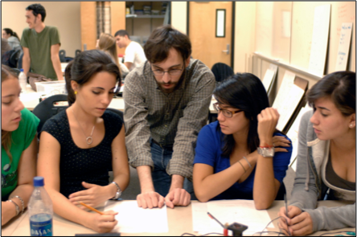
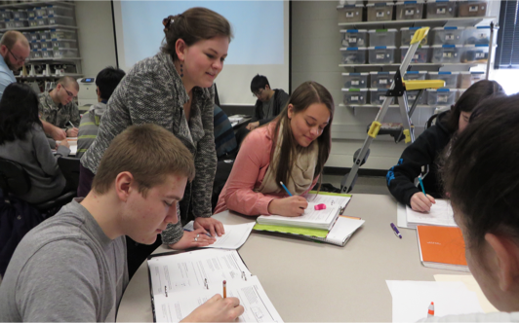
Laboratory
Rochester Institute of Technology & Florida International University: Physics Tutorials in integrated lecture- lab course
Notes:
PHYSICS
Integrated lab lecture
They use UW tutorials (but call it Workshop Physics)
Maybe interspersed with mini-lectures (then back to the tutorials)
# students/section 42 students/section
Contact hours per week MWF 12-2pm (6 hrs)
+ weekly Tues 6:30-7:45pm (recitation—HW, practice problems-optional & take exams)
Activities given every class period

Slide 17
Conclusions
Active learning, active engagement, guided inquiry, inquiry-based learning, activity-based learning, …. maximizes students talking to students
can be incorporated into classes of all levels, all sizes
topics ranging from conceptual understanding to “traditional” problem-solving
existing materials, assessments for STEM faculty to draw upon, or support for modifying current class notes
support for in-class implementations (Learning Assistants)

