Slide 1
Detecting Pal Lipoprotein in Gram-negative Sepsis Patients
Kara Farquharson
4th Year Biochemistry Major in SCMS

Slide 2
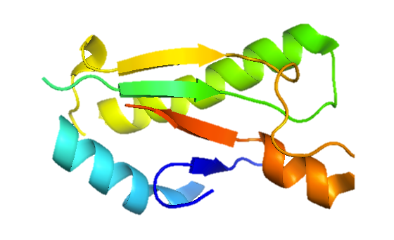
Background
Pal--Peptidoglycan-associated lipoprotein

Slide 3
PAL AND SEPSIS
Background

Slide 4
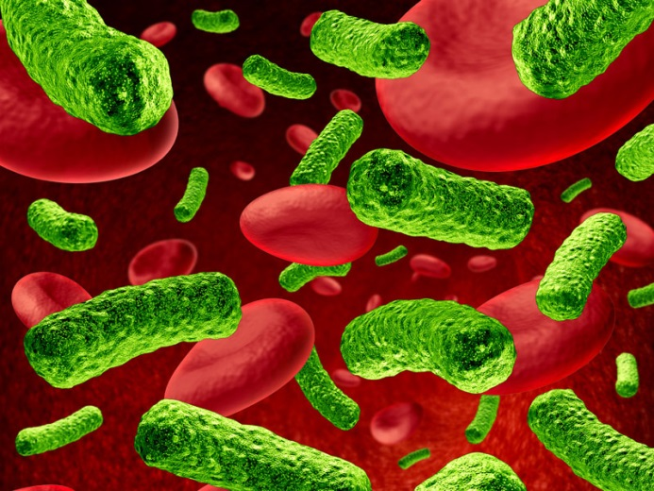
Sepsis
Sepsis is a full body bacterial infection accompanied by systemic inflammatory response syndrome
Symptoms: fever, impaired mental status, organ dysfunction, and septic shock which can be fatal
Sepsis infections often occur due to any of the following:
Puncture wounds/ cuts
burns
infected surgical equipment
vascular and urinary catheters
post-operative drainage tubes

Slide 5
Pal and Sepsis
Pal
E. coli go into the bloodstream
E. coli RELEASE Pal
E. coli
Pal causes inflammation
In other words: Released Pal contributes to sepsis
Notes:
Antiserum was prepared by vaccinating healthy men with heat-killed Escherichia coli J5; this mutant lacks lipopolysaccharide oligosaccharide side chains, so that the core, which is nearly identical to that of most other gram-negative bacteria, is exposed for antibody formation. In a randomized controlled trial, patients were given either J5 antiserum or preimmune control serum intravenously, near the onset of illness. The number of deaths in the bacteremic patients was 42 of 109 (39 per cent) in controls and 23 of 103 (22 per cent) in recipients of J5 antiserum (P = 0.011). In those with profound shock, mortality was 30 of 39 (77 per cent) in controls and 18 of 41 (44 per cent) in recipients of J5 antiserum (P = 0.003). We conclude that human antiserum to the lipopolysaccharide core can substantially reduce deaths from gram-negative bacteremia.

Slide 6
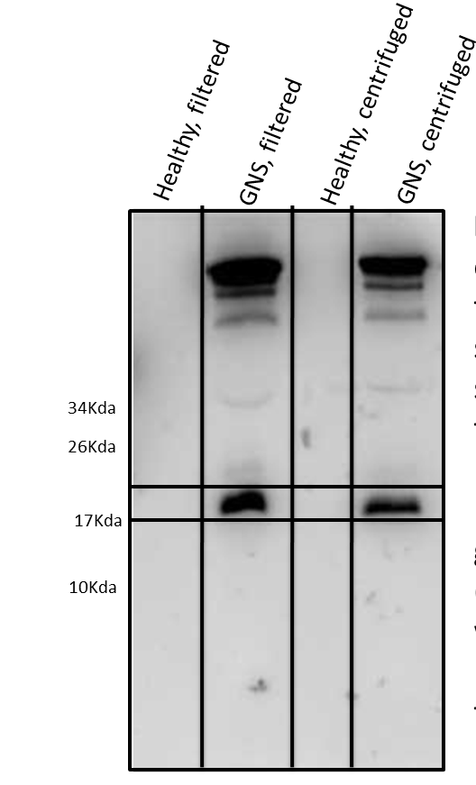
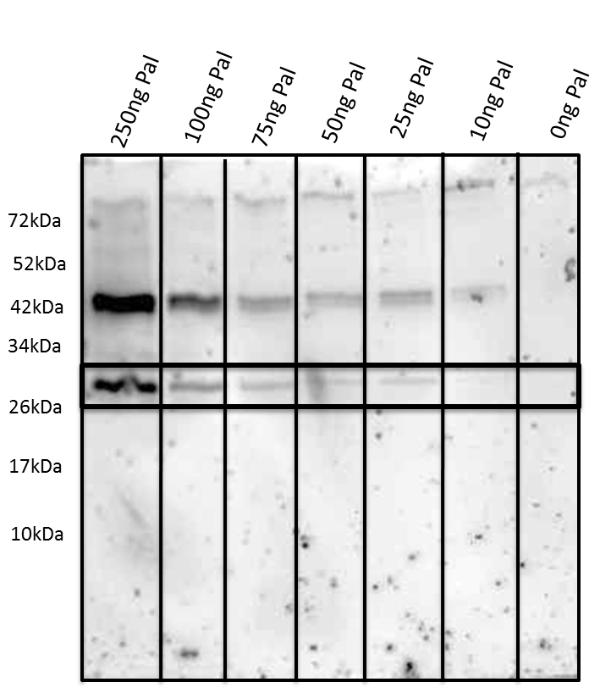
Detecting Pal in Urine
Pal immunoblot of recombinant Pal spiked into healthy urine. The recombinant Pal runs at a higher molecular weight than E.coli Pal due to an N-terminal tag. We were able to detect as low as 25 ng Pal in 50 uL of urine.
Pal immunoblot of healthy urine and urine from a patient with E. coli sepsis. The first 2 samples were filtered and the last two samples were centrifuged to remove whole bacteria.

Slide 7
Summary
Pal
We were able to detect E. coli Pal in the urine of human sepsis patients for the first time.
Future applications:
Diagnostics, treatments
E. coli

Slide 8
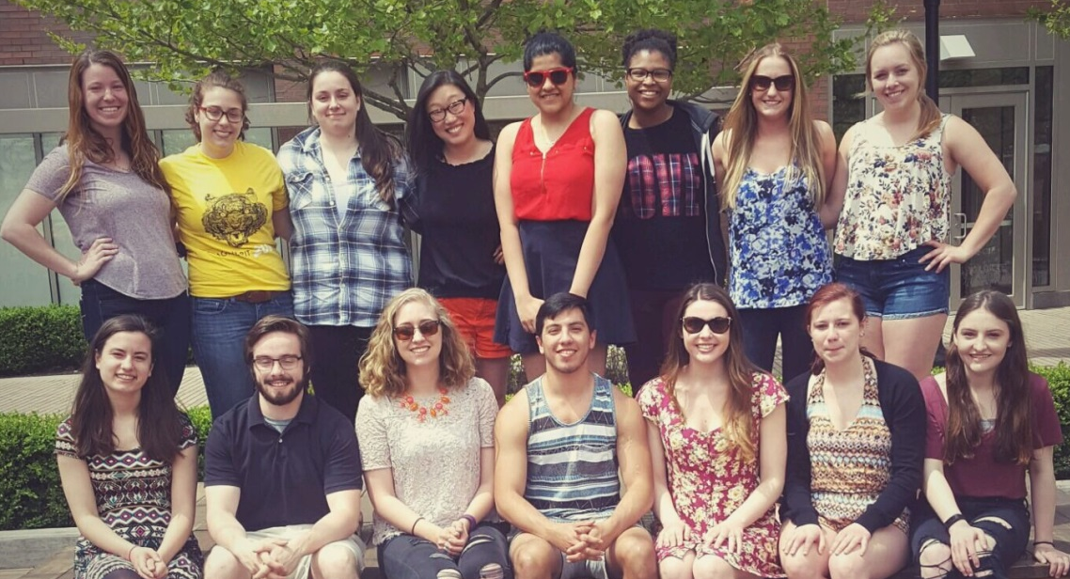
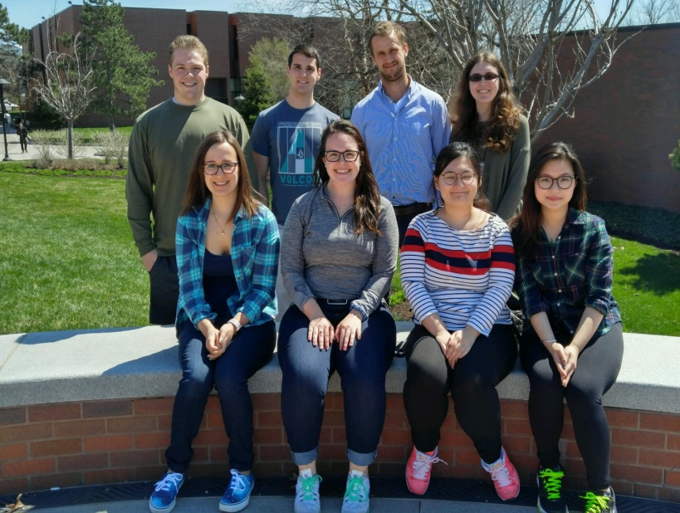
Dreyfus Project
Working with Deaf and Hard-of-Hearing Students
in a Chemistry Research Lab
Lea Vacca Michel
Associate Professor
School of Chemistry and Materials Science
Rochester Institute of Technology

Slide 9
Dreyfus Project
Representation of deaf and hard-of-hearing (DHH) individuals in STEM careers lags in the U.S.
At the postsecondary level, classroom accommodations to facilitate access to STEM information are not universally available
Undergraduate research (UR) experiences have been shown to:
Increase students’ understanding and awareness of graduate school opportunities
Increase confidence in applying for graduate school
Increase success of matriculation
Instill higher learning gains in scientific writing, working independently, and self-confidence for underrepresented students compared with other students
1 Nagle, K., Newman, L. A., Shaver, D. M., & Marschark, M. (2016). American Annals of the Deaf, 160(5), 467–482.
2 Pagliaro, C. M., & Kritzer, K. L. (2013). Journal of Deaf Studies and Deaf Education, 18(2), 139–160.
3 Powell, D., Hyde, M., & Punch, R. (2014). Journal of Deaf Studies and Deaf Education, 19(1), 126–140.
4 Eagan, M. K., Hurtado, S., Chang, M. J., Garcia, G. A., Herrera, F. A., & Garibay, J. C. (2013). American Educational Research Journal, 50(4), 683–713.
5 Russell, S. H., Hancock, M. P., & McCullough, J. (2007). Science, 316(5824), 548–549.
6 Seymour, E., Hunter, A.-B., Laursen, S. L., & DeAntoni, T. (2004). Science Education, 88(4), 493–534.
7 Lopatto, D. (2007). CBE Life Sciences Education, 6(4), 297–306.

Slide 10
Dreyfus Project
Planned Activities
1. Mentoring deaf and HOH students in my research group on independent research projects.
2. Evaluating various mentoring techniques.
3. Evaluating communication devices.
4. Grad School Bootcamp.
5. How-to lab videos (captioned).
7. Disseminating outcomes:
Presentations and publications.
Screenshot from our first captioned how-to video!

Slide 11
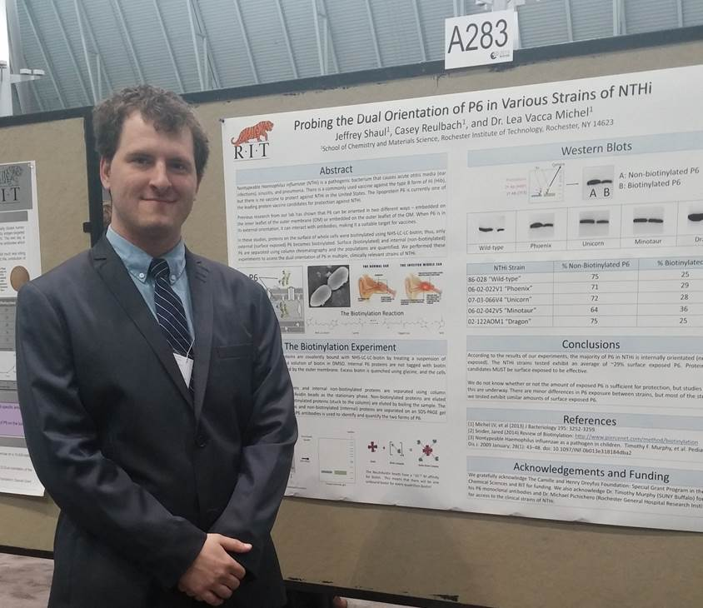
Jeff Shaul
Presentations at ACS Rochester Undergraduate Symposium, RIT Summer Undergraduate Symposium, Undergraduate Research Day (U of Rochester), and the national ASBMB meeting in Boston, MA
Jeff attended U of Rochester (Biophysics PhD program) for one year
Currently getting his MS in Bioinformatics at RIT

Slide 12
Torey MacPherson
Presentations at RIT Summer Undergraduate Symposium and the national ASBMB meeting in San Diego, CA
Torey is a 3rd year medical student at the Philadelphia College of Osteopathic Medicine

Slide 13
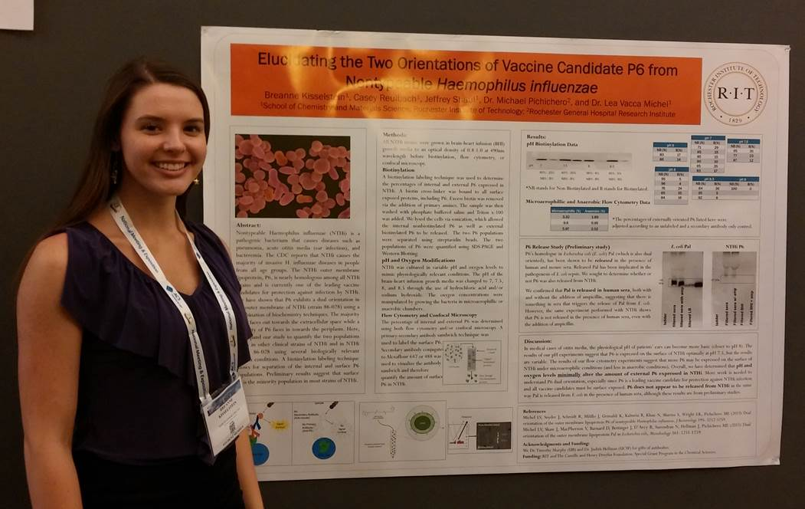
Breanne Kisselstein
Presentations at ACS Rochester Undergraduate Symposium and the national ACS meeting in Boston, MA
Breanne is a PhD student at Cornell University (Plant Pathology)
Recently received a FIVE YEAR graduate fellowship from USDA!

Slide 14
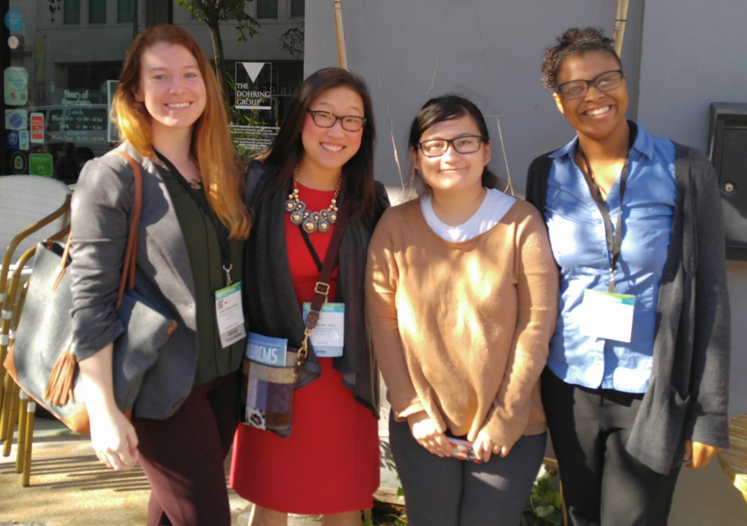
Kara Farquharson
Presentations at RIT, ABRCMS* (Tampa), ASBMB (Chicago), and St Jude’s (Memphis)
Received a highly competitive internship at Merck Pharmaceuticals
Plans to apply to MS programs for next fall

Slide 15
Dreyfus Project

Slide 16
Dreyfus Project

Slide 17
Dreyfus Project
Pilot Study Research Questions
What are the specific challenges faced when training DHH students in molecular bioscience research?
What attitudinal/pedagogical approaches might be needed to effectively mentor DHH students who are involved in bioscience research?

Slide 18
Dreyfus Project
Pilot Study Research Method
Post-graduation survey for students who:
Have documented hearing loss
Participated in UR including at least one full-time summer experience
Advised by a non-signing undergraduate advisor (Michel)
Secured enrollment in STEM or medical graduate program

Slide 19
Dreyfus Project
Participants:
Advisee | RIT Program of Study | Graduation Term | Current Affiliation
Female | BS Biochemistry | 2011-12, Summer | PhD Biochemistry, Ohio State University (4th year)
Male | BS Biochemistry | 2014-15, Spring | MS Bioinformatics, Rochester Institute of Technology (1st year)
Female | BS Biomedical Sciences | 2013-14, Spring | Philadelphia College of Osteopathic Medicine (2nd year)
Female | BS Biotechnology | 2015-16, Spring | PhD Plant Pathology, Cornell University (1st year)

Slide 20
Dreyfus Project
1) What were the major challenges you faced as part of your undergraduate research experience?
This “isolation” bothered me the most when a person comes to me and say, “Remember how so-and-so did this over the weekend – it was so funny! What, you didn’t know?”, making my “isolation” glaringly obvious and painful.
To truly feel like you belong to the lab, you have to develop a connection with the other students. This was hard for me as the students all spoke as (a) group, making it impossible for me to follow along.
The hardest part was probably more related to socialization and incidental learning in the lab.
It was unrealistic to have an interpreter on standby for every minute of lab work. Having that would have helped me catch all of the “little whys” and would have enriched my experience.
I would have liked to get more casual training to pick up on these pesky little whys.

Slide 21
Dreyfus Project
Advisor observations
Communication preferences of hearing lab members dominant discourse
Lab meeting communication dynamics were extremely isolating even with access services (Interpreting, captioning, etc.) present
Peer mentor’s communication modality was the primary communication channel and observed to foster resentment in both students in one instance

Slide 22
Dreyfus Project
Advisor observations
Lack of incidental learning in the research lab
Many DHH students could not fully access extemporaneous discussions in the lab on troubleshooting technical issues
Despite having written protocols available:
A DHH student needed to repeat an ELISA experiment multiple times
A DHH student needed to repeat SDS-PAGE polymerization procedure multiple times

Slide 23
Summary
Challenges | Potential Strategies
Communication tendencies of a lab create isolating atmosphere | Foster an environment that is open to communication (written form, body language, visual cues)
DHH advisees often do not have access to incidental learning to supplement gaps in instruction | Plan/review experiments ahead of schedule
 | Allow for more time for DHH advisee to access all relevant information

Slide 24
Exciting New Projects!
Leader of Research Strand of our HHMI-funded Project
Connecting Faculty Research Mentors with underrepresented and transfer students
for a research experience
Faculty Research Mentor
NIH RISE grant at RIT

Slide 25
MANY THANKS!
Rochester Institute of Technology
Ronald D. Dodge Memorial Faculty Grant
Camille and Henry Dreyfus Foundation
NIH NIDCD RO1 08671 (to MEP)
NIH NEI R15EY018249 (to GT)

