Slide 1



NTID Online Courses -
Results
Power workshop
Summary - Fall, 2161
Linda Bryant, April 26, 2017
National Technical Institute for the Deaf
© Rochester Institute of Technology All rights reserved.

Slide 2
Agenda
•Present course info
•Discuss outcomes
•Detail next steps
National Technical Institute for the Deaf
© Rochester Institute of Technology All rights reserved.

Slide 3
Data collected
Comparative:
•Students
•Grades

Slide 4

Online/Blended only sections:
•Online ready survey results
•SRATE online questions
•Post-course survey

Slide 5
Fall (2161) courses
•Applications of Algebra
•Intro to Performing Arts
•POS: Astronomy
•Personal Finance - Blended

Slide 6
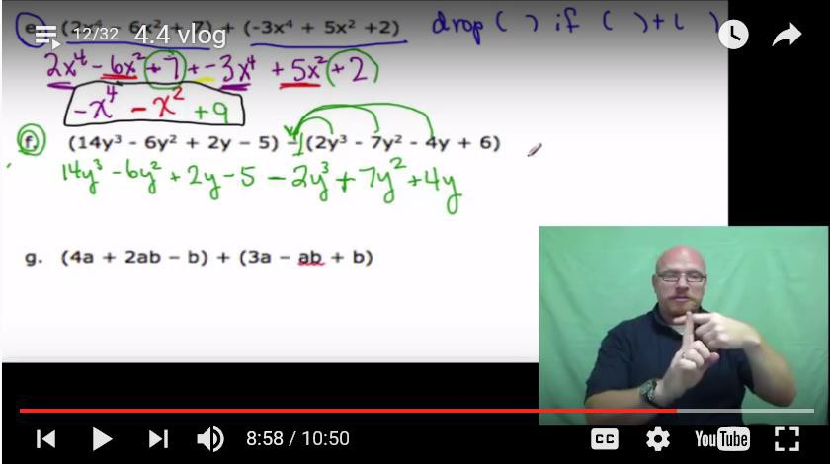
Applications of Algebra
National Technical Institute for the Deaf
© Rochester Institute of Technology All rights reserved.

Slide 7
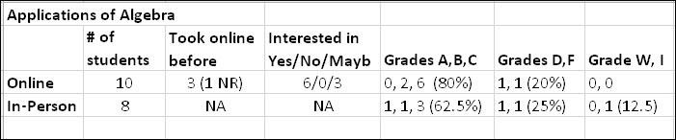
Grades | A-B-C | D-F | W-I
Online | 80% | 20% | 0%
In-person | 63% | 25% | 13%

Slide 8
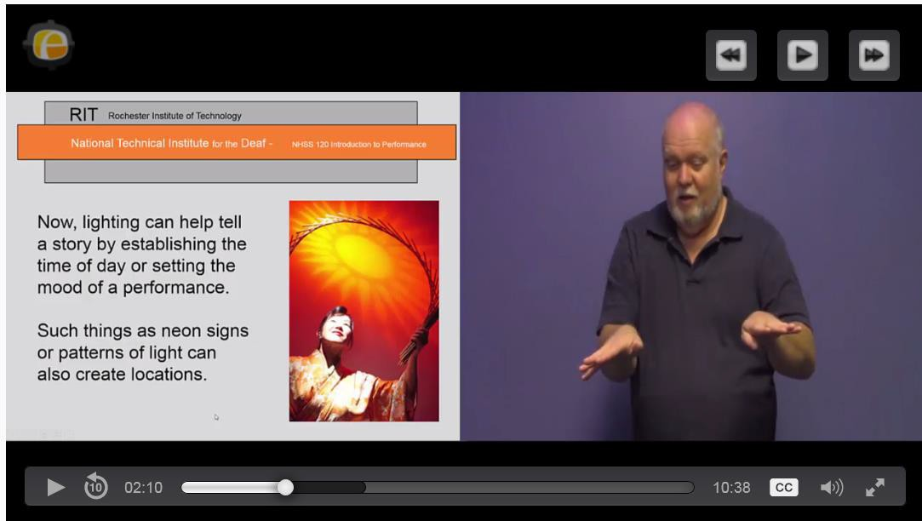
Intro to Performing Arts
National Technical Institute for the Deaf
© Rochester Institute of Technology All rights reserved.

Slide 9
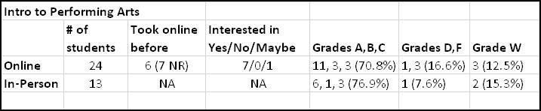
Grades | A-B-C | D-F | W-I
Online | 71% | 17% | 13%
In-person | 77% | 8% | 15%

Slide 10
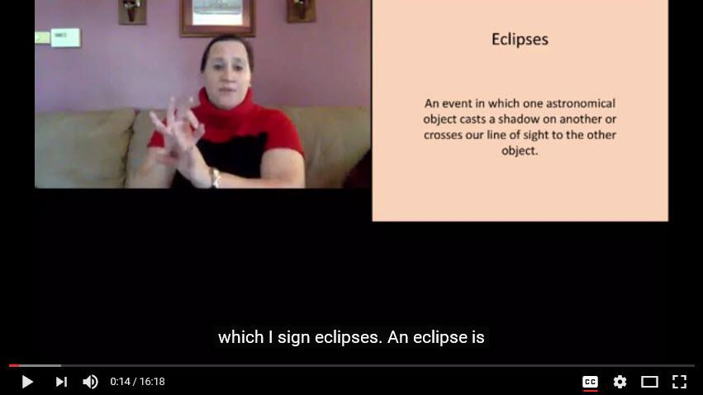
POS: Astronomy
National Technical Institute for the Deaf
© Rochester Institute of Technology All rights reserved.

Slide 11
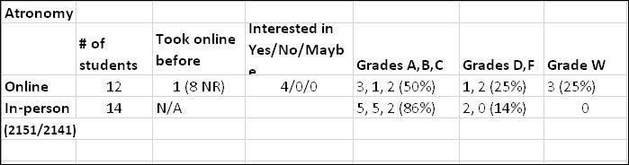
Grades | A-B-C | D-F | W-I
Online | 50% | 25% | 3%
In-person | 86% | 14% | 0%

Slide 12
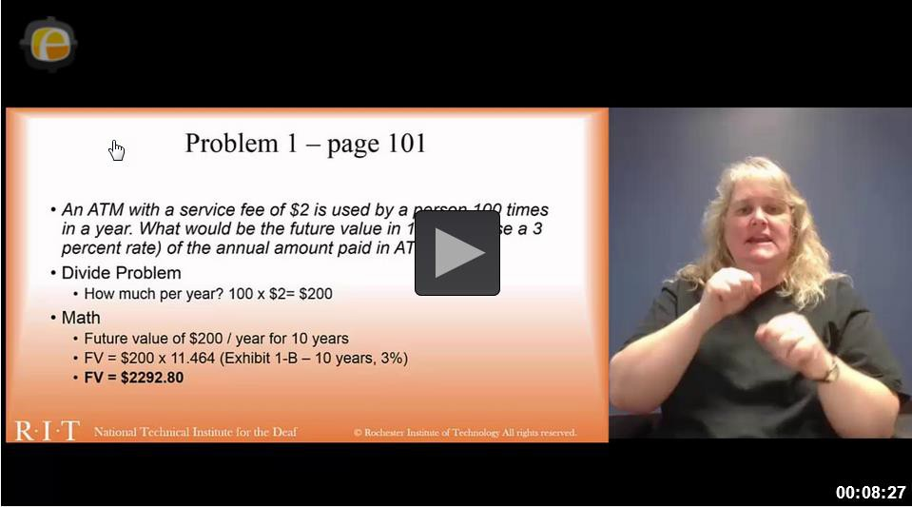
Personal Finance - Blended
National Technical Institute for the Deaf
© Rochester Institute of Technology All rights reserved.

Slide 13
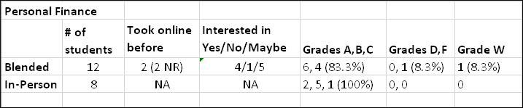
Grades | A-B-C | D-F | W-I
Blended | 82% | 8.3% | 8.3%
In-person | 100% | 0% | 0%

Slide 14
SRATE Questions
•Compared to in classroom
•Compared to online courses
•Quality of video lecture materials
•Comments
National Technical Institute for the Deaf
© Rochester Institute of Technology All rights reserved.

Slide 15

SRATE Responses
•Varied by course
•Numbers are small
•Comments: (Handout)
National Technical Institute for the Deaf
© Rochester Institute of Technology All rights reserved.

Slide 16
Post-course survey
•16% response rate
•100% would repeat online
•90% would recommend
•Biggest challenge?

Slide 17
Since fall…
•2 new courses this spring
•2 continued this spring
•4 fully online this summer
National Technical Institute for the Deaf
© Rochester Institute of Technology All rights reserved.

Slide 18


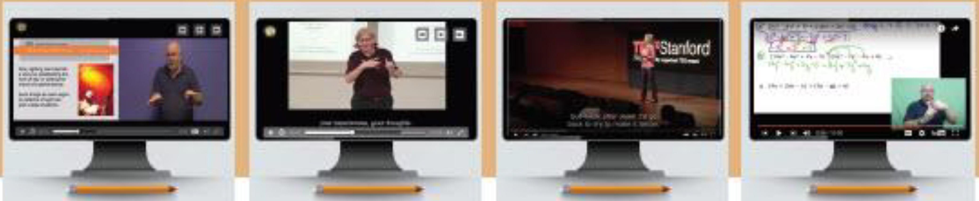

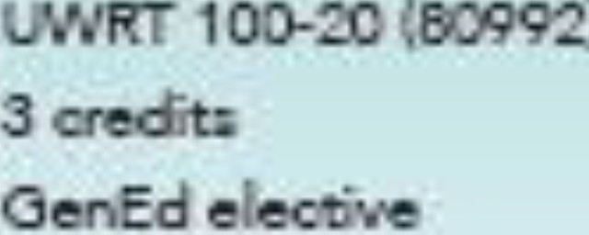


N IN
lntFodiKtion to
Pt:rforming Arts
=nxc«>r - E,-" Auole
HS!l 120-01 {80991)
3
Critical Reading & Writing
uctor-o E·oo· o
of Algebn
ry Blertto- llee
..ctor - el"" Co '/
•• 150-20 (80990 ,
ln=or -
210-01(80998j
3 ere ·u:
NTID OenEd founo,tion axir.e
cour·
3
OenEd ele ·
V. •• g l
Arfu• pervpective
D oerc.d l;;re>e'!J'IIO & O\fetive Explonrtion aa...ne
n-·'11 FY w ing
s
Opon to alI AIT studen ts
Open to NTID-supported student
For more information about these summer onfine co urs
e s
, see your NTID Co uns elo-rl Academic Advisor

Slide 19
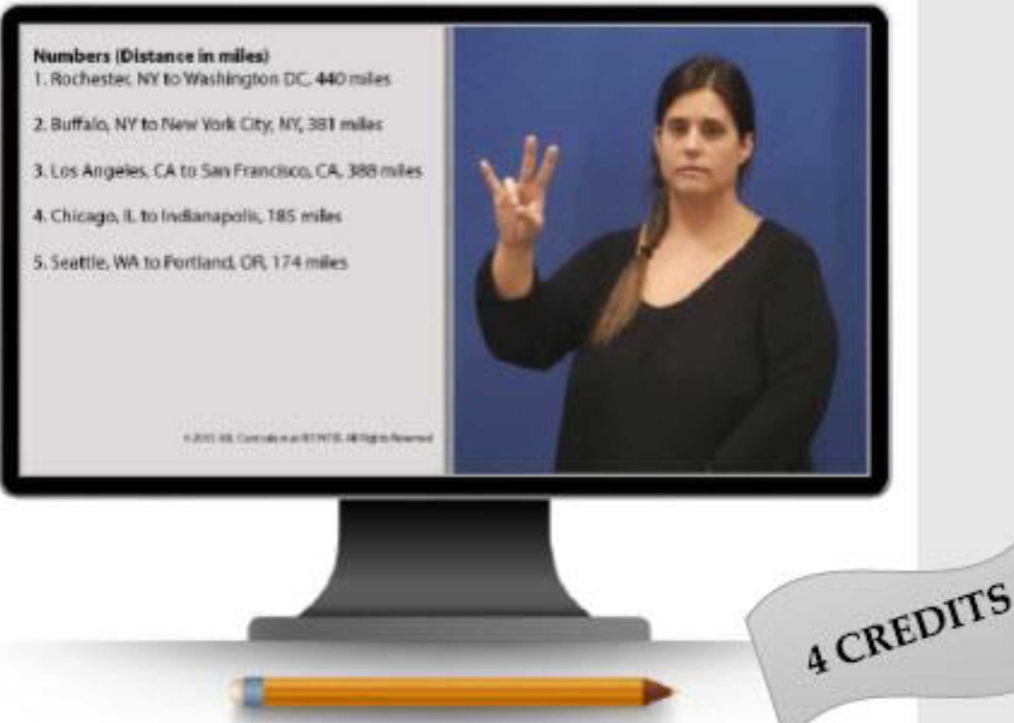
ASL I & II courses are ONLINE this summer!
Beginning American Sign Language I MLAS 201-01 (80858) First Five-Week session (May 30 - June 30)
Beginning American Sign Language II MLAS 202-01 (80859) Prerequisite: MLAS 201 or equivalent course
Second Five-Week sessi on Guly 3 - August 4)
Both courses satisfy:
GenEd Elective
NTID GenEd Perspective (NTID AAS ASL/DCS) GenEd Social Perspective
TAKE ASL ONLINE this SUMMER

Slide 20
Beyond
•Several preparing for next AY
•Creating brochure for advisors
•Developing an “online ready”
survey
National Technical Institute for the Deaf
© Rochester Institute of Technology All rights reserved.

Slide 21
Beyond
•Validating course design
•Establishing student group
•Developing a website (ntid.rit.edu/nlc/online)
National Technical Institute for the Deaf
© Rochester Institute of Technology All rights reserved.

Slide 22

National Technical Institute for the Deaf
© Rochester Institute of Technology All rights reserved.

Slide 23

Have an idea or need help getting started?
Use Outlook Calendar to schedule
an appointment with:
LB at Linda.Bryant@rit.edu &
Wes Blue at Wesley.Blue@rit.edu
Thanks for attending!

