Slide 1
College Students with Autism Spectrum Disorders
Bethany Dragert
Assistant Director
RIT Spectrum Support Program
585-475-6905
bmdssp@rit.edu

Slide 2
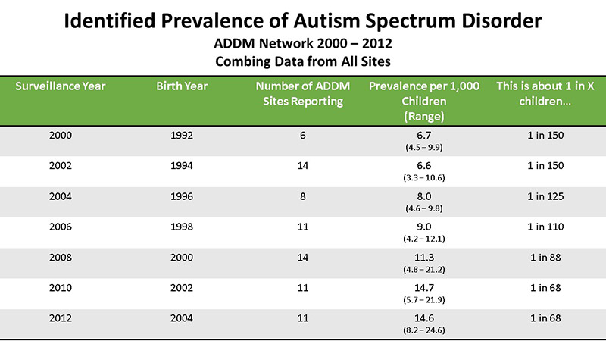

Slide 3
Why the increase?
Expanded definition of Autism
Increases in effective therapies
IDEA- Early Intervention
Active Screening
Increased awareness
Notes:
Autism Defined: 2007 expanded definition and tracking. expanded in 1994 to include a spectrum of disorders with a broader list of symptoms.. Some worry that autism encompass individuals with personality quirks and slight disorders who otherwise carry on with their lives.
ABA—more important to diagnose
1975 Individuals with Disabilities Education Act re: early intervention-enhance the development of infants and toddlers with disabilities; reduce educational costs by minimizing the need for special education through early intervention; minimize the likelihood of institutionalization, and maximize independent living
Routine developmental screening- health care provider will check for problems with your child’s development at every well-baby and well-child visit, even if you don't report any of the signs of autism or other problems. Some disagreement about autism specific universal screening at the 18-month and 24-month visits regardless of whether the child has risk factors for ASD (siblings)
AWARENESS: Autism Speaks founded in 2005
?? mysterious brain disorder that impairs verbal and non-verbal communications and social interactions---do know that there is a biological basis vs sociological basis (refig moms)

Slide 4
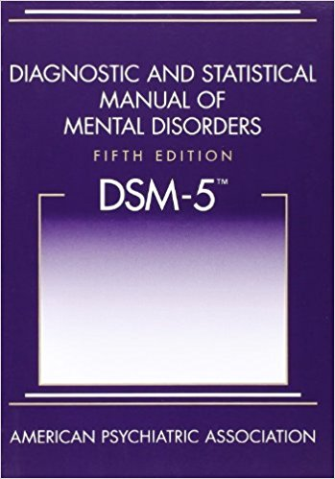
Notes:
2013
4 subcategories (Aspergers, PDD-NOS) folded into 1: ASD (autism spectrum) childhood disintegrative disorder and autistic disorder.
Instead of three domains of autism symptoms (social impairment, language/communication impairment and repetitive/restricted behaviors), two categories will be used: social communication impairment and restricted interests/repetitive

Slide 5
Lower Functioning
Higher Functioning
Social Communication Disorder
Persistent difficulties in social uses of verbal and non-verbal communication ,
Results in functional limitations in effective communication , social relationships, academic achievement and occupational performance
ASD Level 3 | ASD Level 2 | ASD Level 1
Requires very substantial support Severe deficits in social communication and fixated rituals interfere with functioning in all spheres | Requires substantial support Marked social impairment and fixated interests are obvious to the casual observer | Requires support Deficits in social communication are noticeable without supports, repetitive behaviors interfere with functioning
Notes:
significant social, communication, and behavioral challenges.
What we see at the college level is the higher functioning, ASD Level 1.
Also new—Social Communication Disorder

Slide 6
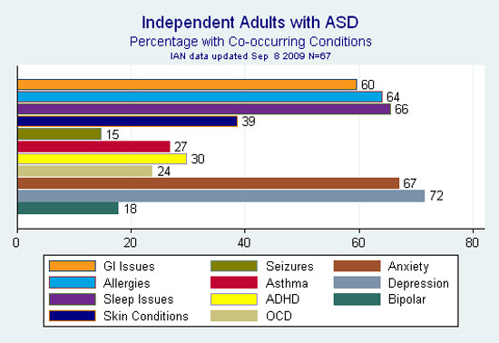
Co-morbid conditions
First Look: Data on Adults on the Autism Spectrum, 2009. http://www.iancommunity.org/cs/ian_research_reports/adults_on_the_autism_spectrum _september_2009
Notes:
Highest—Depression, Anxiety, Sleep Issues→ can all have a direct/significant impact on an adults functioning in college
--Many of our students also have ADHD, and Executive Function Deficits—impact their ability to pay attention class, be productive outside of class. Organize notes, materials etc.

Slide 7
Autism and deafness
social deficits of autism that prevent some children from accessing language – regardless of whether it is signed or spoken
sensory issues that can result in an inability to wear the external components of a cochlear device
difficulties in perspective taking and imitation skills make learning ASL difficult
Numbers of professionals who are capable of offering differential diagnoses with young, deaf children are few and sparsely distributed
Considerable work remains to determine what intervention strategies may prove most successful with deaf children who are diagnosed with ASD
Notes:
further complicate communication development.
All non verbal
accurate diagnosis of ASD is made difficult by the features of many deaf people’s development that result in conditions that can create a presentation that mimics ASD
reverse the direction of their palm while signing. “This suggests differences in how they perceive and imitate others,” he notes, “differences that aren’t revealed in speech.”
Signs – unlike spoken words – look different depending on where you stand
Language deficits can lead to decreased social interaction leads to poor Theory of Mind---social difficulties

Slide 8
Autism and deafness
Language
Interactions
ToM
Connection
Notes:
Language deficits can lead to decreased social interaction leads to poor Theory of Mind---social difficulties
understand that others have beliefs, desires, intentions, and perspectives
Can make it difficult to accurately diagnose ASD

Slide 9
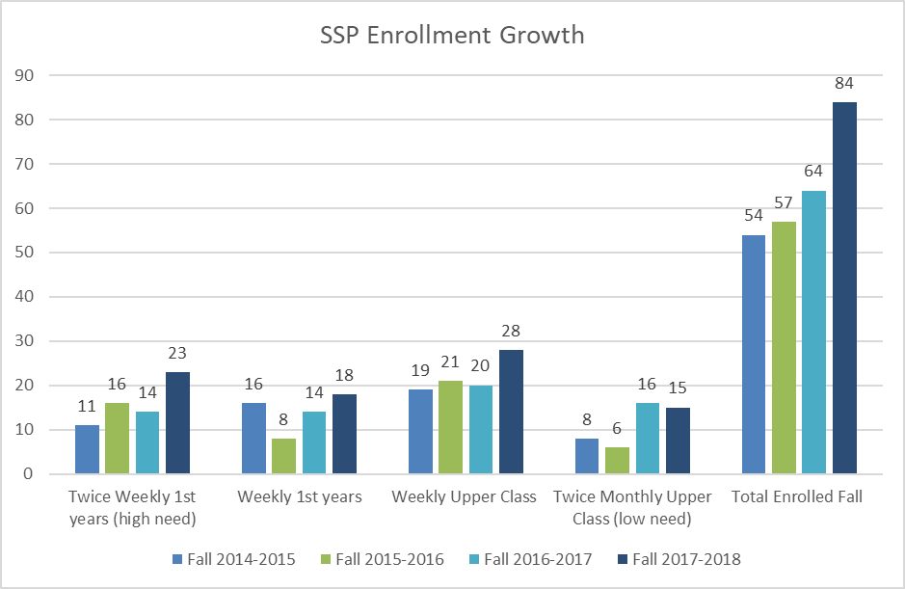
Notes:
RIT 110% increase 2010 to 2018
2014 to 2018 55% increase in just 4 years

Slide 10
Distribution across colleges (2171)
Notes:
GCCIS = 42%
COE = 18%
CIAS = 16%
COS = 11%

Slide 11
Strengths
Average to superior intellect
Passionate commitment to ideas
Strong pursuit of knowledge within areas of interest
Exceptional talents
Creative, out of box thinking
Strong sense of equality and justice
Good visual/spatial learners
Excellent rote memory
Notes:
Distraction- appears disinterested or disengaged
Engage in repetitive behaviors (rocking, tapping, pacing)
Difficulty with vague instructions
Difficulty seeing others point of view
Strong narrow interests
Attempt to monopolize conversation (rude, disrespectful)
Tangential
Difficulty with team work
Trouble suppressing internal thoughts
Difficulty getting started
Inflexibility
Easily overwhelmed/frustrated
BENEFIT FROM
Assistance with building Routine and predictability
Planning, prioritizing, strategizing
Clear rules, boundaries and expectations
Time and space to process
Understanding and support

Slide 12
What we might notice
Oddities in vocal pitch, volume, intonation
May appear distracted
Delays in responding
Can come across as argumentative, rude or monopolizing
Display literal and concrete thinking patterns
May use calming or focusing strategies such as rocking, tapping or pacing
May become easily overwhelmed
Struggle assessing priorities and performance
Heavy reliance on routine
Isolation
Notes:
Distraction- appears disinterested or disengaged
Difficulty with vague instructions
Difficulty seeing others point of view
Strong narrow interests
Difficulty with team work
Trouble suppressing internal thoughts
Difficulty getting started
Inflexibility
BENEFIT FROM
Assistance with building Routine and predictability
Planning, prioritizing, strategizing
Clear rules, boundaries and expectations
Time and space to process
Understanding and support

Slide 13
Standard Accommodations
Extended time on exams
Distraction-reduced testing environment
Note-taking assistance
Textbooks in alternative format

Slide 14
Strategies: What Can we do?
Provide direct feedback
Avoid idioms, metaphors, sarcasm
Assist with planning, prioritizing with building routine and predictability
Supplement oral instructions with written
Set clear rules, boundaries and expectations
Give time and space to process
Offer clarification, understanding and support

Slide 15
Spectrum Support Program
1:1 SSP Coaching
Small group seminars
Case Management
Staff/Faculty Training
Social Events
Career Transition Support
Referrals to campus resources
Pre-Orientation Program

