Slide 1
Student Rights & Responsibilities in the Classroom
In 30 minutes, we will:
Review RIT Policies
Discuss a Few Cases
Open Discussion

Slide 2
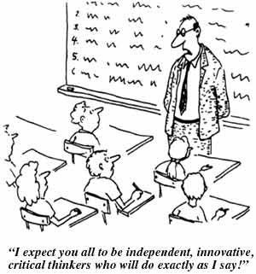
Teaching is challenging!

Slide 3
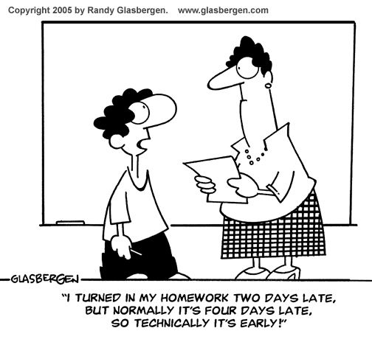
Setting expectations from the beginning avoids misunderstanding (I.E using the syllabus)

Slide 4
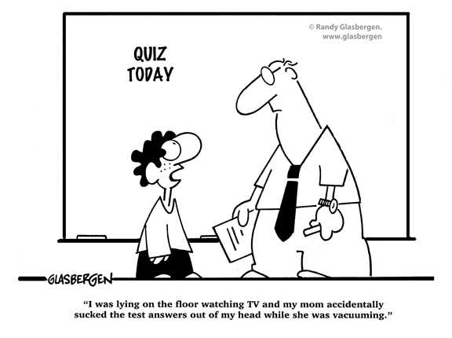
Benefits of Using the syllabus (or “how to prepare for the unexpected”)

Slide 5
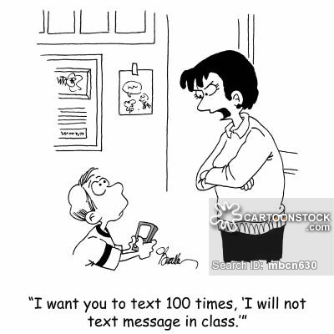
Be Consistent

Slide 6
The Syllabus can generally contain: (There is no specific RIT policy)
Overview of your class
How you will teach and your teaching philosophy
Specify how students can succeed in your class
Maintain an encouraging and friendly tone
Discuss in-depth during your first class
Put online as well as distribute an abridged version

Slide 7
The Syllabus can contain…continued…
Be specific:
Assignment expectations
Grading policy
Behavioral and academic expectations (and a way to measure it)
Schedules and Deadlines
Department policies and expectations (technology use in CR, penalties, extensions, sick days, etiquette…)
University policies and expectations as well as consequences (plagiarism, behavior)…
….all this helps to avoid potential classroom management issues.

Slide 8
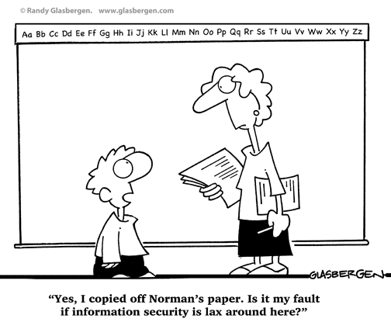
What to do if challenged? (and you will be!)

Slide 9
If Challenged in class:
Always adopt a position of “thank you for asking such a good question; other students are probably asking that question too”
Deflect the ‘but, what if….(add terrible disaster here)” to discuss after class.
If it cannot be addressed in 10 seconds, call for a “after-class” meeting (with enthusiasm!). The classroom is not the place to debate your policies and expectations.
Never be curt, eye rolling or embarrassing :--}
Never disregard a question or statement.
Others from your experience?....

Slide 10
What does RIT Policy Say?
University Policies: Student Library Policies (click to show all policies)
Attendance (D04.0 Summary):
3 Parts:
Student Responsibilities
Instructor Responsibilities
Expulsion of Students from Class

Slide 11
What does RIT Policy Say?
1. Student Responsibilities
It is the responsibility of all students to attend their scheduled classes regularly and punctually in order to promote their progress and to maintain conditions conducive to effective learning.
Absences, for whatever reason, do not relieve students of their responsibility for fulfilling normal requirements in any course. In particular, it is the student's responsibility to make individual arrangements in advance of missing class due to personal obligations such as religious holidays, job interviews, athletic contests, etc., in order that he or she may meet his or her obligations without penalty for missing class.
(My paraphrase: You can make class attendance mandatory and base grades on it, but you must announce this and have some kind of system to show you are keeping attendance, (if ever challenged)…

Slide 12
What does RIT Policy Say?
II. Instructor Responsibilities (D04.0 Summary):
Instructors are not required to maintain formal attendance records of students in their classes. As cases of serious absences become known, the student's advisor or department should be notified.
Each instructor is required to review their class lists every term and report non-attending students to the Office of the Registrar.

Slide 13
What does RIT Policy Say?
III. EXPULSION OF STUDENTS FROM CLASS
An instructor may expel a student from class for no more than one class session. If the instructor wishes to exclude the student for a longer period, a recommendation must be made in writing to the head of the department in which the course is offered. The written recommendation must include all supporting information. Appeal of a sustained expulsion for longer than one class session can be made by the student. See D18.0 - RIT Student Conduct Process and D08.0 - Student Academic Integrity Policy.

Slide 14
What does RIT Policy Say?
D18.0 - RIT Student Conduct Process
IV. RIT Standards of Conduct
Students and Student organizations are expected to conduct themselves in ways that support the university's mission. The behaviors outlined in these standards are inappropriate and do not support the university's mission. They are listed below to provide Students with information about the university’s expectations for community behavior. Students engaging in inappropriate behaviors, including but not limited to those behaviors listed below, will be afforded the opportunity to participate in the process outlined in the Student Code of Conduct.

Slide 15
What does RIT Policy Say? D18.0 - RIT Student Conduct Process Inappropriate behaviors:
Fire/Fire Safety
Unauthorized Access
Violation of Law
Weapon Possession
Gambling
Failure to be a Responsible Host
Dishonest Behavior
Violation of RIT Policies
Code of Conduct for Computer and Network Use
Endangering Behavior
Alcohol and Other Drugs Policy
Harassment
Discrimination
Retaliation
Disruptive/Disorderly Behavior
Theft
Property Damage
Refusal to Comply
Hazing/Failure to Report Hazing

Slide 16
What does RIT Policy Say?
D08.0 STUDENT ACADEMIC INTEGRITY POLICY
IV. ACADEMIC INTEGRITY
A breach of student academic integrity falls into three basic areas:
cheating,
duplicate submission and
plagiarism

Slide 17
What does RIT Policy Say?
D08.0 STUDENT ACADEMIC INTEGRITY POLICY
IV. ACADEMIC INTEGRITY
Cheating: Cheating is any form of fraudulent or deceptive academic act, including falsification of data, possessing, providing, or using unapproved materials, sources, or tools for a project, exam, or body of work submitted for faculty evaluation.

Slide 18
What does RIT Policy Say?
D08.0 STUDENT ACADEMIC INTEGRITY POLICY
IV. ACADEMIC INTEGRITY
Duplicate Submission: Duplicate submission is the submitting of the same or similar work for credit in more than one course without prior approval of the instructors for those same courses.

Slide 19
What does RIT Policy Say?
D08.0 STUDENT ACADEMIC INTEGRITY POLICY
IV. ACADEMIC INTEGRITY
Plagiarism: Plagiarism is the representation of others’ ideas as one’s own without giving proper attribution to the original author or authors. Plagiarism occurs when a student copies direct phrases from a text (e.g. books, journals, and internet) and does not provide quotation marks or paraphrases or summarizes those ideas without giving credit to the author or authors. In all cases, if such information is not properly and accurately documented with appropriate credit given, then the student has committed plagiarism.

Slide 20
What does RIT Policy Say?
D08.0 STUDENT ACADEMIC INTEGRITY POLICY
V. Procedures for Handling Alleged Breaches of Academic Integrity
The course instructor bringing the allegation forward is responsible for assembling evidence and making an initial determination of appropriate action to be taken, up to and including failing the student in the course.
Notify the student in writing…
Set up a meeting to discuss the allegation, if not resolved,
Set up a meeting with the Instructors academic unit head…
Then Dean or Dean’s delegate
Then the Academic Integrity Committee…
See D08.0 for more details…

Slide 21
Instructor Challenges & Competition of Priorities:
You want a positive SRS review
You want your students to learn and acquire knowledge
You want to be well liked
You want promotion, tenure, positive review
Some students don’t want to do the work…
It is ok to negotiate …today’s students !!!

Slide 22
Case Studies:
The students in your class have decided that your reading assignments are too much for them and they want you to teach them the contents of each chapter of the book during class time. Do you:
Say “too bad, you have to learn to read anyway so might as well start now
Cave in and agree to teach from the book so they don’t have to read much
Express your desire for self learning, how it will be necessary on the job and in life and make opportunities for directing them or offering extra reading assistance each week….(one option)
Other strategies???

Slide 23
Case Studies:
One student in your 8:00 am class is constantly falling asleep. Do you:
Constantly wake them up and tell them to pay attention
Ask other students to wake them up
Let them sleep, it’s their responsibility to pay attention and learn the material
….What do you think???

Slide 24
Resources
Department of Counseling and Academic Advising Services:
Counselors are:
confidential
provide services to students, staff and faculty
Know the students
Any counselor you know or work with is fine
Colleagues – talk to someone who you respect. Classroom management is difficult and challenging, there is no shame in reaching out to others
Yourself:
Remind yourself why you are here
Remember that unruly behavior is typically a symptom of some other situation or problem in the student’s life…

Slide 25
Discussion….Questions???

