Slide 1
NTID/RIT STUDENTS
COMMUNITY BUILDNG

Slide 2
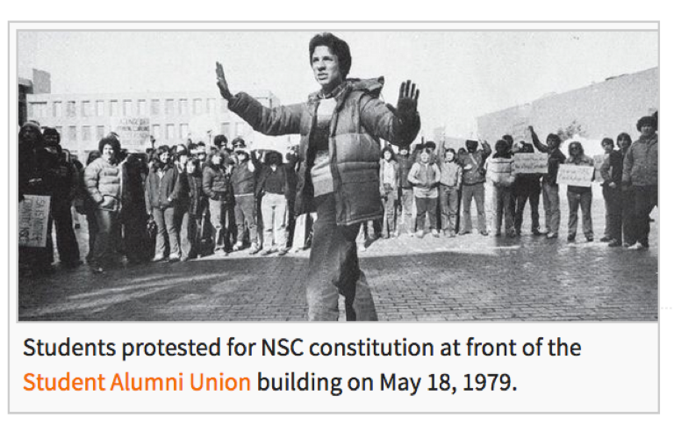
NSC 1979
RIT Protests. Reporter magazine online. (November 16, 2006)
https://ritpedia.rit.edu/NTID_Student_Congress#cite_note- reporterissuephoto-5

Slide 3
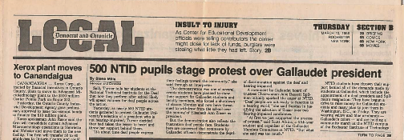
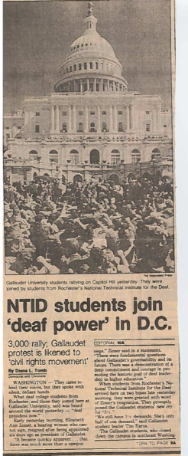
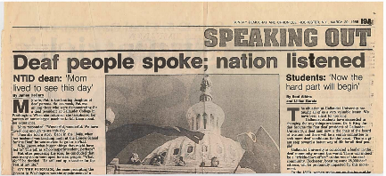
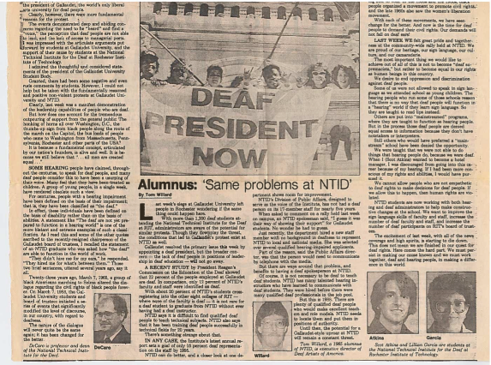
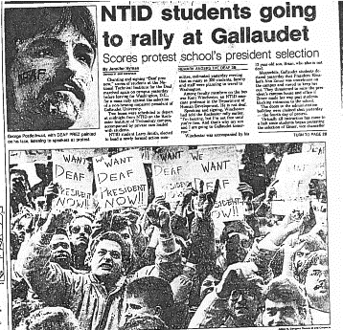
DPN 1988 SOLIDARITY
Newspaper clippings courtesy of Scot Atkins

Slide 4
OUTCOME
Gallaudet get its first Deaf President in 124 years (1988 I King Jordan)
NTID got its first Deaf VP in 26 years (1996 Davila) title did not change to president until Hurwitz

Slide 5

CAMPAIGN FOR ACCESS NOW (CAN) 1991-1992
https://ritpedia.rit.edu/NTID_Student_Congress#cite_note- reporterissuephoto-5

Slide 6

VIDEO CLIP ANTHONY DIGIOVANI

Slide 7
OUTCOME
More TTYs on campus
More signing campus safety members
Higher expectations of faculty signing

Slide 8
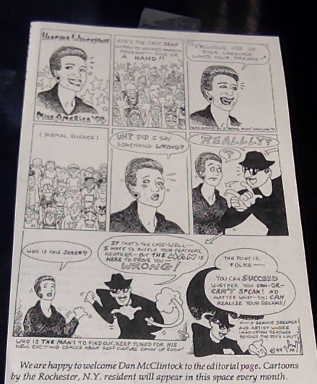
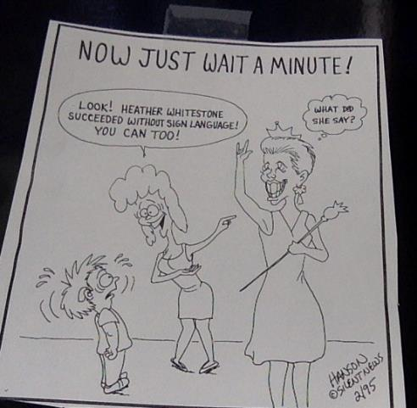
HEATHER WHITESTONE AT NTID 1995

Slide 9
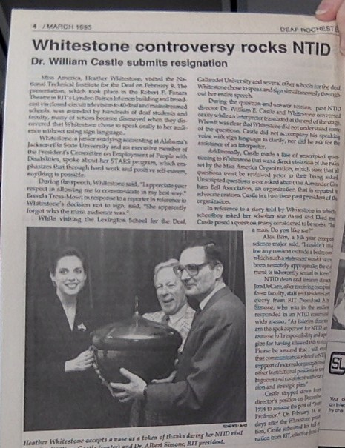
Deaf Rochester March 1995 Vol 1 No. 3

Slide 10
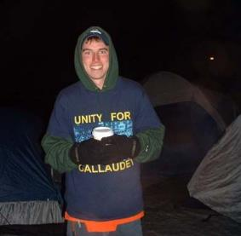
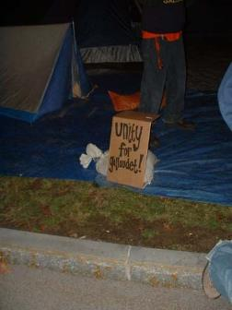
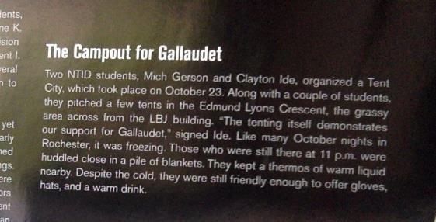
UNITY FOR GALLAUDET TENT CITY OCT 2006
Claytton Ide
https://rochesterfssa.wordpress.com/
Reporter Nov 10, 2006 Vol 56 Issue 10

Slide 11
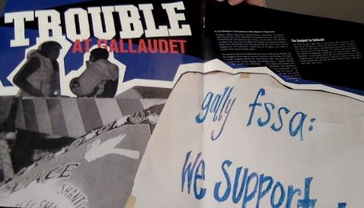
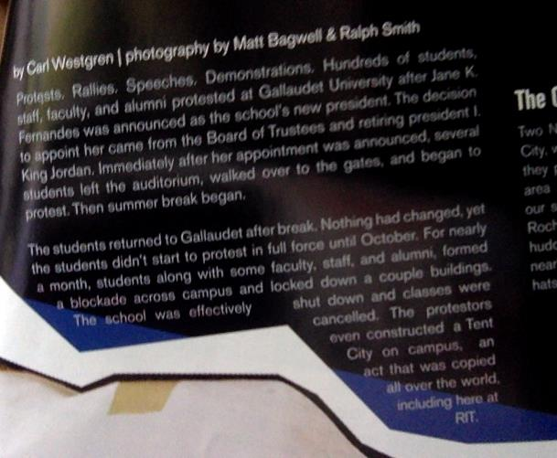
Reporter Nov 10, 2006 Vol 56 Issue 10

Slide 12
OUTCOME
JK Fernandes was terminated as president for Gallaudent University
Robert Davila became president
Alan Hurwitz became president
Now Bobbi Cordano is president
Reaffirms the importance of solidarity with sister college

Slide 13
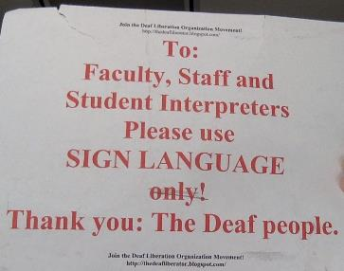
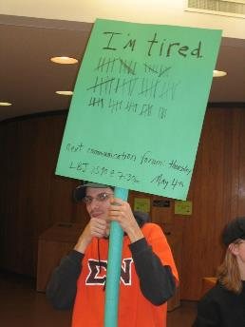
SILENT PROTEST FOR SIGNING IN PUBLIC PLACES 2006
http://thedeafliberator.blogspot.com/

Slide 14
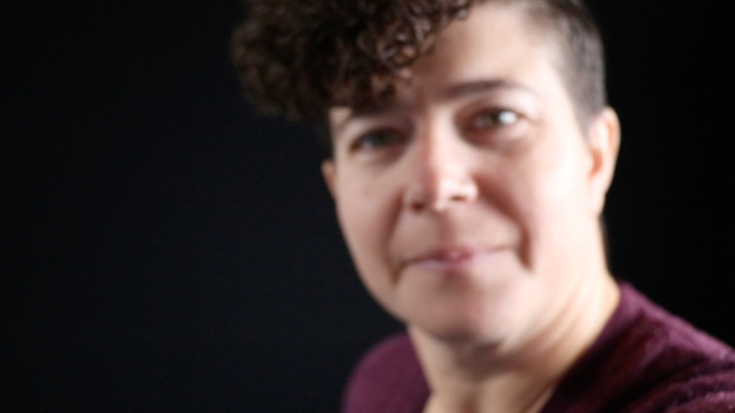
VIDEO CLIP FROM LIZZIE SORKIN

Slide 15
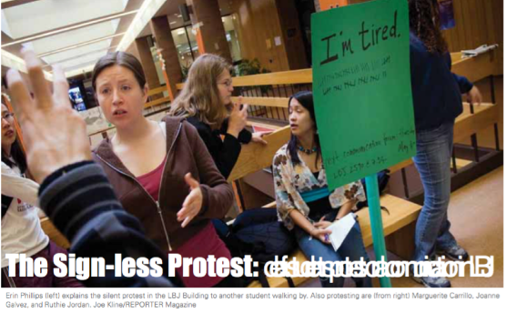
”OUTCOME
“Respect” Posters
Signing in public places committee
Reporter Mag May 5, 2006
reportermagarchive.com/staff/pdfs/2006_05_05.pdf

Slide 16
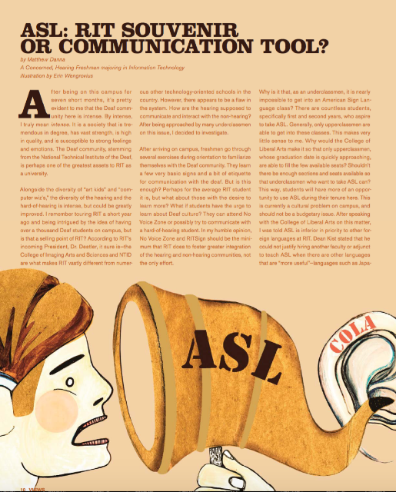
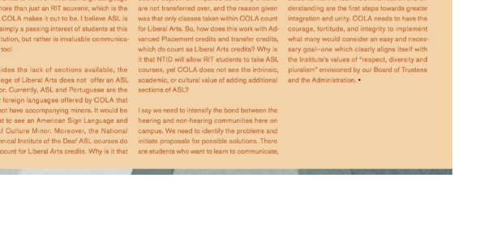
ASL CLASSES FOR COLA
Reporter Mag.2006_Vol56No23

Slide 17
OUTCOME
Increase of ASL courses for CLA
Leads to Minor/Immersion in ASL / Deaf Cultural Studies
RADSCC

Slide 18

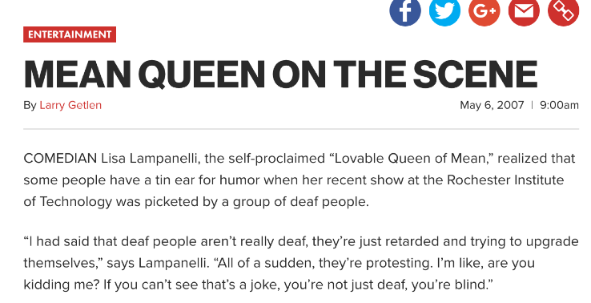
LISA LAMPENELLI 2007
Reporter march 16, 2007 Vol.
56 Issue 21

Slide 19
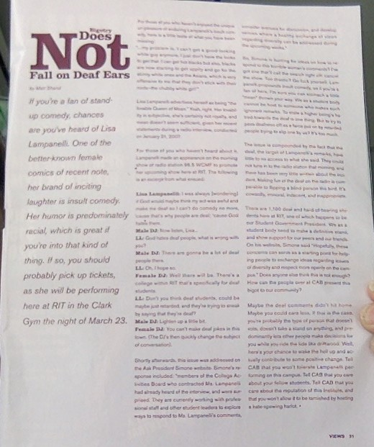
Reporter march 16, 2007 Vol. 56 Issue 21

Slide 20
OUTCOME
Dangerous Discussions
Teachable Moments
1st Amendment over hate speech
Bias incidents

Slide 21
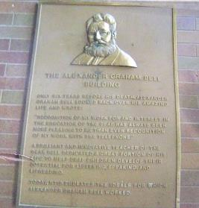
AG BELL DORM AND PLAQUE 2008
Text from the plaque:
Only six years before his death,Alexander Graham Bell looked back over his amazing life and wrote:
“Recognition of my work for and interest in the education of the deaf has always been more pleasing to me
than even recognition of my work with the telephone.”
A brilliant and innovative teacher of the deaf, Bell dedicated a great portion of his life to help
eaf children develop their potential for listening, speaking, and lip-
reading.
Today, NTID emulates the ideals of which Alexander Graham worked.

Slide 22
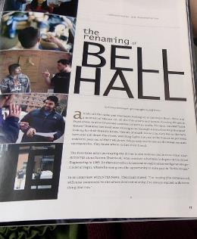
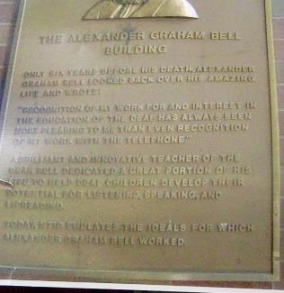
AG BELL DORM AND PLAQUE 2008
Video clip Ruthie Jordan
http://orangebrownrit.blogspot.com/2008/04/ag-bell-plaque-dormpetition.html
Petition video https://www.youtube.com/watch?v=3qq9LVkq_VQ
ruthie 50 year reuion https://www.facebook.com/168758442874/videos/10155945762117875/
Reporter march 21, 2008 Vol 57 Issue 23

Slide 23
VIDEO CLIP RUTHIE JORDAN
https://youtu.be/DCjeYUZcHac

Slide 24
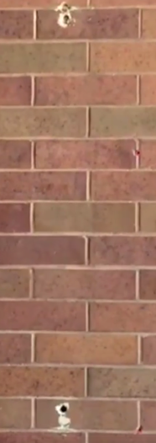
OUTCOME
Community engagement including alumni
Plaque came down and was melted
Dorm is no longer called Bell Dorm

Slide 25
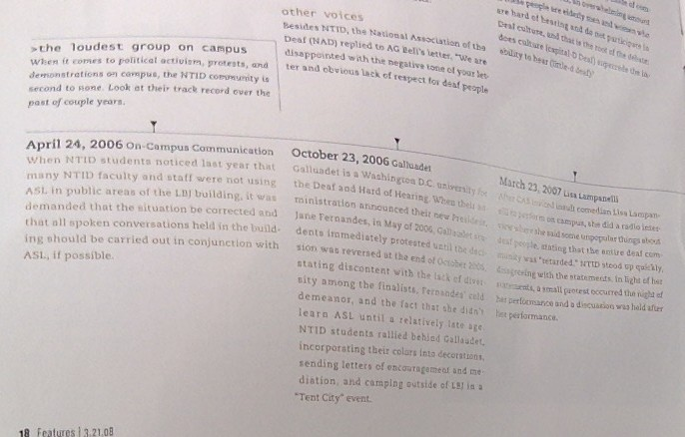
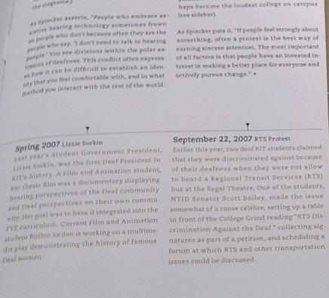
Reporter march 21, 2008 Vol 57 Issue 23

Slide 26


COMMUNICATION ACCESS NOW (CAN) & EBONY CLUB
Video clips Josh Mora & Demara Jeanty

Slide 27
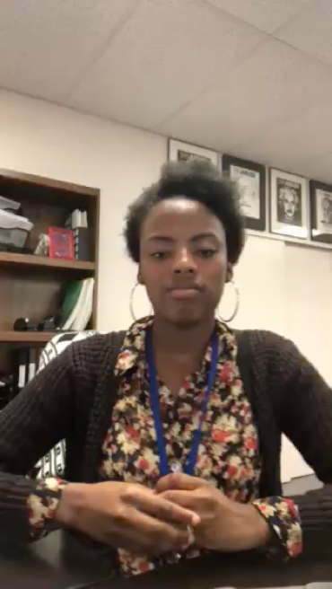
DEMARA JEANTY

Slide 28

JOSH MORA

Slide 29
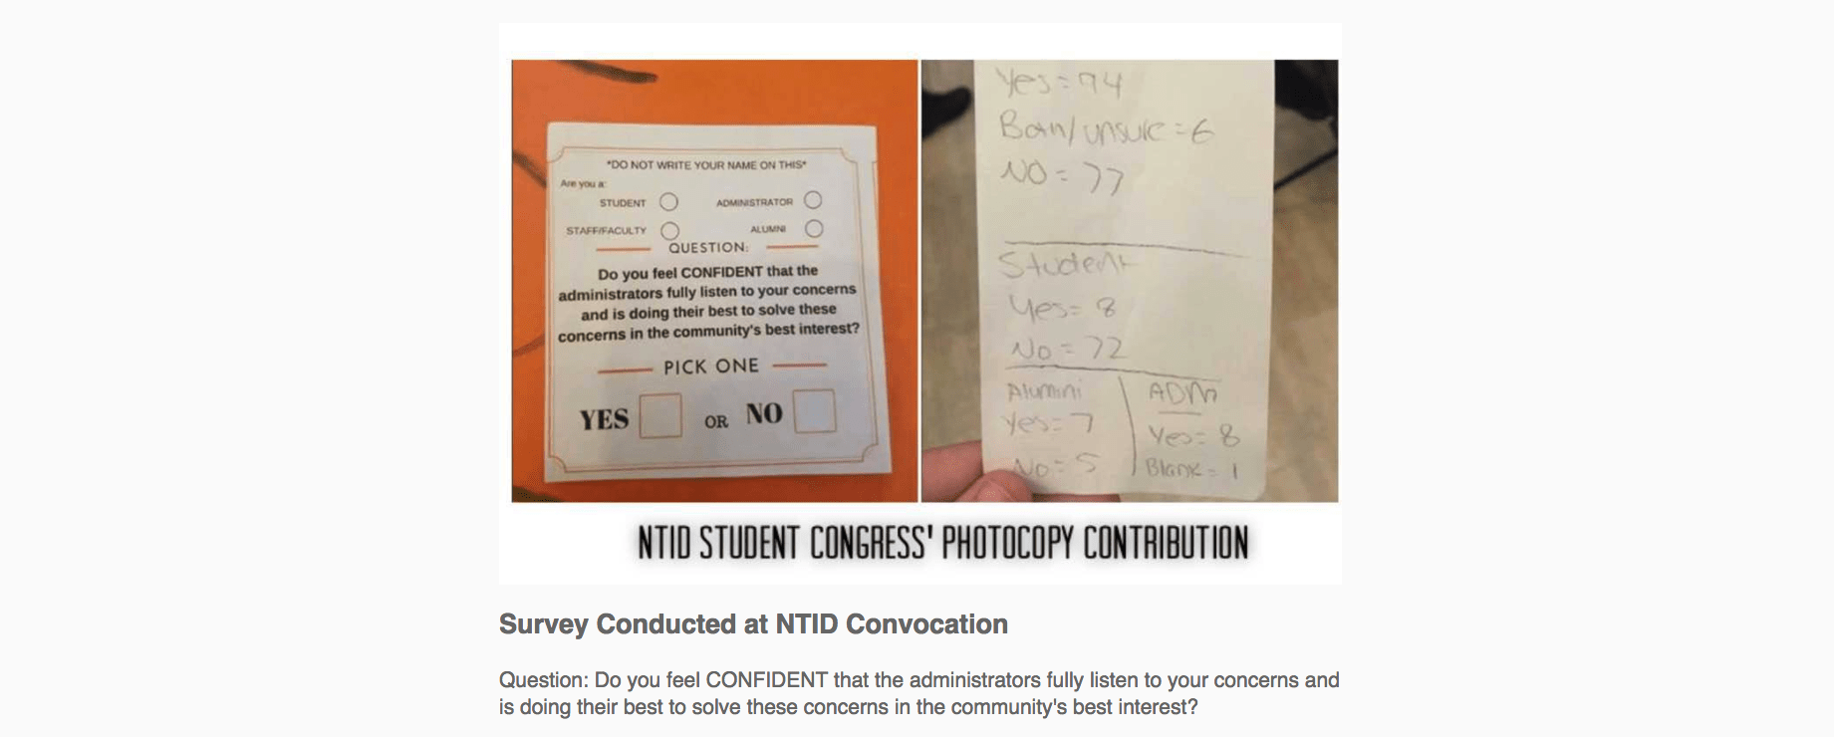
DPAN coverage https://handeyes.wordpress.com/2016/12/17/dpan-dtv-news-covers-convocation-controversy- more/
Ebony club letter
https://docs.google.com/document/d/1s9QXmYYI5Zhv0YjabYjSYKwtmxkmSddaqAfocMmO_q4/edit
CAN letter https://drive.google.com/file/d/0B4qgIGViQcZNSmE2Z0huSGMxemw1Vi0wM0x2Q2ZrSHdvRGVV/view
Tigerstripes
https://us9.campaign- archive.com/?u=9bc8e90a19e5a450777179b4c&id=2ebb5ff4eb

Slide 30
OUTCOMES
Hiring of Diversity and Inclusion officer (We love and miss you Stephanie)
Deaf culture, Diversity and Intersectionality training
Push for searches to include POC and hiring of POC
Can request interpreters for NTID classes
Change in administration
Increased level of SLPI requirement for faculty?
Bilingual community?

Slide 31
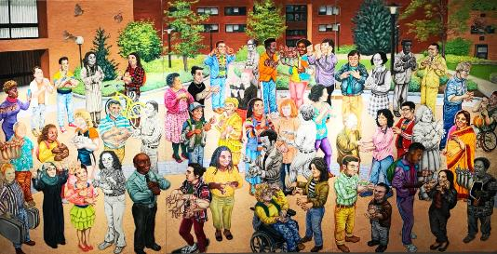
OVERRIDING THEME OF
STUDENT COMMUNITY BUILDING
“TOGETHER” TRIPTYCH BY SUSAN DUPOR
LANGUAGES
ACCESS
DIVERSITY
RESPECT REPRESENTATION
If we commit to LADRR then the
next 50 years of the Grand Experiment will be GRAND.

