Slide 1
Study Abroad at NTID/RIT
Erin Esposito
Dept. of Liberal studies

Slide 2
RIT’s Vision: Study Abroad

Slide 3
Types of Study Abroad Programs
Global Campus Programs
students to directly enroll in one of RIT’s international campuses located in Croatia, Dubai, Kosovo, and China
Faculty-Led Programs
are designed and developed by RIT faculty members, who lead a group of students on a short-term program abroad. Programs vary in length (between one to five weeks) and may take place over intersession, spring break or summer
Exchanges
are culturally immersive programs that allow a student to directly enroll in a local university and are usually major specific
Affiliate Programs
are facilitated by partner universities and organizations to enhance the variety of locations and course offerings available to students
International Research
opportunities allow students to conduct research abroad at one of RIT's approved overseas partners with the guidance of an RIT faculty member.

Slide 4
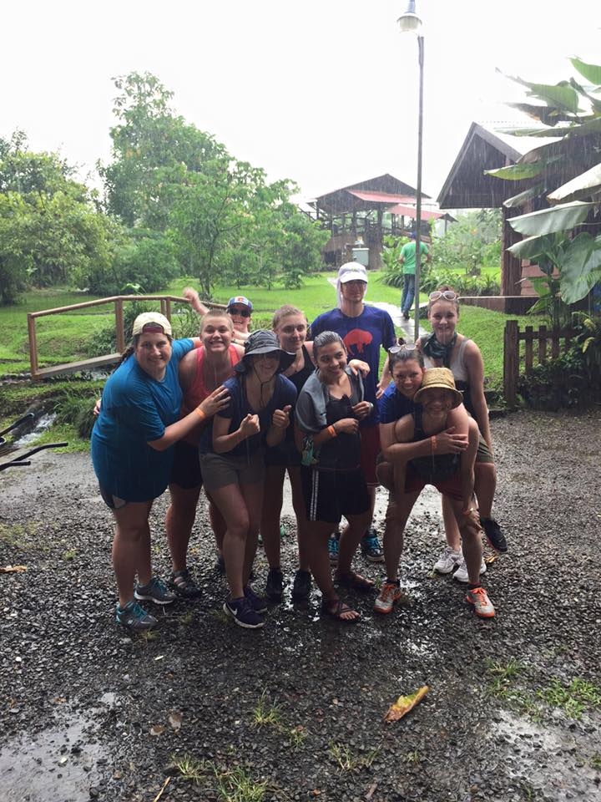
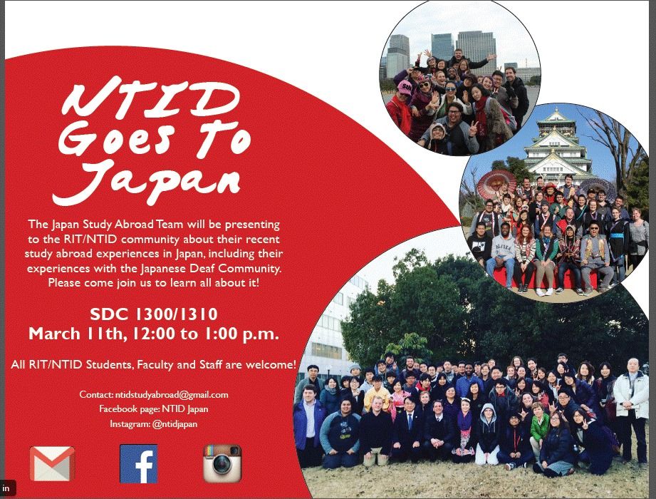
NTID Faculty-Led Programs

Slide 5
NTID Faculty-Led Programs (2014-2018)
2014: Chile
2015: Chile & Costa Rica
2016: Costa Rica
2017: Japan & Italy
2018: Japan
2019: Russia
Tentative Countries (still in process of proposals)
France
Cambodia
Sweden
Italy

Slide 6
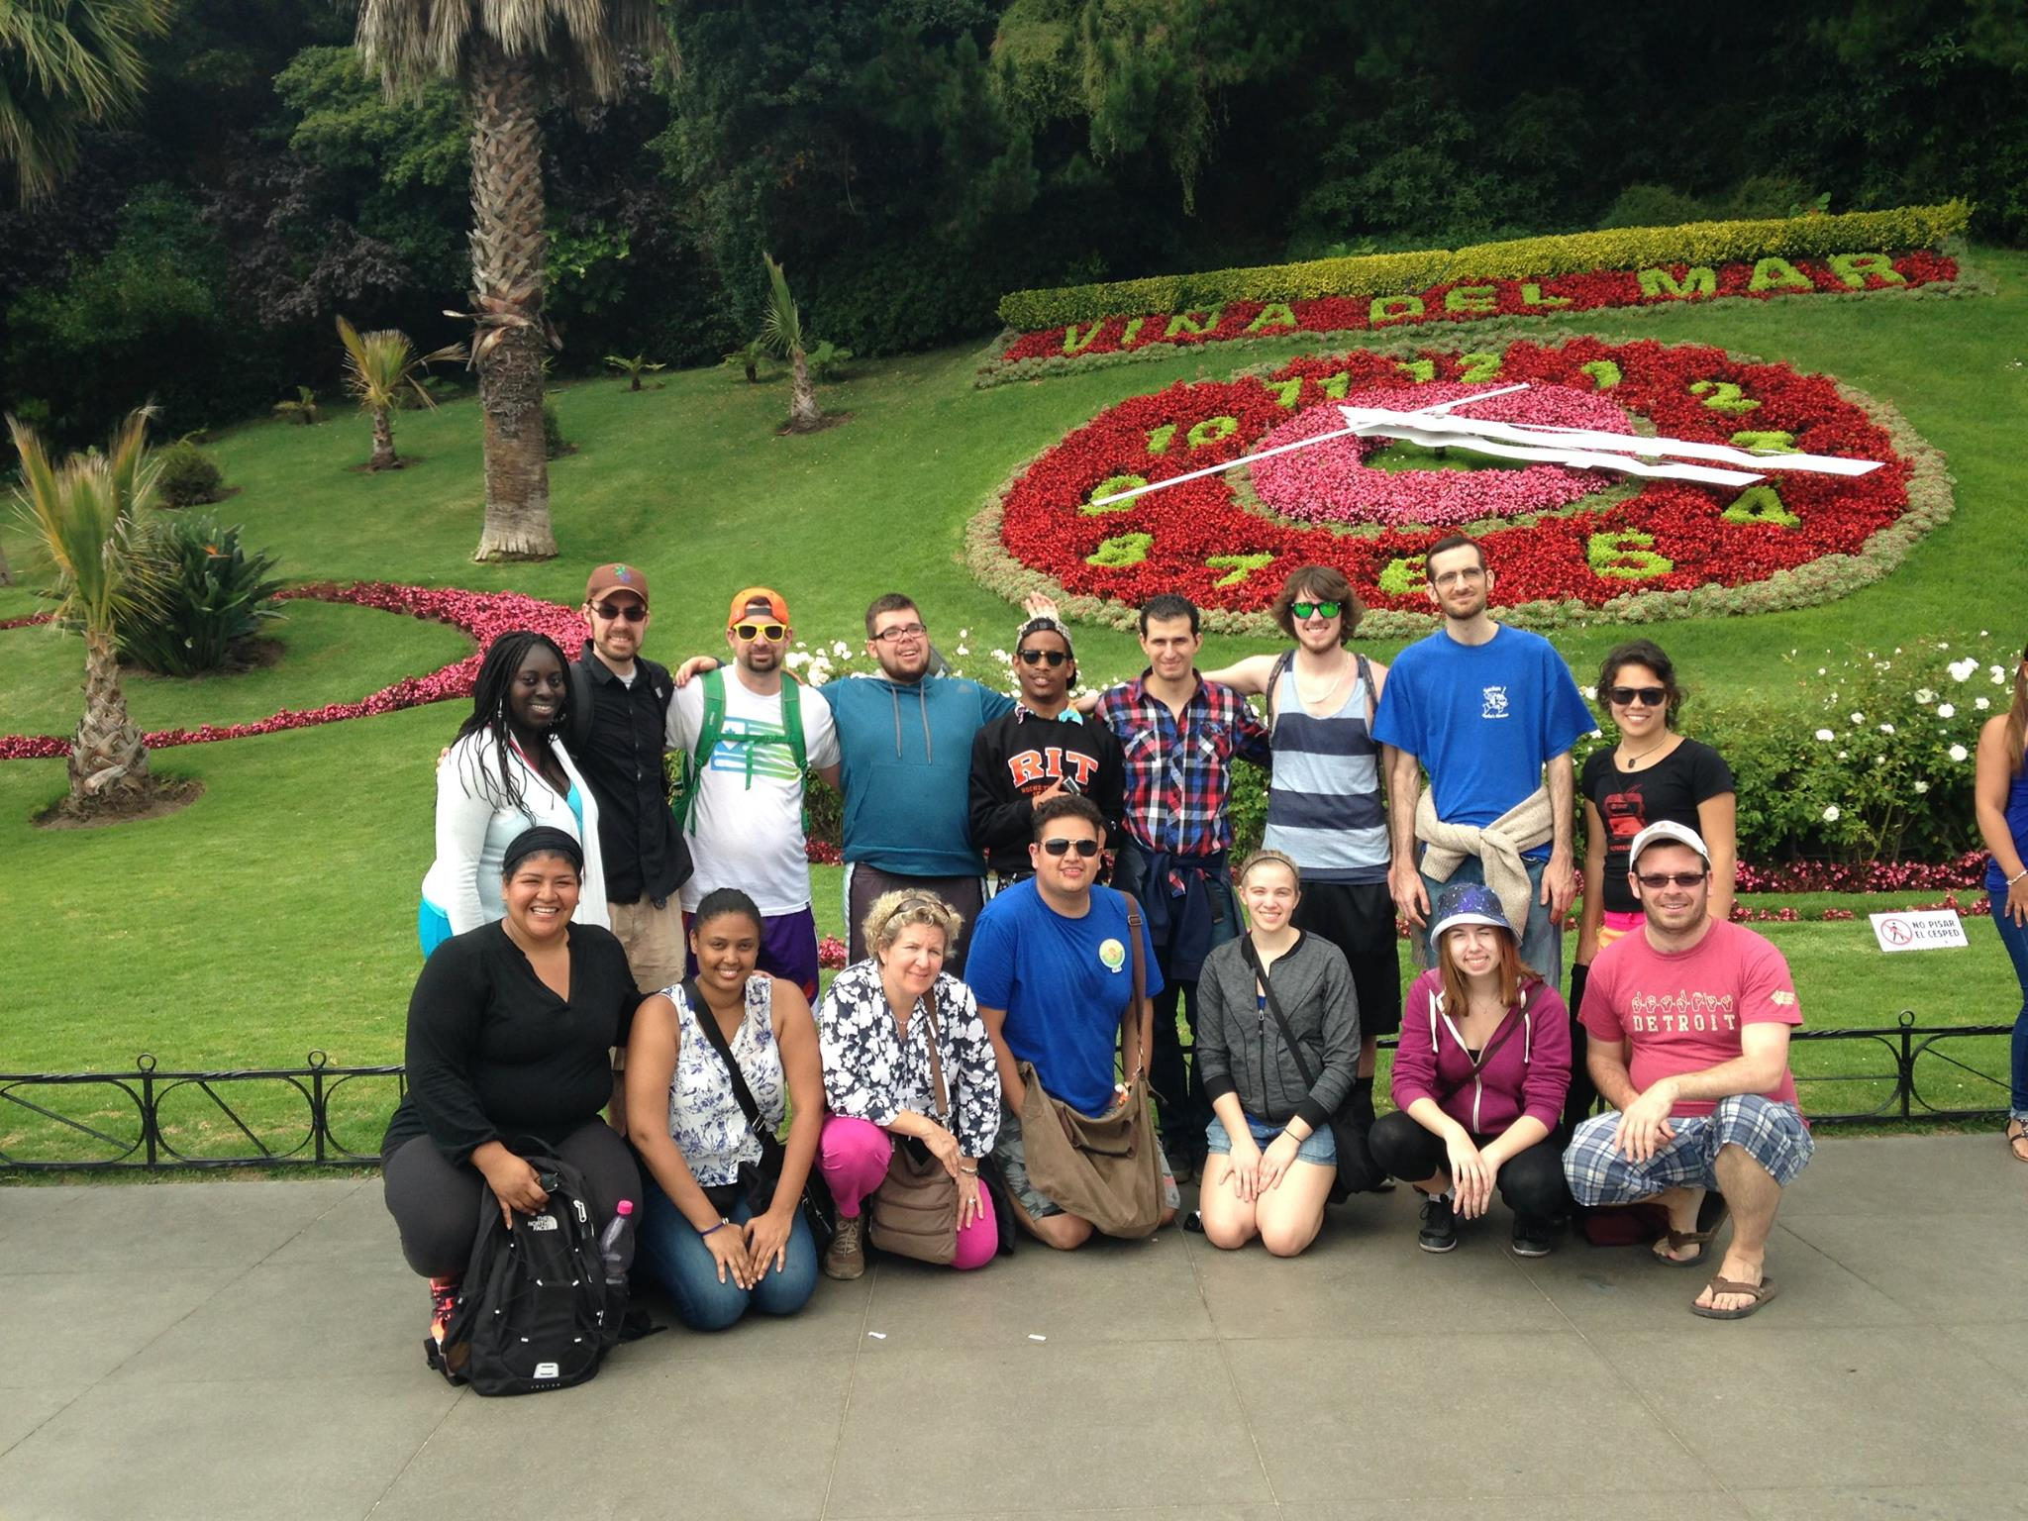
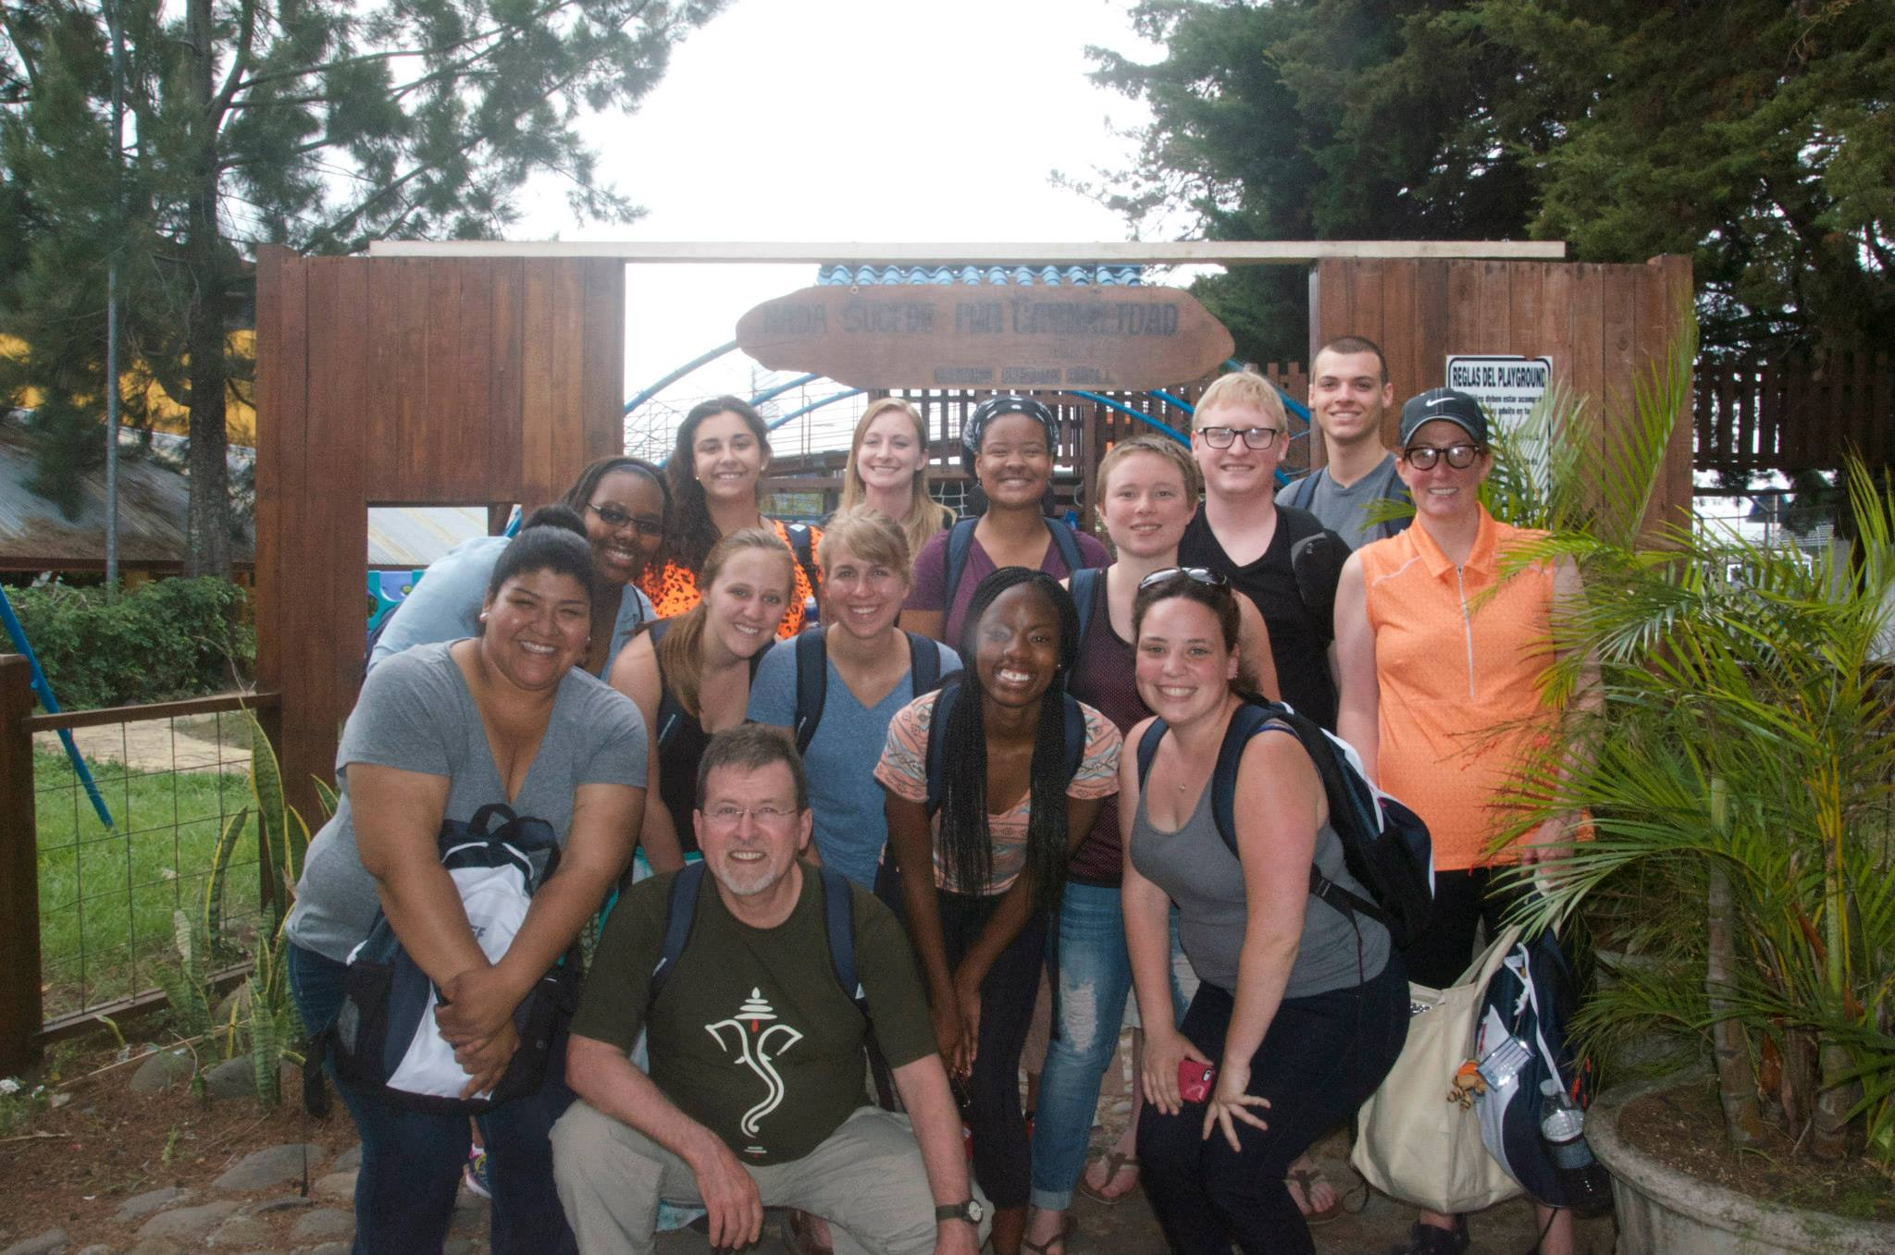
NTID Faculty-Led Programs

Slide 7
How to Apply for a Faculty-Led Program
Timeline
Paperwork
Phase I
Phase II
Selection Process

Slide 8
Faculty-Led Proposal Phase I
Outline the academic rationale for your program. Present it to your Department Chair and Dean for review and approval. Submit final document and approval to the Education Abroad office.
Faculty-Led Proposal Phase II
Outline program and travel logistics. Submit the final document to the Education Abroad office for approval by Risk Management and RIT Global.
Budget Planning
Estimate program costs. Once you’ve done some research, you’ll bring this to a meeting with Education Abroad to build the total program budget as well as the student budget.

Slide 9
Site Visits
Strongly encourage faculty-directors to conduct an in-person site visit
better understand how to integrate the culture into the curriculum, to evaluate the site for safety concerns, to make connections and do some logistic and budget planning.
The International Education and Global Programs office offers site visit grants.

Slide 10
Things To Consider
From personal commitment to cultural immersion, there are important topics to consider when developing a program such as:
Support
Program Structure
Location
Logistics
Safety
Cost

Slide 12
Student Application Deadlines
Fall Semester, Fall/Winter break (travel enhancement), Summer/Fall (travel enhancement): April 15
Spring Semester, Winter break/Spring (travel enhancement), Spring/Summer (travel enhancement): October 15
Summer: March 1

Slide 13
Educational Component: NDLS 280
Original model 6 credits (preparation (3) and integration (3))
Faculty member must teach a 3 credit hour course
Global Perspectives Course
Linguistic and Cultural Competencies to maximize learning on trip
Students must give a presentation to the NTID/RIT community after the trip in order to receive full credit for the course

Slide 14
