Slide 1

Lessons Learned From 2020 NIH Virtual Seminar
Hans Schmitthenner, PhD, Research Professor
School of Chemistry & Materials Science
Terry Koo, PhD, Research Development Specialist,
Personalized healthcare Technology
Notes:
Good afternoon. Thank you for joining us. Few months ago, NIH held the first-ever virtual seminar on program funding and grant administration. In this presentation, our goal is to highlight some topics discussed in the virtual seminar, and point you to additional resources if you are interested in learning more about NIH grants process, policies, and programs.

Slide 2
Overview
NIH 2020 Virtual Seminar Resources
PHT180 Grant Writing Resources
Finding NIH ICs that match
Funding options across the career path
Career Development Awards (K-award)
Next Generation Researchers Initiative
Diversity Supplements (covered by Dr. Hans Schmitthenner)
Notes:
Here is my plan for today’s presentation. First, I will introduce the NIH Virtual Seminar Resources as well as the PHT180 Grant Writing Resources that we put together recently. Next I will talk about some specific topics including NIH Matchmaker, Career Development Awards, and NIH’s Next Generation Researchers Initiative. After these, Dr. Hans Schmitthenner will share his first-hand experience on diversity supplement applications with us.

Slide 3
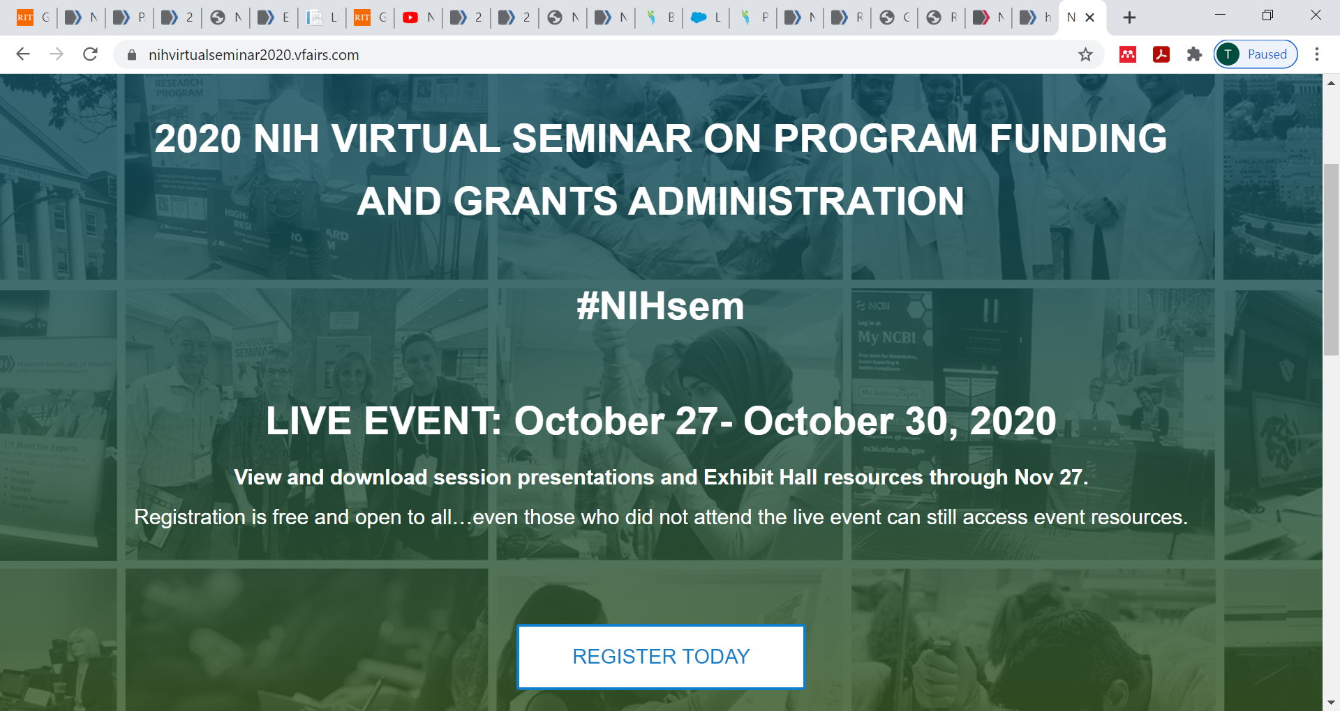
https://grants.nih.gov/virtual-seminar-2020/presentations.html
Notes:
I am not sure anyone here join some of the sessions of the NIH virtual seminar? The good news is, even if you missed it, you can still access the event resources either through the website listed here or

Slide 4
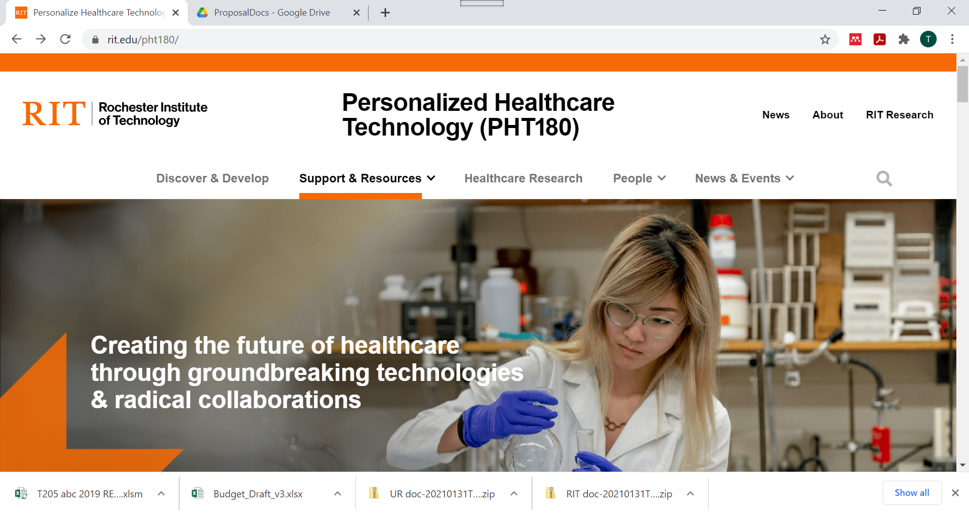
Notes:
Go to pht180 website. click on “support & resource”,

Slide 5
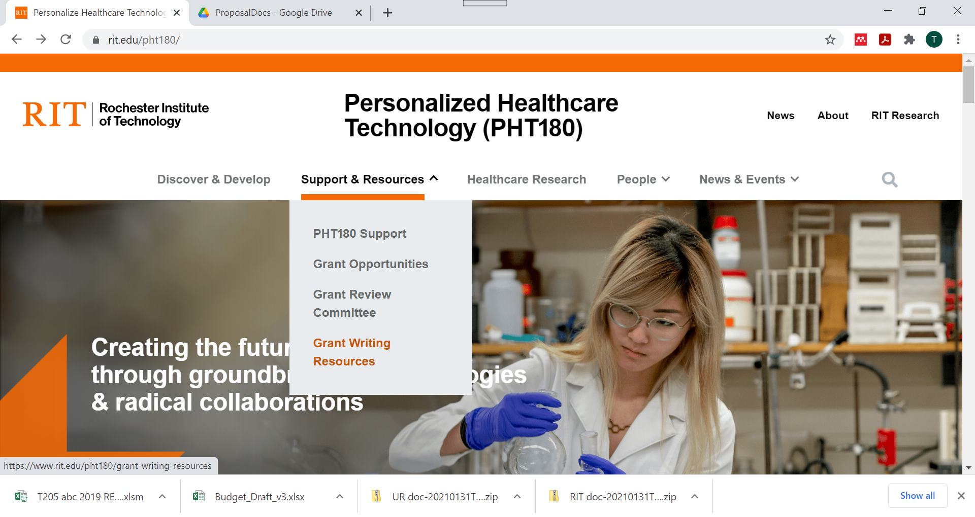
Notes:
and then click on “Grant writing resources”.

Slide 6
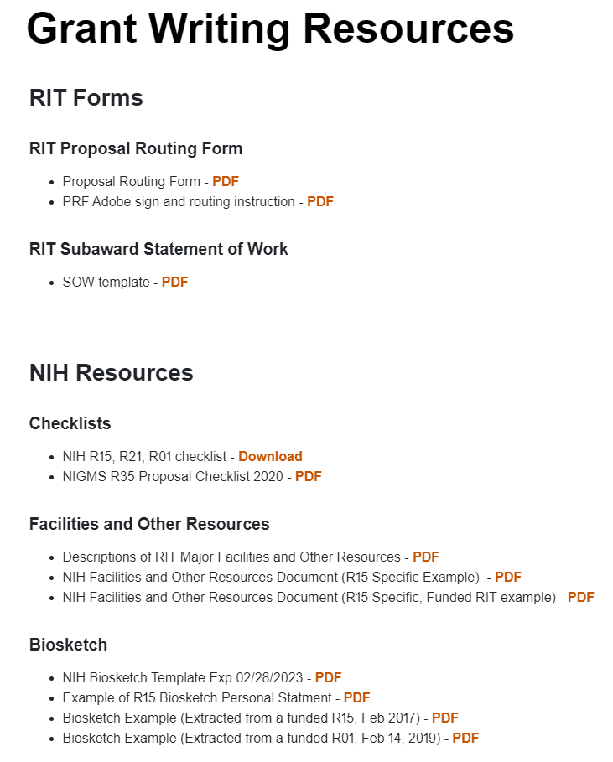
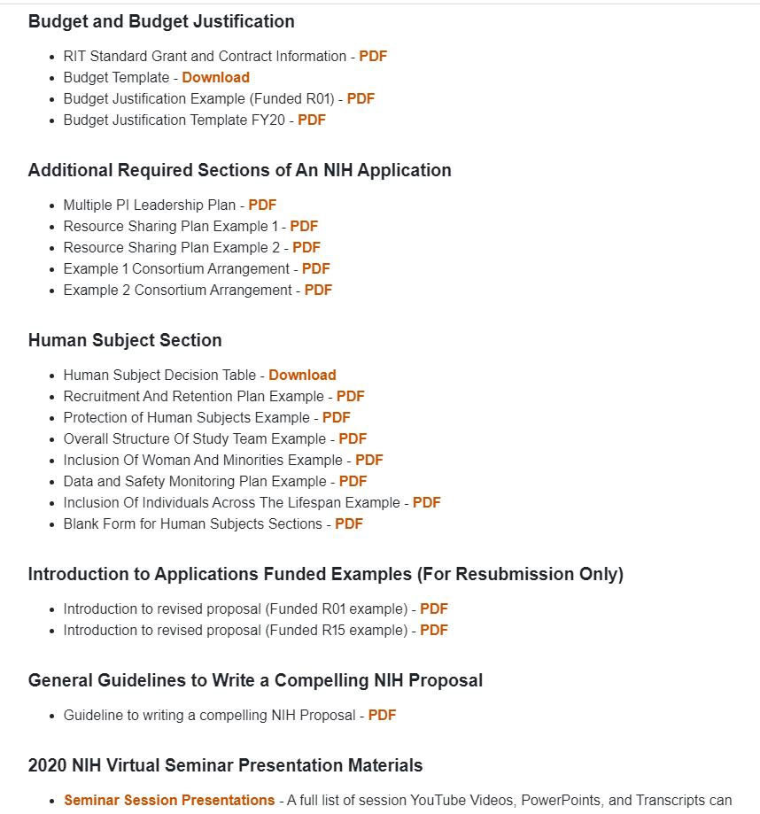
be accessed directly through the NIH website.
Notes:
You will be directed to login the resource page using your RIT username and password if it is your first time to access the materials. Click on “2020 NIH Virtual Seminar Presentation Materials”,

Slide 7
2020 NIH Virtual Seminar Presentation Materials
https://www.rit.edu/pht180/
57 presentations (including video, PowerPoint, and script) in topics related to NIH grants process, policies, and programs.
Selected topics include:
Fundamentals of the NIH Grants Process and Need-to-Know Resources
Navigating NIH Programs to Advance Your Career
Grant Writing for Success
Rigor and Reproducibility: Back to Basics
Understanding NIH Career Development "K" Awards
NIH Peer Review: "Live" Mock Study Section
Notes:
which will redirect you to over 57 presentations (including video, PowerPoint, and script) in topics such as Fundamentals of the NIH Grants Process and Need-to-Know Resources, Navigating NIH Programs to Advance Your Career, Grant Writing for Success, and NIH Peer Review: "Live" Mock Study Section, just to name a few.

Slide 8
be accessed directly through the NIH website.
Notes:
In the grant writing resources page, you can find checklists for common NIH funding opportunities, and sample documents and templates for facilities and Other Resources, Biosketch, Human Subject Section, and other documents such as resources sharing plan, consortium arrangement, etc. Special thanks to those faculty who let us share their examples in our website. I encourage you to leverage these valuable resources to facilitate your future NIH grant application. If you have any questions, please feel free to contact me. Our future plan is to expand the resources page to incorporate similar materials for NSF grants.

Slide 9
NIH includes 27 Institutes and Centers (IC)
Office of Extramural Research
Division of Biomedical Research Workforce (DBRW)
Office of the Director
Office for Scientific Workforce Diversity
Office Intramural Training and Education
National Institute
on Aging
National Institute
on Alcohol Abuse
and Alcoholism
National Institute
of Allergy and
Infectious Diseases
National Institute
of Arthritis and
Musculoskeletal
and Skin Diseases
National Cancer
Institute
National Institute
of Child Health
and Human
Development
National Institute on
Deafness and Other
Communication
Disorders
National Institute
of Dental and
Craniofacial
Research
National Institute
of Diabetes and
Digestive and
Kidney Diseases
National Institute
on Drug Abuse
National Institute
of Environmental
Health Sciences
National Eye
Institute
National Institute
of General
Medical Sciences
National Heart,
Lung, and Blood
Institute
National Human
Genome Research
Institute
National Institute
of Mental Health
National Institute
of Neurological
Disorders and
Stroke
National Institute
of Nursing Research
National Center
for Complementary
and Integrative
Health
Fogarty
International
Center
National Center
for Advancing
Translational
Sciences
National Library
of Medicine
National Institute of
Biomedical Imaging
and Bioengineering
National Institute on
Minority Health and
Health Disparities
Clinical Center
Center for
Information
Technology
Center for
Scientific Review
Source: https://grants.nih.gov/virtual-seminar-2020/presentations.html
Notes:
NIH is made up of 27 institutes and centers or ICs, but 24 of them are extramural funding centers. Given that each IC has its own mission, priorities, budget, and funding strategy, you need to identify which ICs might be interested in your area of science and determine if your proposal fits within that ICs mission and priorities. The reason why this is important because ~80% of R01 awards were investigator-initiated research grants.

Slide 10
“Does my research fit?”
NIH Matchmaker compares text you provide with funded NIH projects. It is part of the NIH RePORTER tool, which provides extensive information.
https://projectreporter.nih.gov/reporter.cfm
Notes:
You can tell finding a fit is not an easy task. Fortunately, NIH Matchmaker could help you streamline the process.

Slide 11
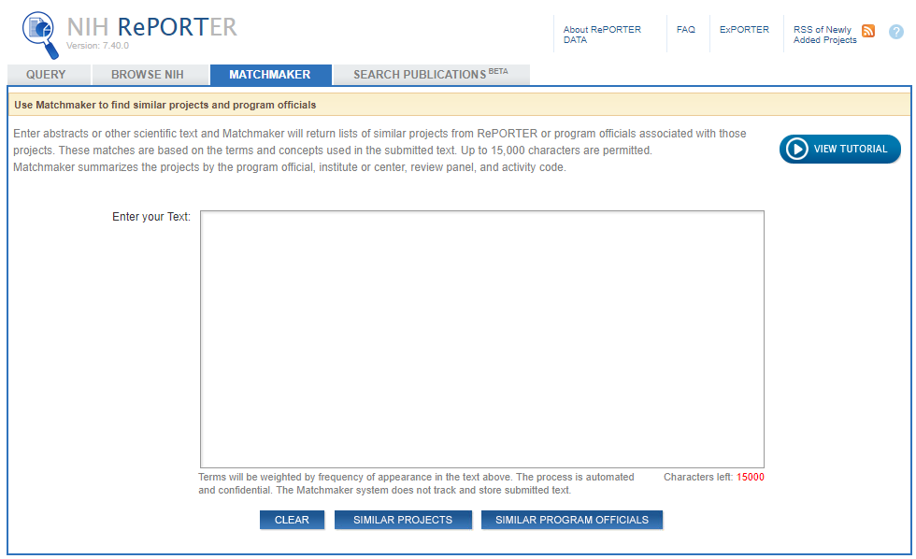
NIH Matchmaker
https://projectreporter.nih.gov/reporter.cfm
Notes:
To use matchmaker, go to nih reporter website and click on matchmaker.

Slide 12
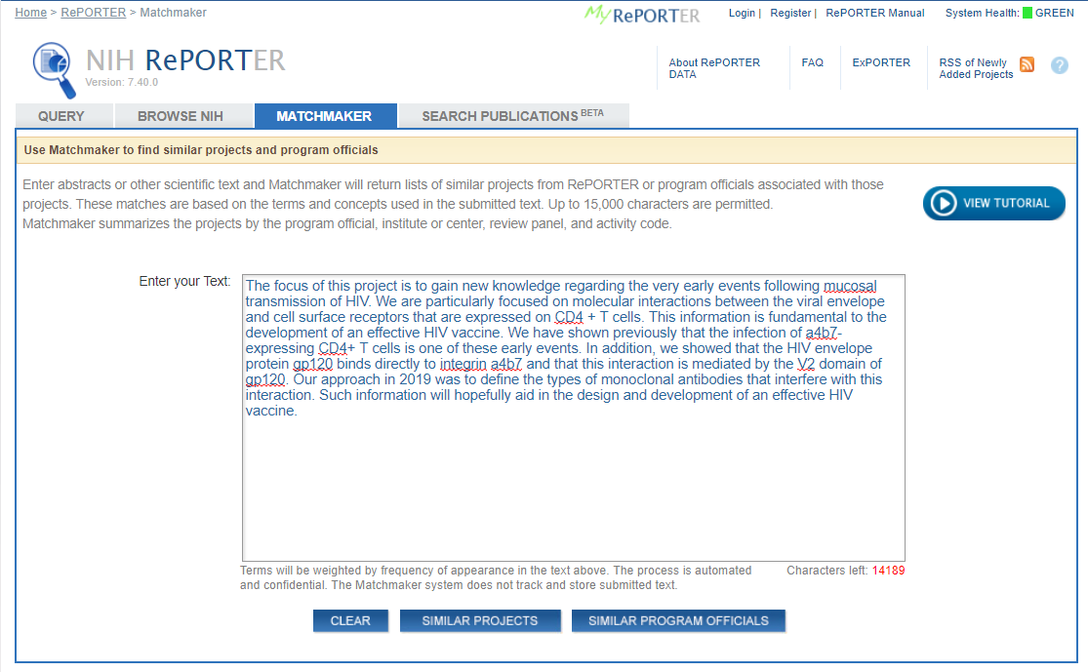
RePORTER - Matchmaker
Notes:
Give Matchmaker up to 15,000 characters of text which you can pull from your abstract, specific aims, or other source that describes your proposed research …

Slide 13
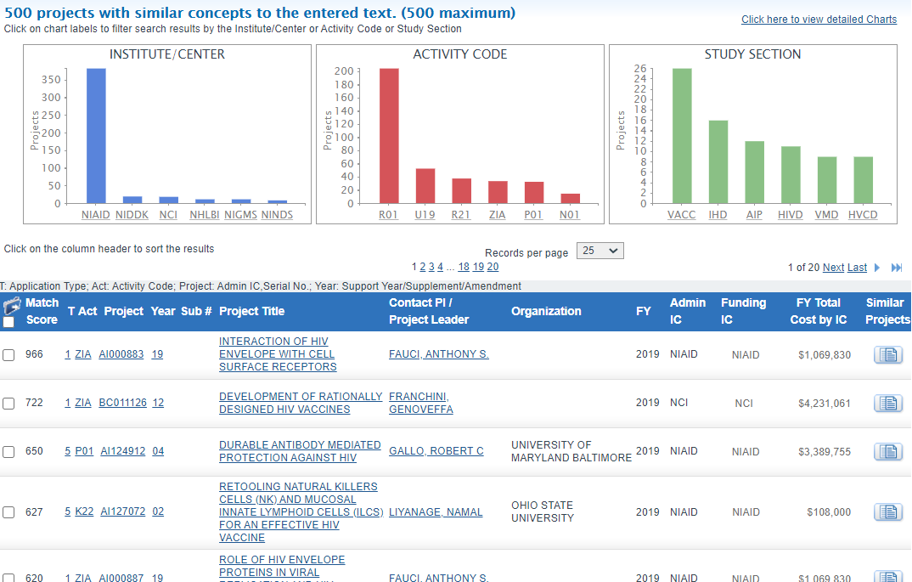
RePORTER – Matchmaker results
Notes:
… and Matchmaker returns the awarded projects that most closely match that text. And, the results include graphs along the top for the ICs, activity codes and study sections associated with those projects.

Slide 14
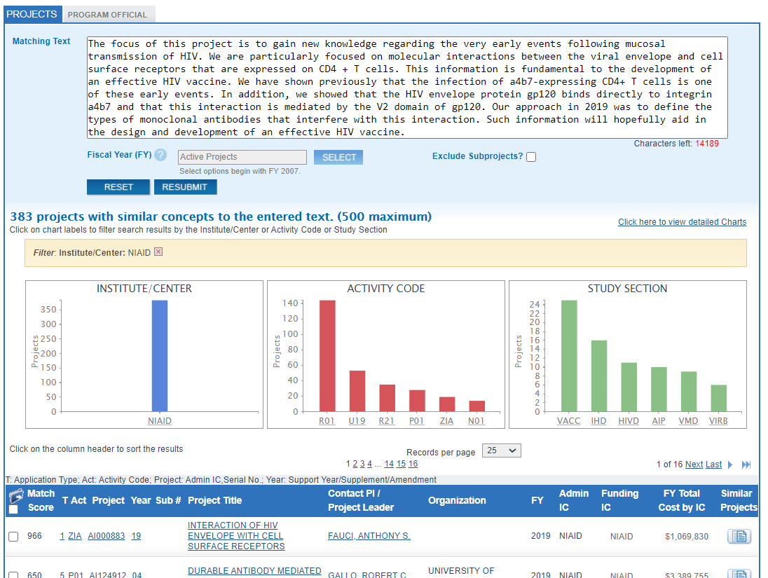
RePORTER – Filtered results
Notes:
At the top, you can even move from the Projects tab to the Program Officials tab …

Slide 15
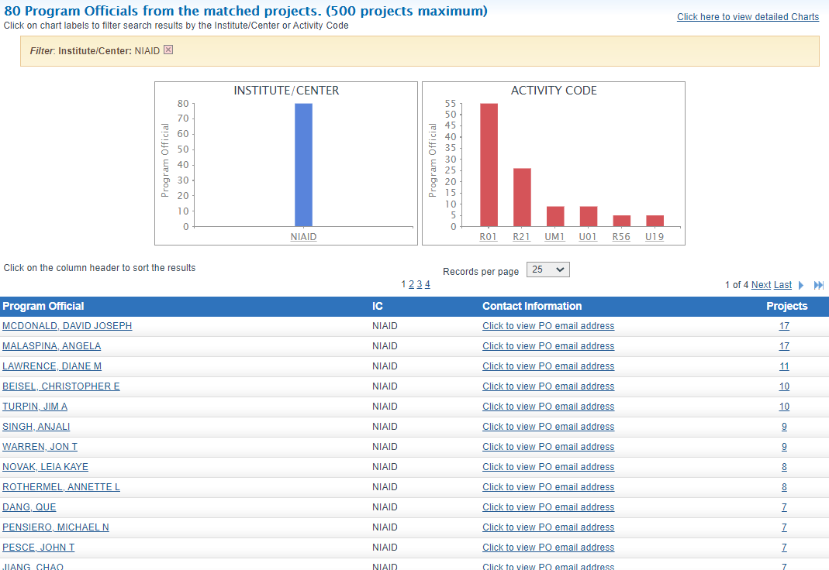
RePORTER – Program Officials
Notes:
to get a list of NIH program officers whose portfolios include the identified projects. Using the Matchmaker, with just a few clicks, you identified both a potential funding institute and staff contacts. From there, you can go to the website of a specific IC to further explore its funding priority and contact specific program officers to further discuss your research idea to see whether it falls within an IC’s funding priority, and seek for advice regarding FOA and study section recommendation.

Slide 16
Types of NIH Funding Opportunity Announcements (FOA)
Type of FOA | Description
Parent Announcements (PA) | Broad announcement Many ICs participate Released by activity code (R01, R21, R03, etc.) For “investigator initiated” or “unsolicited” research Often use standard receipt dates
Program Announcements (PA, PAR, PAS) | Highlights areas of focus Usually ongoing (3 yrs) Often use standard receipt dates
Requests for Applications (RFA) | Narrowly defined scope Usually single receipt date Set aside funds IC usually convenes review panel
Source: https://grants.nih.gov/virtual-seminar-2020/presentations.html
Notes:
Apart from unsolicited research which can be submitted through parent announcements, NIIH also posts other types of funding program announcement, including PAR, PAS, and Request for applications (RFA). Unlike the parent announcements, PAR and PAS highlight areas of focus, and PAS have set-aside funds for the program, whereas PAR has special submission requirements such special submission dates or review criteria.
RFA has a narrowly defined scope and the participating ICs set aside funds in their budgets to award applications submitted to RFA. RFAs often have a single receipt date and may not be posted again.

Slide 17
Notices of Special Interest (NOSIs)
Increasingly used instead of program announcements
Highlight areas of scientific interest
Designate existing FOAs to use for application submission
Notes:
Apart from program announcements, Notice of Special interest or NOSI is increasingly used to make funding opportunity announcement. NOSIs provide the unique information for an initiative in a succinct document which is easier for applicants and they point to existing funding opportunity announcements for application submission. So when you look for NIH funding opportunities, make sure you also play attention to NOSI.

Slide 18
Different Grant Programs
Research Grants (R series)
Career Development Awards (K series)
Research Training and Fellowships (T & F)
Program Project/Center Grants (P series)
Cooperative Agreements (U)
Notes:
NIH funding opportunities cover a wide range of grant programs, including
Research award such as R01, R21,
Career development award such as K01, K25
Training award such as T32, T35
Fellowship such as F31, F32
Program Project and Center grants such as P01
Cooperative agreement such as U01, and etc

Slide 19
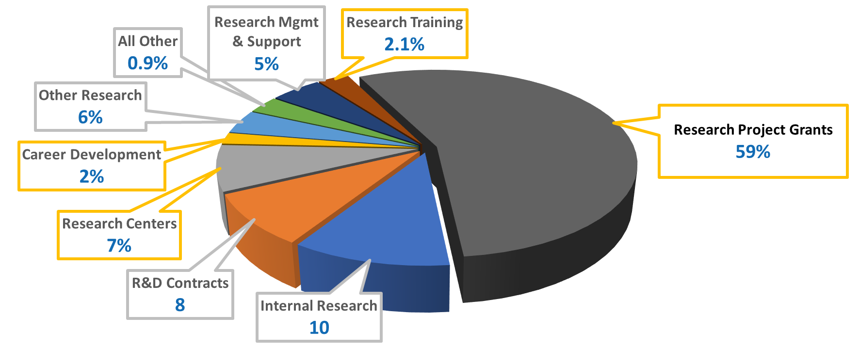
FY 2019 NIH Operating Budget
%
%
Source: https://grants.nih.gov/virtual-seminar-2020/presentations.html
Notes:
To give you a perspective about the distribution of NIH operating budget to each grant program, 59 percent went to research project grants, two percent to research training grants and two percent to career development, and seven percent to research centers. Even though career development only accounts for 2% of NIH’s operating budget, its successful rate is indeed higher than research project award. In addition, K-award recipients have much higher rate of getting future R01 grant. So K-award could be a great stepping stone to pursue NIH funding.

Slide 20
NIH Find Funding Tool: Find opportunities using keywords and various filters. https://grants.nih.gov/funding/searchguide/index.html#/ GrantForward can be great sources of information, as well. https://www.grantforward.com/search
Finding NIH Funding Opportunities
Notes:
You can find NIH funding opportunities using NIH find funding tool using keywords and various filters. Grantforward.com can also be a great source of information as well.

Slide 21
Funding Options Across the Career Path
Source: https://grants.nih.gov/virtual-seminar-2020/presentations.html
Notes:
This slide shows some major funding options across the career path from training grants, fellowships, K awards and through many of the research and program project awards. NIH also has other programs such as loan repayment program and diversity supplements to support post-doc, and early stage investigators.

Slide 22
What are Career Development “K” awards?
Purpose: Awards to provide scholars with protected time to conduct research and career development activities leading to independence in the biomedical, behavioral, or clinical sciences.
Types of Awards: There are multiple “K” Award types designed for different scientific/educational backgrounds and career stages.
Mentored – For early stage investigators needing mentored research training
Non-mentored – For independent investigators to acquire new research skills or to support mentoring activities
Institutional – Awards to institutions to support multiple K-level scholars
Notes:
I believe many of us may not be familiar with the career development K awards. In the nutshell, the basic purpose of career development awards is to provide scholars with protected time to conduct research and career development activities leading to independence in any of the areas that NIH supports. There are multiple types of K awards. They can be broken down into the mentored awards for early stage investigators who need mentored research training, the non-mentored awards for those investigators who are already independent, and the institutional awards that are supporting multiple K-level scholars.

Slide 23
Career Development Awards
Fellowships & Career Awards
GRADUATE &
MEDICAL
STUDENTS
F30 Pre-doctoral Fellowships (MD/PhD Programs)
F31 Pre-doctoral Fellowships (Parent F31)
F31 Diversity Pre-doctoral Fellowships
Training
POST-
DOCTORAL
FELLOWS
F32 Individual Post-doctoral Fellowships
K22 Career Transition Award (some ICs)
Transition
K99-R00 Pathway to Independence Award
K01 Mentored Research Scientist Development Award
K08 Mentored Clinical Scientist Development Award
K23 Mentored Patient-Oriented K Award
K25 Mentored Quantitative K Award
FACULTY
Independent
K02 Independent Scientist Award
K24 Mid-career Award in Patient-Oriented Research
K18 Research Career Enhancement Award for Established Investigators
Source: https://grants.nih.gov/virtual-seminar-2020/presentations.html
Notes:
Since majority of the audience are faculty members, I am going to skip those awards for graduate students and post-doc. K01 K08, K23, and K25 are really for early stage faculty without independent funding, K02 and K24 are for those who already have independent funding, and K18 is for established investigator. Generally speaking, K award recipients require to devote 75% of their effort on the K-award for 3 to 5 years.

Slide 24
Mentored Quantitative Research Awards – K25
K25: Supports investigators whose quantitative science and engineering research has thus far not been focused primarily on questions of health and disease
Candidates must have advanced degree in a quantitative area of science or engineering (e.g., M.S.E.E., Ph.D., D.Sc.)
Provides a unique opportunity for these candidates to embark on special study, including course work, seminars, meetings, and mentored research
Encourages research-oriented quantitative scientists (e.g., mathematics, statistics, computer science, imaging science, informatics, physics, chemistry) & engineers with little or no experience in biomedicine to conduct basic or clinical research
Learn more
Source: https://grants.nih.gov/virtual-seminar-2020/presentations.html
Notes:
Let’s talk a bit more about K25 because it could be particularly relevant to RIT faculty. For instance, Dave Borkholder got a R25 before. K25 aims to encourage research-oriented quantitative scientists such as mathematicians, statisticians, computer scientists, imaging scientists, physicist, chemists & engineers with little or no experience in biomedicine to conduct basic or clinical research. It provides a unique opportunity for these candidates to embark on special study, including course work, seminars, meetings, and mentored research.

Slide 25
Next Generation Researchers Initiative
Policy Supporting the Next Generation Researchers Initiative
Notice Number: NOT-OD-17-101
Key Dates Release Date: August 31, 2017 Implementation Date: August 31, 2017
Notes:
Lastly, I want to talk a little bit about the next generation researchers initiative. It called on NIH to take a variety of steps to increase opportunities for the early stage investigators (ESI) to obtain funding.
NIH has declared as a priority that Early-Stage Investigators should be funded. So NIH aims to fund at least 1,100 Early-Stage Investigators every year, and to put that in perspective, NIH get about 4,000 to 4,500 applications from Early-Stage Investigators each year. So this roughly means that NIH want to fund at least 25 percent of the Early-Stage Investigators who come in and request funds.

Slide 26
Early Stage Investigator (ESI)
An ESI is a Program Director / Principal Investigator (PD/PI) who has completed their terminal research degree or end of post-graduate clinical training, whichever date is later, within the past 10 years and who has not previously competed successfully as PD/PI for a substantial NIH independent research award. A list of NIH grants that a PD/PI can hold and still be considered an ESI can be found at https://grants.nih.gov/policy/early-investigators/list-smaller-grants.htm.
Notes:
NIH defines ESI as a PI who has completed their terminal research degree or end of post-graduate clinical training within the past 10 years, whichever date is later, and who has not previously competed successfully as PI for a substantial NIH independent research award such as R01.

Slide 27
R01 Funding for Early Stage Investigators
“Early Stage Investigator”: A New Investigator who is within 10 years of the terminal doctoral degree or end of formal clinical training (residency and fellowship)
NIH funds R01s of ESIs at more favorable pay lines !!
Pay lines and relative advantage differ by NIH Institute; 3%-10% more generous pay lines
Advice for Early Stage Investigators
Apply for R01 now !!!!! (If you have preliminary data)
Notes:
The major benefit of ESI is that NIH funds R01 of ESI at more favorable pay lines. The payline and relative advantage differ by NIH institute, roughly 3-10% more generous than the regular payline. So the advise from NIH is that if you have preliminary data, apply for R01 now.

Slide 28
Katz ESI R01 Award Program
Notes:
Another strategy for NIH to increase opportunities for ESI to obtain funding is to create new programs for which only ESIs are eligible. Most recently, NIH launches a new funding mechanism called Katz ESI R01 award program.

Slide 29
Key Features of Katz ESI Award
Substantial/significant R01-equivalent research
project award for Early Stage Investigators
New research direction for PI
Preliminary data not allowed
Notes:
Key features of Katz ESI award includes 1) only ESI researchers are qualified to apply; 2) it provides R01 equivalent research project award for ESI researchers, but the catch is the PI must propose a new research direction in the application and no preliminary data is allowed.

Slide 30
Preliminary Data Not Allowed
Preliminary data are defined as data not yet published. Existence of preliminary data is an indication that the proposed project has advanced beyond the scope defined by this program and makes the application unsuitable for this funding opportunity.
In addition, publication in the proposed new research direction is an indication that the proposed work may not be in a new research direction for the ESI.
Notes:
Preliminary data are defined as data not yet published. Existence of preliminary data is an indication that the proposed project has advanced beyond the scope defined by this program and makes the application unsuitable for this funding opportunity. In addition, publication in the proposed new research direction is an indication that the proposed work may not be in a new research direction for the ESI.

Slide 31
New Research Directions
Can rely on the applicant’s prior work and expertise as its foundation
Should not be an obvious or incremental advancement, expansion or extension of a previous research effort
New approach, methodology, technique, discipline, target, paradigm
Applicants must explain how proposed direction is new to them
New Research Directions will be its own attachment
Because a change in research direction is heavily dependent upon the area of investigation, potential applicants are strongly encouraged to contact a program director to discuss their proposed project.
Notes:
So what is a new research direction? According to the FOA, proposed research projects can rely on the PI’s prior work and expertise as its foundation, but must not be an incremental advancement, expansion, or extension of a previous research effort. Importantly, the proposed direction must represent a change in research direction for the PI. This change in research direction could involve, for example, a new approach, methodology, technique, discipline, therapeutic target, and/or new paradigm, different from the ESI’s previous research efforts. Because a change in research direction is heavily dependent upon the area of investigation, potential applicants are strongly encouraged to contact a program director to discuss their proposed project before submission.

Slide 32
Two Katz FOAs
For studies that do not involve clinical trials: - PAR-21-038: Stephen I. Katz Early Stage Investigator Research Project Grant (R01 Clinical Trial Not Allowed)
For studies that include Basic Experimental Studies with Humans (BESH): - PAR-21-039: Stephen I. Katz Early Stage Investigator Research Project Grant (R01 Basic Experimental Studies with Humans Required)
It is important to check which NIH ICs are signed onto each FOA
Notes:
Currently, there are two FOA for the Katz R01: Clinical Trial Not Allowed and Basic Experimental Studies with Humans Required.

Slide 33
Contact
Terry Koo, PhD
Research Development Specialist
Email: terry.koo@rit.edu
Phone: 585-475-4324
PHT180.rit.edu
Notes:
Okay, I will stop here. If you have any questions, please feel free to contact me.

Slide 34

Diversity Supplement: Learning from Experience
Hans Schmitthenner, PhD
Research Professor
School of Chemistry
& Materials Science
Notes:
Now, I will let Hans to share his hands-on experience in diversity supplement. Hans please.

Slide 35
NIH Interest in Diversity NOT-OD-20-031
Enhance the participation of diverse groups including those underrepresented in the biomedical research workforce
Individuals from nationally underrepresented racial & ethnic groups
Blacks or African Americans, Hispanics or Latinos, American Indians or Alaska Natives, Native Hawaiians and other Pacific Islanders
In addition, individuals from racial or ethnic groups that can be demonstrated convincingly to be underrepresented by the grantee institution should be encouraged to participate in NIH programs to enhance diversity.
Persons with disabilities
Individuals with a physical or mental impairment that substantially limits one or more major life activities
Individuals from disadvantaged backgrounds
Must meet two or more of the criteria listed in this category in NOT-OD-20-031
Women
NIH encourages institutions to consider women for faculty-level, diversity-targeted programs to address faculty recruitment, appointment, retention or advancement.
https://grants.nih.gov/grants/guide/notice-files/NOT-OD-20-031.html
Notes:
NIH is particularly interest in enhancing the participation of groups that are underrepresented in the biomedical research workforce, and you can see from this slide what those groups are, and just in general, individuals from nationally underrepresented racial and ethnic groups, persons with disabilities, individuals from disadvantaged backgrounds and women.

Slide 36
Diversity Supplements - Research Supplements to Promote Diversity in Health-Related Research
Administrative supplement to an existing research grant, designed to:
Diversify the biomedical research workforce
Support candidates from diverse & underrepresented groups who “wish to develop research capabilities... participate in… career development experiences”
Support many career stages from high school to junior faculty
Administratively reviewed by the Institute or Center (IC) funding the original grant
PA-21-071 Most recent FOA
Note: ICs have different deadlines and policies
Notes:
One of the initiative to promote diversity is through diversity supplements. It is an administrative supplement to an existing research grant to diversify the biomedical research workforce, Support candidates from diverse & underrepresented groups who “wish to develop research capabilities... participate in… career development experiences”. It supports many career stages from high school to junior faculty. Importantly, diversity supplements are administratively reviewed by the Institute or Center (IC) funding the original grant, and hence it requires the applicant to work closely with the program officer to be successful.

Slide 37
Application Requirements for Diversity Supplements
Proposed research experience plan for the candidate must contribute to the (broad) goals of the funded project
Research Abstract of funded project, research experience, plans for interaction with others in the grant/research area, mentor commitment
Plans for future career development
Candidate bio-sketch
Highlight evidence of research interest or achievement, any current funding, personal statement
Candidate eligibility statement (citizenship/permanent resident, identify under-represented group), signed by PI and institutional official
Notes:
To apply for Diversity Supplements, proposed research experience plan for the candidate must contribute to the (broad) goals of the funded project
Research Abstract of funded project, research experience, plans for interaction with others in the grant/research area, mentor commitment
Plans for future career development
Candidate bio-sketch
Highlight evidence of research interest or achievement, any current funding, personal statement
Candidate eligibility statement (citizenship/permanent resident, identify under-represented group), signed by PI and institutional official

Slide 38
New FY18 Diversity Supplement Applications, Awards, and Success Rate by Career Level
Application and award data withheld
Source: https://grants.nih.gov/virtual-seminar-2020/presentations.html
Notes:
Nonetheless, as you can see here, the successful rate of diversity supplement applications are 65% or higher, which is much higher than regular research grant applications.

Slide 39
Q&A
Notes:
That is the end of my presentation. Thank you.

