Slide 1
Procurement on Federal Grants
Presented by PSO & SPA
June 15, 2023

Slide 2
Introduction
Uniform Guidance
https://www.govinfo.gov/app/details/CFR-2014-title2-vol1/CFR-2014-title2-vol1-sec200-317
Procurement Services Contacts
https://www.rit.edu/procurement/commodity-categories-and-suppliers
Sponsored Program Accounting
https://www.rit.edu/fa/controller/sponsored-programs-accounting
Sponsored Research Services Contacts
https://www.rit.edu/research/srs/about/contact

Slide 5
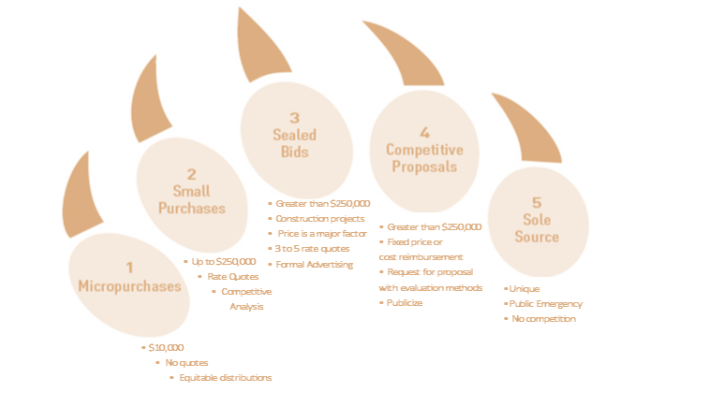
Procurement Claw
Notes:
Purchase Transaction Threshold
Type of Competitive Action
Micro Purchase<$10,000- Price must be reasonable
Small Purchase≤$250,000
- Requires at least three (3) written bids - Requires Price Summary Form and Federal Funds Procurement Checklist
Procurement by Sealed Bid>$250,000- Requires at least three (3) written bids - Formally advertised - Firm fixed price contract - Preferred method for construction services - Requires Price Summary Form and Federal Funds Procurement Checklist
Competitive Proposals>$250,000- Requires at least three (3) written bids - Non-federal entity must have written procedures for evaluating proposals - Formally publicized with evaluation criteria - Firm fixed price cost reimbursable contract - Awarded to firm most advantageous to program - Requires Price Summary Form and Federal Funds Procurement Checklist
Sole Source≥$10,000
- Item available only from single source - Public emergency will not permit a delay from competitive solicitation - After solicitation of sources, competition is determined inadequate - Cost or price analysis -Requires Sole Source Justification Form and Federal Funds Procurement Checklist -Guidance for Sole Source Request

Slide 6
Understanding Sole Source Justification
Availability
Item is only available from a single source
Public Emergency
Public emergency will not permit a delay resulting from competitive solicitation
Award Exemption
Specific award expressly authorizes noncompetitive process
Inadequate Competition
AFTER soliciting bids – competition is determined to be inadequate

Slide 7
Example Audit Findings
Lack of competitive bidding
Failure to solicit multiple bids
Insufficient sole source justification
Inadequate Documentation
Missing bid evaluations
No evidence of price reasonableness
Conflict of Interest
Not disclosed or managed during procurement
Notes:
Real examples from university audits
*Competitive Bidding
*Need to prioritize fair competition
*Inadequate documentation
*Sole source to demonstrate reason for bypassing competitive bidding (unique specifications, sole manufacturer or emergency circumstances)
*Conflict of Interest
*individuals involved had personal or financial interest that could potentially influence the outcome of the award decision

Slide 8
FAQ - SPA
The desired vendor was named in the proposal for my grant.
Does that constitute sponsor approval for that vendor?
No – all procurement procedures still need to be followed & documented
Does this satisfy the requirement for a Sole Source justification?
No – the requirements for sole source are the same whether a vendor is identified at proposal or not
I have an established relationship with a particular vendor and they are expecting to provide goods or services for the work on my grant.
Does this impact the procedures to be followed?
No - All procurement procedures still need to be followed & documented
Avoid “promising” work to vendors prior to engagement on a federal award – keep language tentative

Slide 9
Key take aways
Early engagement is important
Document your followed process and decisions
PSO and SPA teams are here to help!

Slide 10
Web links to review and bookmark
Procurement Services Federal Funds Procedures
https://www.rit.edu/procurement/federal-funds-procedures
Procurement Services Manual
https://www.rit.edu/procurement/procurement-services-manual#7-specialized-policies-and-procedures
Procurement Services Forms (Federal Funds Checklist, Sole Source, Price Summary, etc)
https://www.rit.edu/procurement/forms
Sponsored Programs Accounting
https://www.rit.edu/fa/controller/sponsored-programs-accounting

