Slide 1

Advisor Assignment
in PeopleSoft
Jenny LaFlam
jeliao@rit.edu
advising@rit.edu

Slide 2
Agenda
Advisor Assignment Structure
Advisor Roles
Committee ID Naming Convention
Advisor Assignment Scenarios
Questions
Notes:
Roles display on student center, advisor center. Able to click and e-mail the correct advisor

Slide 3
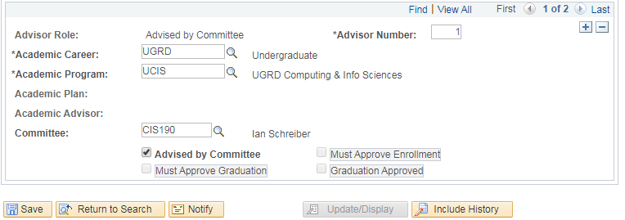
Committees
Committees of one person
Why committees?
Show roles of advisors – transparency to students, faculty, staff
Easy to transfer case loads between advisors
Ms. Frizzle
Notes:
Roles display on student center, advisor center. Able to click and e-mail the correct advisor

Slide 4
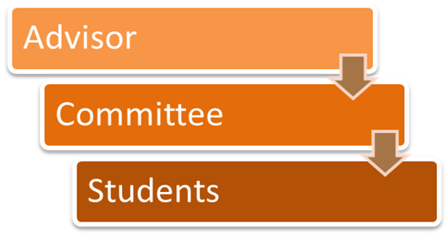

Slide 5
Committee Roles
Primary Academic Advisor
CRP Advisor
English Language Center Advisor
Faculty Advisor
NTID Counselor/Advisor
NTID Support Coordinator
Honors Advocate
CSTEP Support Specialist
HEOP Counselor
CES Coach
NCAA Compliance Officer
ROTC Commanding Officer
SA Specialist
Veteran Student Success Coach

Slide 6
Committee ID Prefixes in Colleges
IAS### - College of Art and Design
CST### - College of Engineering Technology
HST### - College of Health Sciences and Technology
CLA### - College of Liberal Arts
COS### - College of Science
CIS### - B. Thomas Golisano College of Computing and Information Sciences
COE### - Kate Gleason College of Engineering
TID### - National Technical Institute for the Deaf
SCB### - Saunders College of Business
INT### - School of Individualized Study
ELC### - English Language Center
GIS### - Golisano Institute of Sustainability
GLO### - Global Campus Primary Academic Advisor
CRP### - College Restoration Program
*Academic Advisor Committee IDs use numbers 001-099, Faculty advisor Committee IDs use numbers100 and up.
i.e. Academic Advisor: CST001, SCB003. Faculty Advisor: CST101, CST227

Slide 7
Committee ID prefixes, Support Advisors
CSTP## - CSTEP Support Specialist
HEOP## - HEOP Counselor, Higher Education Opportunity Programs
MCAS## - CES Coach, Center for Engagement and Student Success
HON### - Honors Program Advocate
NCAA## - NCAA Compliance Office,
National Collegiate Athletic Association
ROTC## - ROTC Commanding Officer, Reserve Officers’ Training Corps
SLSA## - SA Specialist, Spectrum Support Program
TID###* - NTID Counselor/Advisor, National Technical Institute for the Deaf
TID20#* - NTID Support Coordinator, National Technical Institute for the Deaf
VETS## - Veteran Student Success Coach
*For NTID Support Advisors; NTID Counselor/Advisor Committee IDs use numbers 001-099, Support Coordinator Committee IDs use numbers 200 and up.
i.e. NTID Counselor/Advisors: TID001, TID003. NTID Support Cordinators: TID201, TID204

Slide 8
Assigning Advisors by Committee
Assign advisors to incoming students
Add an advisor to an existing student
Change a student’s advisor
Delete an assigned advisor from a student
Advisor Assignment Update after Change of Program
New/Acting departments are responsible for accurate assignments
Update advisor assignments after a change of program
Carry over NTID and/or support advisors
Notes:
Adjusting current students should occur after all incoming students have been assigned. Impacts: advisor still sees student in myAdvisees, shows ‘Academic Advisor’ instead of ‘Primary Academic Advisor’, students cannot tell what the advisor’s role in SIS, your advisees will not show up in Starfish if they are not assigned by committee, reports will not include students who are attached to you without a committee.

Slide 9
Other things to remember
One save per student per day on assignments
Changes/corrections can be future dated
You can use tomorrow’s date to make a change if you have already saved today
If you make a mistake and you’re not sure what to do, don’t save your changes!
If you make a mistake and you saved your work email jeliao@rit.edu or advising@rit.edu. Explain what needs to be corrected, we can help.
Students’ advisor assignment history is recorded, all past advisor assignment changes for students are available to reference.

Slide 10
Managing/Maintaining Committees
Centrally coordinated by the University Advising Office (UAO)
https://www.rit.edu/advising/about#advisor-assignment
Committee requests should be submitted to the UAO by the Deans’ Delegates for Advising
Questions: Jenny LaFlam, jeliao@rit.edu or 5-2273

Slide 11

Questions?

