Slide 1
RIT Leadership
Virtual Town Hall
May 7, 2020

Slide 2
Before we get started, some Zoom notes
This is a webinar, not a Zoom meeting
The panel will field questions when all presentations are complete
Real-time captioning and ASL interpreters
For best viewing, select “hide non-participant video” in your Zoom video settings
Select the “Gallery View” to see the speaker and the interpreter

Slide 3
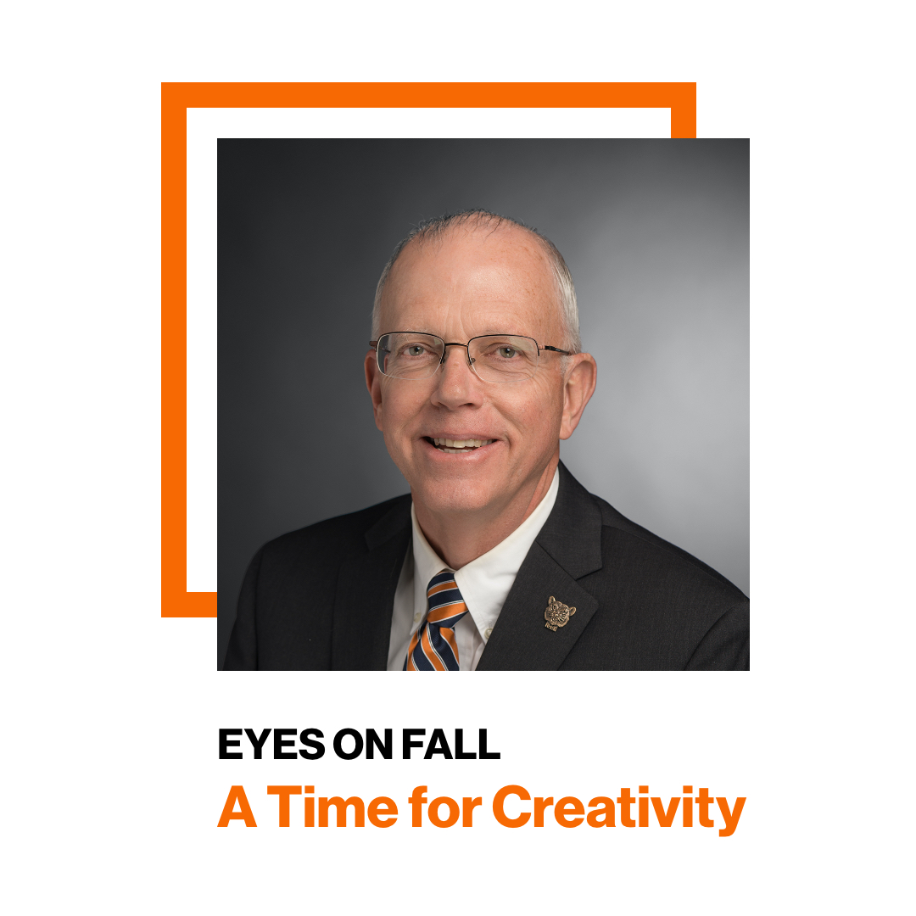
Today’s Panel
David Munson, RIT President
Sandra Johnson, Senior VP, Student Affairs
Ellen Granberg, Provost, Senior VP,
Academic Affairs
Ian Mortimer, VP, Enrollment Management
Jim Watters, Senior VP, Finance and Administration

Slide 4
President Munson: Pandemic Landscape
A trying time for all
Rapid change
Pandemic curves have flattened; very slowly declining
Therapeutic may help by Fall
Vaccine (availability uncertain)
RIT responds magnificently with PPE and ventilator designs
Thank you!!!!

Slide 5
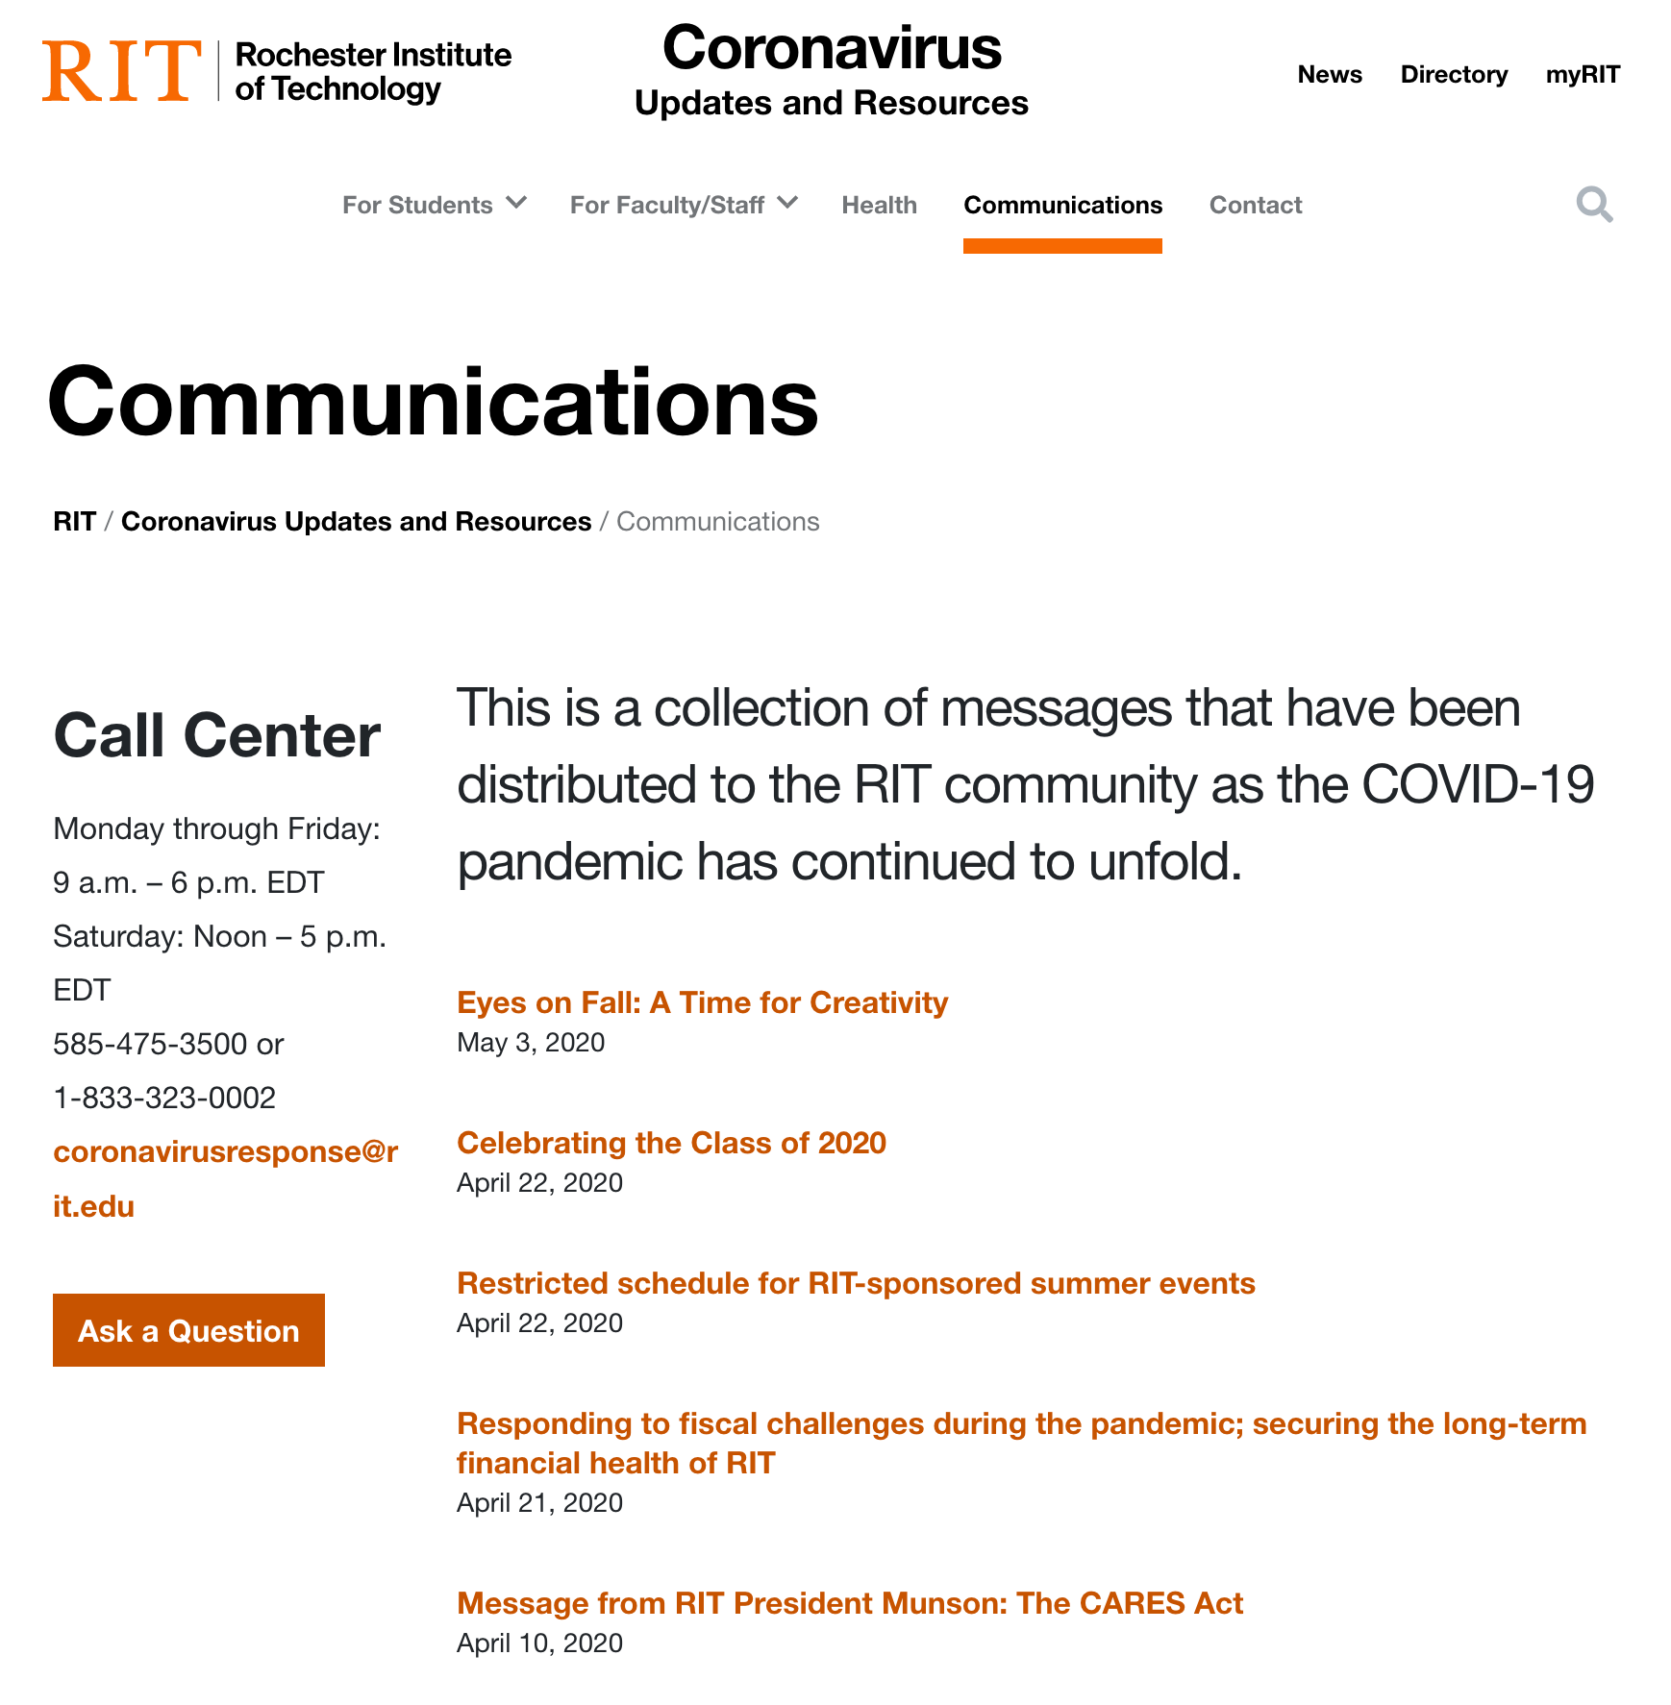
Our Priorities During the Pandemic
Safety of our community
Keeping RIT strong
Taking care of our people
Timely decisions
Communication

Slide 6
Early Decisions
Extended Spring Break
Moved instruction online
Moved students out of RIT residences
Idled research labs
Canceled commencement

Slide 7
Difficult Financial Decisions
Halted faculty and staff hiring
No merit raises
Furlough program
Possible salary cuts

Slide 8
Campus Construction Plan
Summer projects postponed
Global Cybersecurity Institute will be completed
IMLC and Performing Arts Center designs continuing; bond and donor funded; key to our future
Design of Saunders addition will proceed
Design of stadium and athletic fields continuing; construction will be postponed

Slide 9
Campus Reopening
Health and safety considerations at the forefront
Reopening schedule dictated by State of New York
Optimistic for reopening of research labs
Optimistic for on-campus Fall semester with heavy testing, monitoring, and social distancing
Prepared for fully online if necessary
Special provisions for those who are at most risk
Fall Planning Task Force and three committees will chart our course

Slide 10
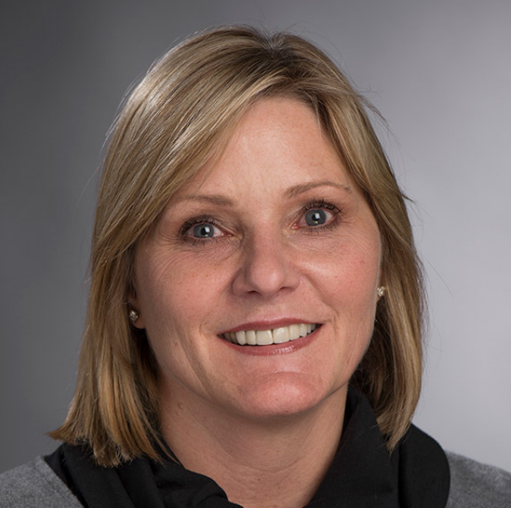
Sandra Johnson
Senior Vice President, Student Affairs

Slide 11
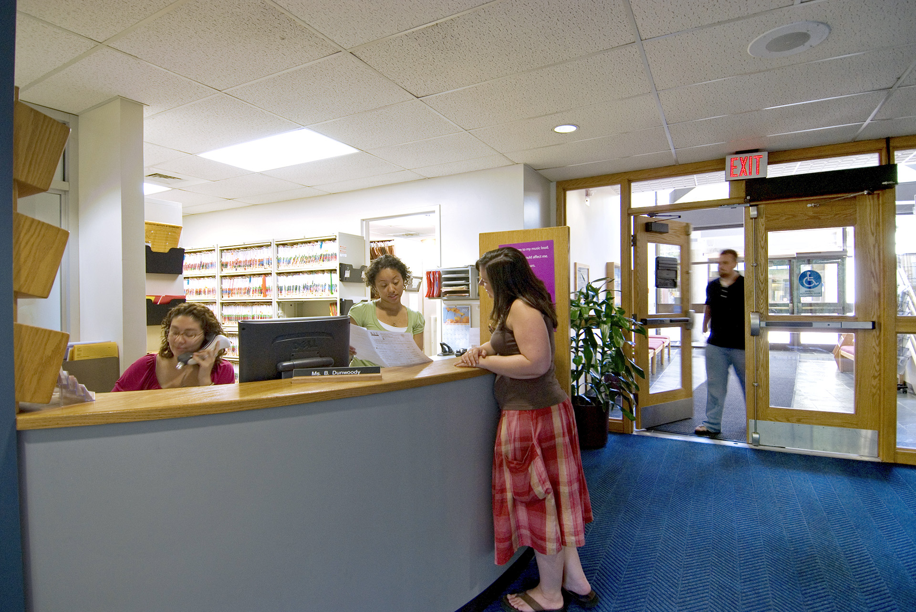
Special Thanks!
Supporting the health and well-being of our students
Development and Alumni Relations
Critical Incident Management Team
COVID-19 Emergency Fund
Dr. Wendy Gelbard
August Center

Slide 12

Support Over Summer
Support over Summer
Drop-in Connections
Parent-Coffee Talks
Case Management
Student Government
Virtual Student Life

Slide 13
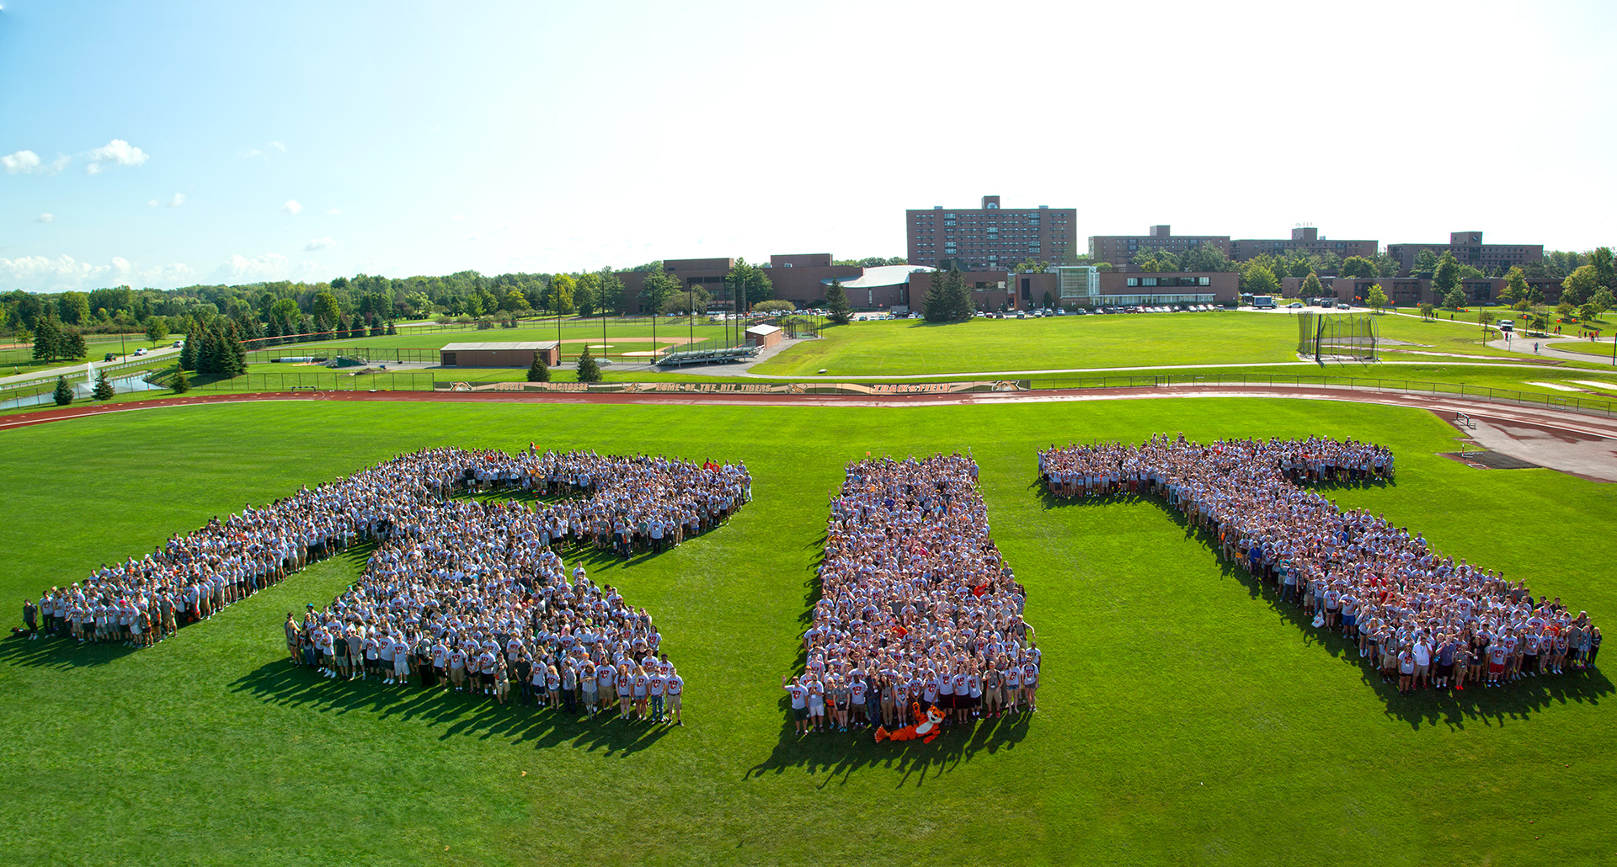
Fall Planning
Community Readiness Committee
Orientation and Move In
Intercollegiate Athletics
We are in this TOGETHER!

Slide 14

Celebrating the Class of 2020!
It’s time to celebrate the Class of 2020!!
5 p.m., Friday
Let’s share a toast!
rit.edu/classof2020

Slide 15
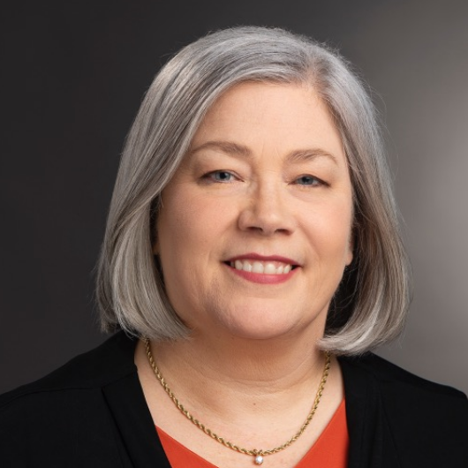
Ellen Granberg
Provost, Senior Vice President, Academic Affairs

Slide 16

Thank You!
3,500 course sections moved online in 10 days
All advising and student support moved online
Over 50,000 Zoom sessions held
Students from 125 nations participated
Final exams ended yesterday
Students receive their degrees tomorrow!

Slide 17

Summer 2020
Courses begin May 14 online
140 new courses offered this summer
Summer enrollment is up 40% over the same time last year
Special summer grant program
Free courses for incoming first year students

Slide 18
Academic Fall Planning Committee
Planning for two options:
  Many courses meet in the context of social distancing and safety protocols
  Pivot to online instruction, including a full semester online
Focus groups held last week to hear input and concerns about both options.
  630 faculty and staff participated
  Questions recorded and will be shared with the other planning committees
  Resources identified to support instruction and student services in fall

Slide 19
Fall Academic Planning Committee Principles
The health and well-being of the campus community is the top priority.
Students must be able to stay on track with their degree programs.
Faculty and staff will need institutional support to enable them to offer classes and provide services that meet the needs of students in the context of COVID-19.

Slide 20
Fall Academic Planning Committee Principles continued
Health conditions or COVID-19 vulnerabilities should not prevent students from continuing in the fall if they wish.
Faculty and staff who are uniquely vulnerable to COVID-19 should receive support in performing their duties.

Slide 21
Fall Academic Planning Committee
Chair: Carmala Garzione, Associate Provost for Faculty Affairs
Co-Chair: Andre Hudson, Director, Gosnell School of Life Sciences
Co-Chair: Tina Sturgis, Senior Associate Registrar
Co-Chair: Anne Wahl, Assistant Provost

Slide 22
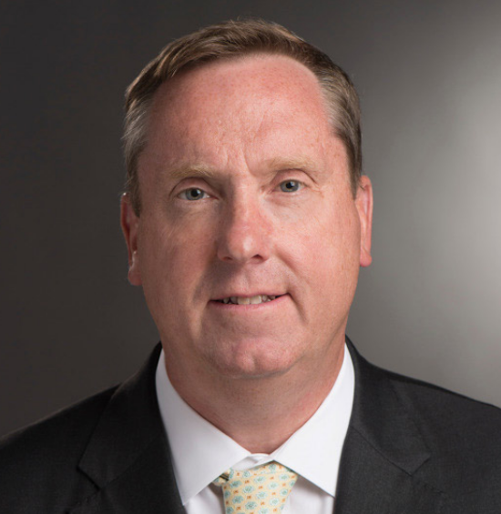
Ian Mortimer
Vice President,
Enrollment Management

Slide 23
The Chapters to Fall 2020
Chapter 1: Before March 8
Chapter 2: March 9 to Today
Chapter 3: Tomorrow to September

Slide 24
Chapter 1: The plan to +300
 | Fall 2019 | Fall 2020 | Diff
Freshman (Minus NTID) | 2541 | 2827 | +286
Transfers | 416 | 400 | -16
Graduate (MS & MFA) | 845 | 875 | +30
TOTAL | 3802 | 4102 | +300

Slide 25
Chapter 1: Metrics as of March 8
 | Fall 2019 | Fall 2020 | Diff | % Diff
Early Decision Deposits | 892 | 1091 | 199 | 22.3%
Regular Admits | 17831 | 19836 | +2005 | 11.2%
Transfer Admits | 358 | 330 | -28 | -7.8%
Transfer Deposits | 97 | 59 | -38 | -39.1%
Graduate Admits | 1290 | 1954 | 664 | 51.5%
Graduate Deposits | 115 | 155 | 40 | 34.8%

Slide 26
Chapter 2: Switching Gears Fast
Moved deposit deadline to May 15 (GR) and June 1 (UG)
Conducted +80 academic open house sessions
Financial aid webinars and automated appointment scheduler
Streaming video tours with student ambassador
Virtual open house
India engagement and new pathways
Summer term priority

Slide 27
Chapter 2: Current Reality
Early Decision deposits remain +200
We are trending well on regular, but won’t know until June 1
Transfer deposits have slowed way down
International graduate will be down between 50-70%
New programs will need to backfill
Questions regarding fall are top-of-mind

Slide 28
Chapter 3: New work to September
Regional Campaign
Class of 2020 Master Plan
International Fall Online – 50%
Retention of Performing Arts Scholars – larger cohort
RIT Online and Adult Learners
More financial aid appeals

Slide 29


www.rit.edu/masterplan
Regional Campaign

Slide 30
Chapter 3: What needs to happen
Our regular admit pool needs to get close to last year – it has a good chance
The transfer decline needs to be offset by the regional campaign
New graduate students re: Class of 2020 Master Plan + 100
Salvage 50% of our new grad from India and China
Fend off waitlist grabs — $
Retention remains steady

Slide 31
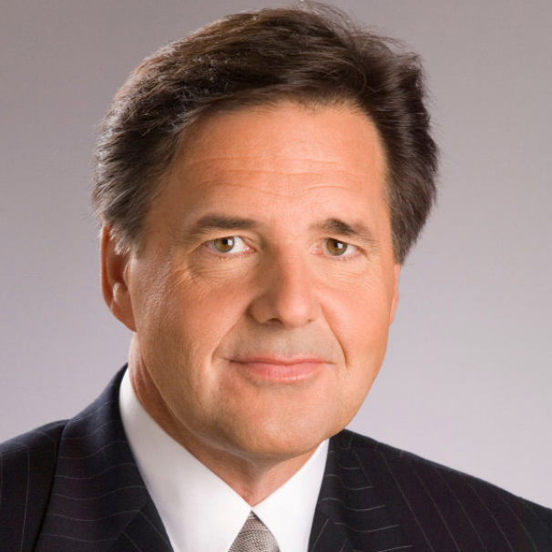
Jim Watters
Senior Vice President,
Finance and Administration

Slide 32
Current Year Fiscal Challenges
Fall Enrollment Below Budget Plan
Mid Semester Closure of Housing and Dining
Lost Revenue From Facility Rentals
Maintaining Credit Rating

Slide 33
Current Year Fiscal Challenges continued
Fall Tuition Revenue Shortfall | $9.20 million
Housing Refunds for Partial Year | $9.30 million
Dining Plan Refund for Partial Year | $4.98 million
Estimated Dining Loss Closed Stores | $1.70 million
Estimated Facility Rental Loss | $.300 million

Slide 34
Current Year Action Steps for Savings*
Renegotiated Service Contracts 3 mos | $.630 million
Suspended travel and non-critical purchases | $4.80 million
Deferred or canceled Capital Projects | $18.0 million
Position Control for Salary Savings | $3.40 million
Energy Savings | $.710 million
CARES Act | $5.19 million
*Representative list of actions taken

Slide 35
Fall 2020/2021 Fiscal Planning
Developing Multiple Budget Scenarios
Developing Options to Address Fiscal Challenges if Required
Assisting Overseas Campuses with Financial Planning

Slide 36
Physical and Health Technology Committee
Investigating latest in building air treatment systems
Evaluating Health Care Technologies for Student, Staff and Faculty Wellness Assessments
Investigating a variety of antimicrobial metals and treatments
Investigating Touchless Bathroom Improvements
Investigating virus testing services and efficacy
Evaluating new food service delivery models

Slide 37
President Munson Recap
Eyes on Fall: A Time for Creativity
Fall Planning Task Force
Academic Planning (Office of the Provost)
Infrastructure and Health Technologies (Finance and Administration)
Community Readiness (Student Affairs)

Slide 38

Join Us!

Slide 39
Let’s take your questions
Please click your Q&A button to
submit your question or comment

