Slide 1
Generative AI at RIT
ITS
Beth Bailor – Principal Enterprise Architect
Geremy Gersh – CTO & Associate CIO
Aldwin Malato – CISO

Slide 2
Approved Tools
Microsoft Copilot:
  Copilot.cloud.microsoft
Google Gemini
  Gemini.google.com Log in with @g.rit.edu
Google NotebookLM
  Notebooklm.google.com Log in with @g.rit.edu
Zoom AI Companion:
  Turn on inside your zoom settings or within your meeting

Slide 3
Keeping our Information Safe
Public Data (Safe for any AI):
  Course descriptions, public website info, policies, marketing language
Internal Data (Approved Tools Only):
  Meeting minutes (non-sensitive), internal memos, standard operating procedures.
Confidential (Approved Tools Only, after ISO review):
  Information that is restricted to a need-to-know basis
  Private (Do Not Use in any AI tool):
  FERPA data, PII (Personally Identifiable Information), intellectual property.
Information Handling Matrix

Slide 4



Practical Use Cases for Staff
Creation & Strategy
Productivity
Analysis
Create a presentation
Draft an email
Generate an infographic
Create a video
Take meeting minutes
Create a repeatable process
Build an agent to answer common questions
Analyze a large quantity of documents
Summarize a series of meeting minutes or notes

Slide 5
Critical ”Do’s and Don’ts”
DO: Review everything the AI generates. (It hallucinates/makes mistakes!)
DO: Disclose use if you are publishing content generated by AI
DON'T: Rely on it for factual accuracy without checking sources
DON'T: upload unpublished research or intellectual property

Slide 6
Resources & Support
Information Security Office (ISO): For questions on "Can I put this data here?”
https://www.rit.edu/security/generative-ai (The source of truth for policy).
Other Resources:
RIT Library has AI Tools for Scholarly Research: How-to Guides and Additional Information
https://infoguides.rit.edu/aitools/guides (includes a link to LinkedIn learning)
Community of Practice
in Slack - gen-ai-community-of-practice
Sharepoint site - Gen AI Community of Practice Sharepoint
Need Additional Support?
AI Consulting Request

Slide 7
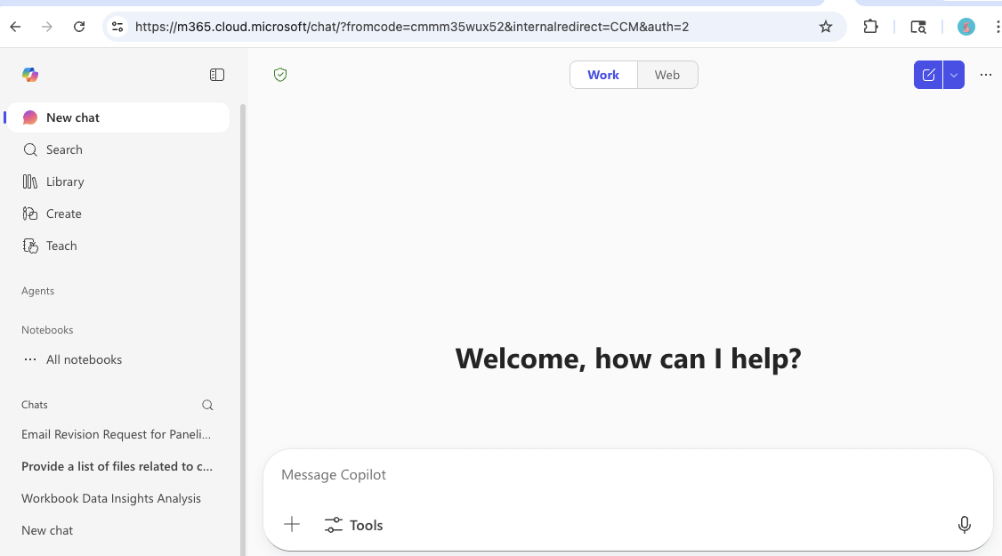
How To Learn – CoPilot
1. Chat with an AI Assistant:
Ask questions and have conversational help on many topics.
Get summaries, explanations, writing help, and brainstorming.
2. Web Grounded Answers:
Copilot can look up information from the internet to give up-to-date responses.
3. Use it for real work.
Writing assistance (emails, articles, etc.)
Brainstorming and idea generation
  Copilot.cloud.microsoft

Slide 8
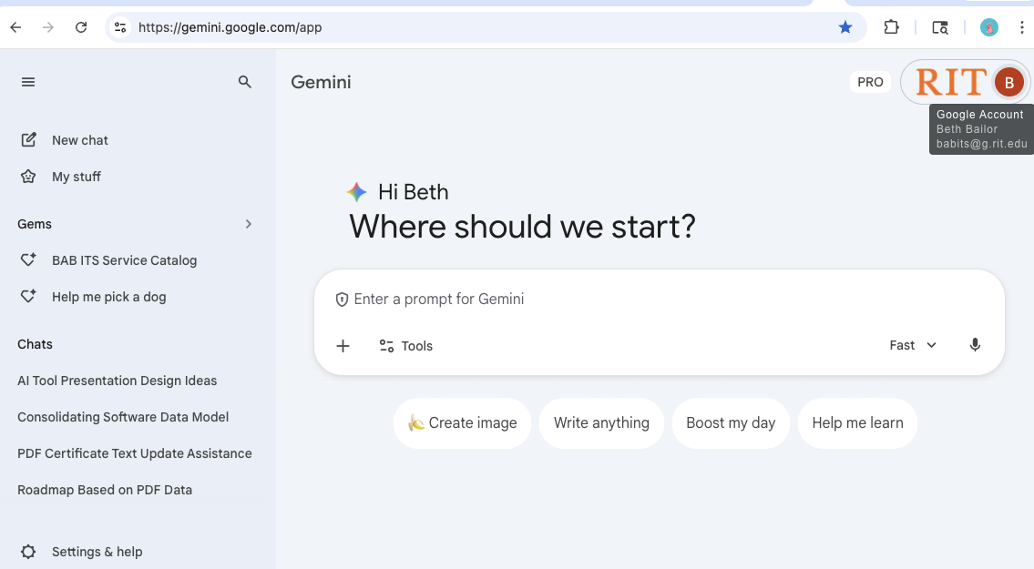
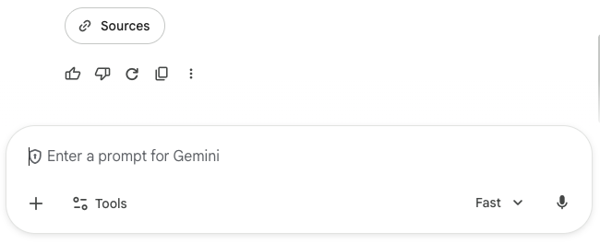
How To Learn – Gemini
Must be signed in to your
g.rit.edu account
Create a prompt. Context-Action-Format:
"Act as a friendly neighbor (Context). Write a 3-sentence email (Format) asking to borrow a ladder for the weekend (Action).”
Click + to upload a pdf or other document and ask:
"Summarize the three most important takeaways from this document.”
Refine and Fact-check
Review the sources
Gemini.google.com

Slide 9
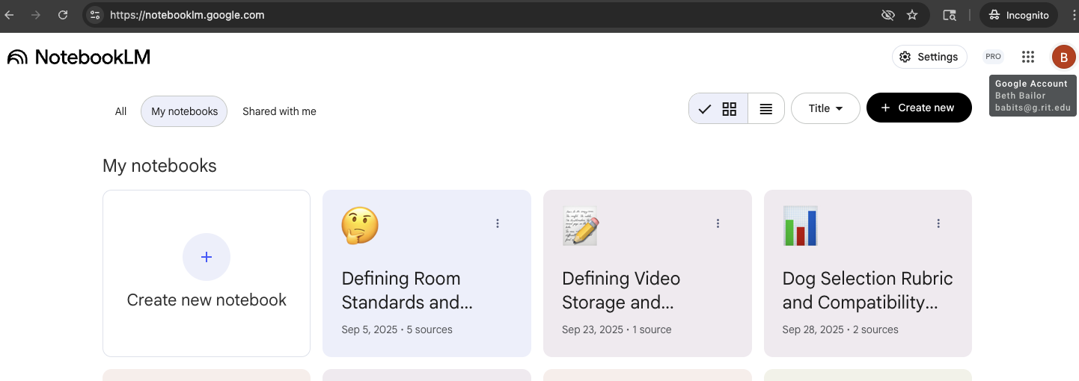
How To Learn – NotebookLM
Must be signed in to your
g.rit.edu account
1. Upload a real document and ask:
“Summarize this for executives.”
“What risks or gaps exist?”
“What questions should I ask?”
2. Ask better prompts. Be specific about:
Role: “Act as an enterprise architect.”
Audience: “Create a CIO-ready briefing.”
Analysis: “What conflicts exist across these docs?”
3. Use it for real work.
Comparing vendor proposals
Extracting decisions from notes
Creating executive summaries
Finding inconsistencies across documents
4. Improve through iteration.
Upload multiple documents.
Ask it to synthesize, critique, and identify risks.
You’ll learn fastest by applying it to something you already have to produce.
Notebooklm.google.com

Slide 10
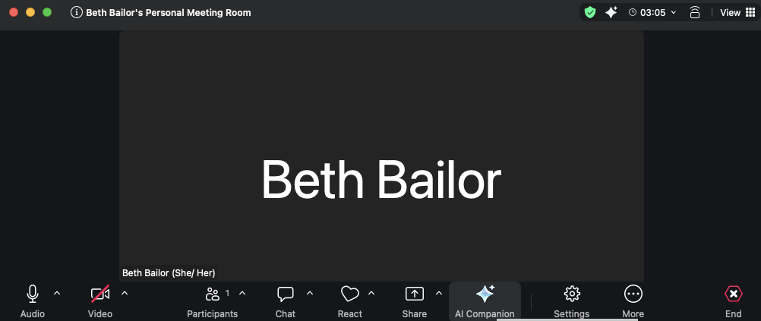
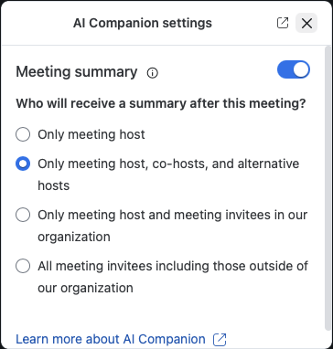
How To Turn on AI in Zoom
When your meeting starts, choose the AI Companion button
Pick your settings

Slide 11
Questions

Slide 12

Next Steps
After the pilot is completed, printers would be enrolled via attrition, as leases expire and by departmental request.
  Note: the entire fleet will be turned over by 2030 as of today with ~140 printers up in 2029.
Notes:
Add, Work with Xerox to do an analysis of non-MPS devices to catalog and put on a program to reduce number of purchased devices? Xerox is pushing this service.

