Slide 1
Employee
Medical and Disability Accommodations
April 18, 2024
Office of Compliance and Ethics

Slide 2
Applicable Regulations
The Pregnant Workers Fairness Act
The Americans with Disabilities Act (ADA)
Statutes that require employers to provide reasonable accommodations to qualified individuals with disabilities.

Slide 3
What Qualifies as a Disability?
The ADA defines disability as:
A physical or mental impairment that substantially limits one or more major life activities.
Major life activities are the basic functions of everyday life, such as:
Seeing
Hearing
Lifting
Concentrating
Learning
Sitting
Sleeping
Breathing
Reading
Eating
Working
Walking
Communicating/Interacting with Others
Bending
Thinking
Reaching
Standing
Speaking
Must be a substantial limitation
Can be episodic or intermittent
Notes:
Not every impairment related to a major life function is substantially limiting.

Slide 4
Medical Documentation Requirements
Diagnosis/nature of disability
Description of current level of functioning
Suggestions for accommodation(s)
Anticipated duration of the accommodation(s)

Slide 5
Reasonable Accommodations
Employers are required to make reasonable modifications or adjustments that enable a disabled individual to have equal employment opportunities.
Examples of reasonable accommodations:
Accommodations that occur during the job application process
Accommodations that involve the work environment
Accommodations that enable an individual to enjoy the benefits and privileges of employment
What is not reasonable?

Slide 6
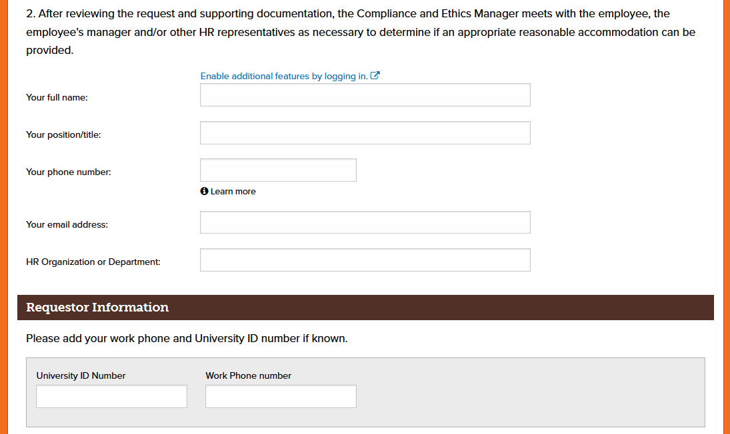
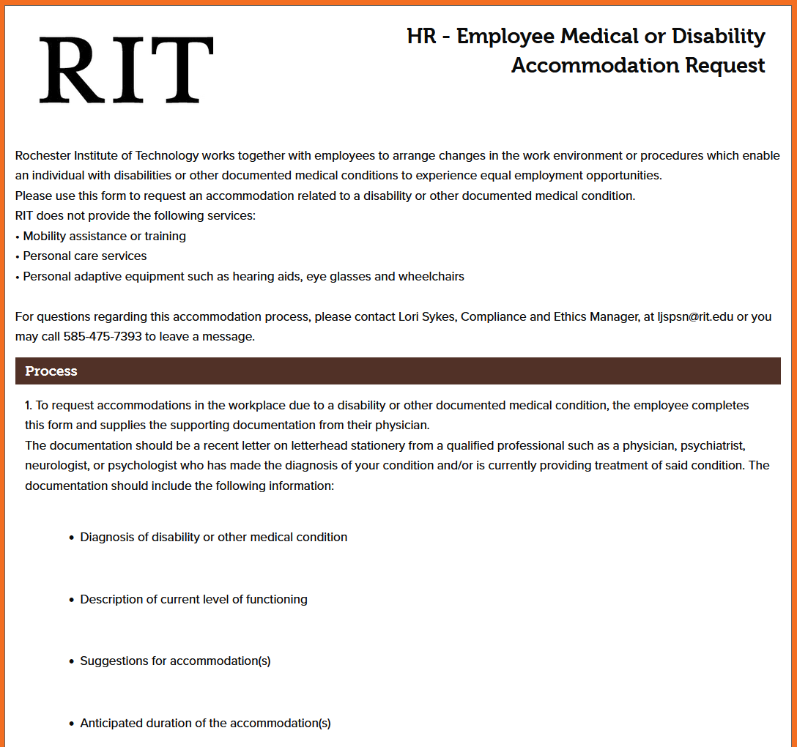
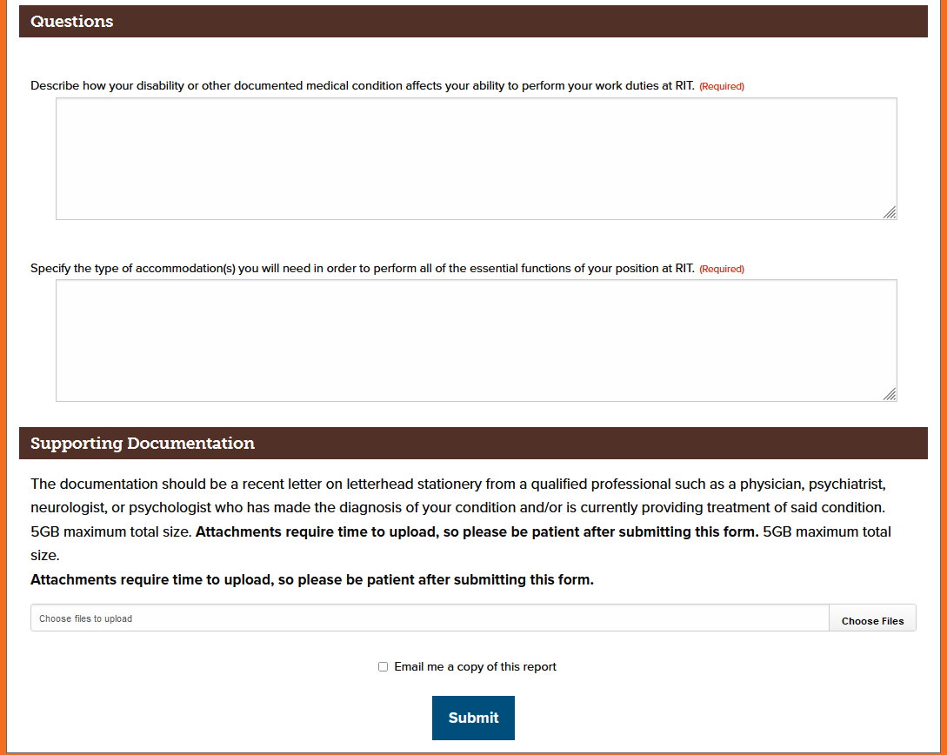
Accommodation Request Form

Slide 7
Interactive Accommodation Request Process

Slide 8
Questions?

