Slide 1
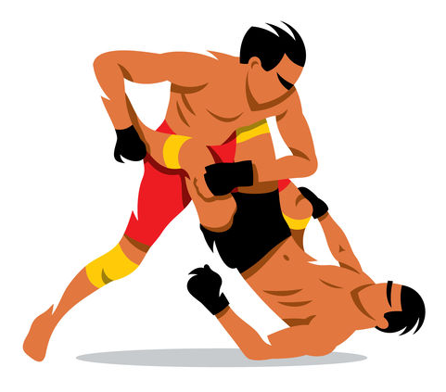
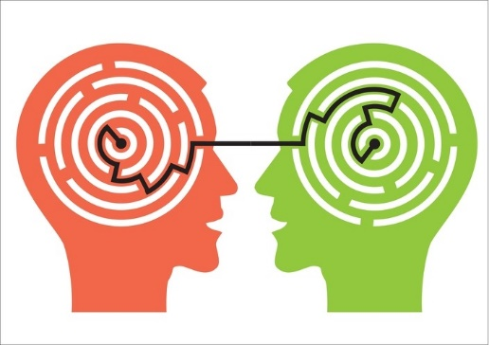
2 Step Process: Grapple, then Understand
123rf.com 123rf.com

Slide 2


Curiosity, by itself, isn’t enough. Mental “sweat equity” is required to attempt to accurately answer the questions that you ask.
Roll up your sleeves
and get to work.
alexpokusay@123rf.com

Slide 3
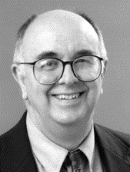

“Most actual cases of killing are clearly terrible… and one hears of such cases every day. On the other hand, one hardly ever hears of cases of letting die, except for the actions of doctors who are motivated by humanitarian reasons. So one learns to think of killing in a much worse light than of letting die. But this does not mean that there is something about killing that makes it in itself worse than letting die.” (James Rachels)
solerf@123rf.com

Slide 4
Slide Title Goes Here
“
Most actual cases of killing are clearly terrible… and one hears of such cases every day. On the other hand, one hardly ever hears of cases of letting die, except for the actions of doctors who are motivated by humanitarian reasons. So one learns to think of killing in a much worse light than of letting die. But this does not mean that there is something about killing that makes it in itself worse than letting die.
’’
James Rachels
solerf@123rf.com

Slide 5


Parenting & Paternalism
Wear your seatbelt!
Wear your seatbelt!
Wear your seatbelt!
https://www.theodysseyonline.com/finding-middle-ground-with-parenting-crucial
https://www.pinterest.com/pin/482588916297170578/

Slide 6
Parenting & Paternalism
If there is something to say, you can add to it.
WEAR YOUR SEATBELT!
WEAR YOUR SEATBELT!
https://www.theodysseyonline.com/finding-middle-ground-with-parenting-crucial
http://www.pinterest.com/pin/482588916297170578/https

Slide 7
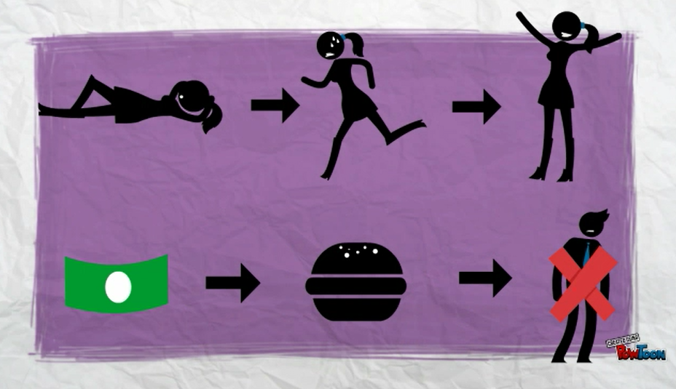
Notes:
Money is good as a means to buying useful things, such as food. Food is good as a means to, among other things, avoiding the pain of hunger. Pain is intrinsically bad.

Slide 8
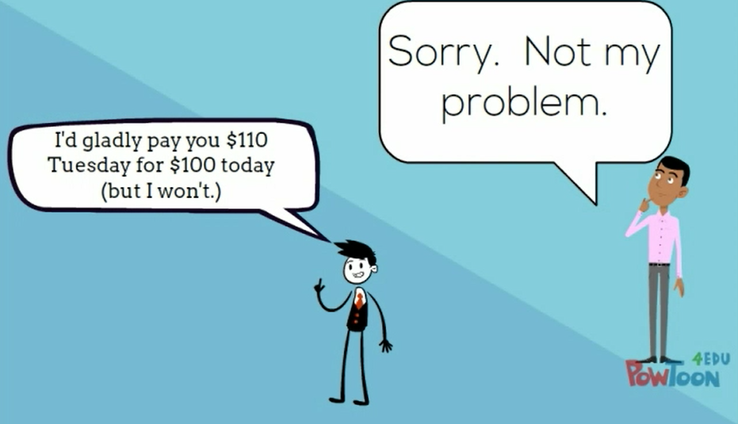
Version (b) covers omissions.
Version (a) covers comissions.

