Slide 1
Today’s Agenda
Top Inquiries and Answers
Time Tracking – Terminology / Key Terms
The Who, What, Where, Why, and When
Employee, Timekeeper and Manager Roles
Processing Deadlines
Enter Time Business Process
Navigating the phases of a Timesheet
Approval / Corrections best practice
Q&A
Notes:
Today's agenda is packed with all things Time Tracking. I wanted to kick off with the most frequent inquiries that we have been receiving through the Controllers Office Timekeeping help line.
From there we will go through some of the workday time terminology to set the stage
Then move to the Who, What, Where, when and maybe a touch of the why where possible.
The Enter Time Business Process where we will touch on the variations of the timesheet status, the views, and some best practice methods for Approving Time.
I will do my best to leave time at the end for Q&A

Slide 2
Timekeeping top inquiries
Inquiry | Potential Cause | Solution
There is a problem with my paycheck, I worked 22 hours and was only paid for 4 | This is where the troubleshooting starts and for the purposes of this session – the cause found here is that the employees Unmatched punches were not corrected. | When reviewing time – start with the report Unmatched Time Clock Events Or Edit and Approve Time – By Period
Unable to enter time for worker / new hire | The start date of that position is in the future. | Critical to confirm the actual start date. Work with the SEO or HR Ops team to rescind or re enter the new hire with the correct start date.
Time Clock is returning an incorrect “Clock in” when I expect a “Clock out” (or vice versa) | Mixture of entry types or a correction to a missed punch prior to the next shift was entered. Clock does not see this activity. Entering in /out times directly on the timesheet should be avoided. | To correct – add a second punch immediately to sink with the correct task. This will create an unmatched time message that will need to be corrected. Avoid using multiple methods of entry.
Time Off Requests coming to me for approval – Not for my job though? | Time Off requests will route to the primary manager only for approval, unfortunate expected behavior. | Work with Students to have a conversation with the primary manager about sick days. Manager will approve on your position's behalf
How do I correct the timecard for a worker that recorded hours on the wrong job | Employees with multiple jobs are required to select the job for each shift. The Primary job will default. The only place to see all multiple jobs active for an employee is on the timesheet. | Work with employee’s to be more careful, review their own time for accuracy and communicate the correction needed. Update the
Notes:
I wanted to start with the Top inquiries and my best attempt at an answer – so that as we go through the remaining slides, I can point out where some of these come into play

Slide 3
Key Terms ; Time Tracking
Timekeeper Security Role – To support the approval process “On Behalf of” the reporting manager. Critical role and managers are responsible for these approvals.
Unmatched Punch – Forgot to punch, Students are unable to make corrections and should communicate, Staff should correct. All Edited time and activity not tracked in real time is added risk for audit.
Workday Timecard / Timesheet – Enter Time for Worker will bring you to the Employees’ Timesheet (these words are interchangeable)
Period Schedule – All Nonexempt employees are on Biweekly schedule with a Friday – Thursday work week.
Work Schedule – A required attribute of Time Tracking, generic work schedules created with no rules attached. Currently, schedules do not drive any rules or calculations.
Supervisory Organization – A manager’s organization, drives security and allows for separate rules. When requesting the Timekeeper role, you will select the supervisory organization for Staff, Students, and / or Adjuncts
Employee Type - This will differentiate and allow for conditions and rules to be assigned (Student; Adjunct, Faculty, Staff)
Review Time – The view / report to use when approving hours, or the step prior to Submit Time
Submit Time – The first step of the Business process “Enter Time” a Timesheet is submitted and will kick off a task for all positions worked in that period.
Notes:
There are a lot of key Terms, hopefully several you have learned already but will serve as a good reference.
Safe Harbor – this is from the Time perspective
Supervisory org
Employee Type

Slide 4
Key Terms ; Time Tracking
Send Back – Please don’t do it, when payroll mass submits and you send back; you are sending back to payroll
Request Absence – A separate business process to use a Time Off type that normally has an accrual balance that drives the availability. These plans are supported by the Benefits team and payroll cannot make corrections or adjustments.
Check in / out – Real Time method of Tracking time in Workday. Most compliant method and available on the Web, Mobile and Timeclocks
Micro Edit – Entering Time on the Timesheet ; Students do not have the access to edit through this method.
Time block – A completed in and out punch that calculates time and records the transactions associated with the business process
Time Type – Selection at the Kiosk or on the web ; Worked time is default and most common
Absence - plans that use Time Off ;Student workers cannot use the Timesheet for Time Off.
Position – Another field on the Time Block
Location – An organization assigned to the Worker or for Time Tracking purposes, an attribute on the time clock that defaults to the clock location.

Slide 5
The Who, What, When, Where and How of Time Tracking

Slide 6
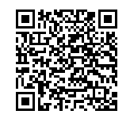
How – There are Four Ways to Record Time
Workday Timeclock
Workers will enter their 9-digit UID at one of the physical time clocks at the beginning, meal and end of your shift.
Time punches are viewable in Workday within minutes
Multiple Entry methods or Corrections to Timesheet prior to the next shift may cause unexpected errors at the clock
Workday Web clock
Workers will log in to Workday and use the Check In button when your shift begins. Workers will return to Workday to Check Out at a meal break and when your shift ends.
Workday Mobile Check in / out
Geofence was created for most of the university buildings except for Residence Halls.
* Phone signal may impact
Workday Timesheet –Staff only
Workers will log in to Workday and manually record time for the applicable position.
At the end of each pay period, workers submit your timesheet to your manager for review and approval.
Workers can correct approved time.

Slide 7
The What & Who - Time Entry and Approval Actions by Role
Time Tracking Tasks | Staff | Students | Manager | Timekeeper | Manager’s Manager | Audit | Benefit/Absence
Clock Time on Workday Timeclock | X | X
Enter Time Mobile Check in /Check out | X | X
Enter Time on Timesheet – Micro Edit | X |  | X | X | X
Time off on Timesheet – Staff only | X |  | X | X | X
Review and Submit Timesheet | X | X | X | X | X
Correct Time / Missed Punches | X |  | X | X | X
Enter Time Off – Request Absence | X | X | X | X |  |  | x
Approve /Correct Time Off |  |  | X |  |  |  | X
Approve Time Worked |  |  | X | X | X*
Run Time Audit Reports |  |  | X | X | X | X
** Employees should follow rules established by their departments for Time Entry

Slide 8


Payroll
Payroll Audits and supports approval inquiries
Finalize Payroll
Period Ends – Wash / Rinse Repeat
Time Tacking
Mass Submit
Time Entry Lock –9am then Mass Approve ; current period only
Wednesday at 12:01 am Prior periods open for corrections
Employee
Employee Time Entry Begins – Employee Responsible for checking in / out in real time, selecting the correct Job working; recording time off requests, review – submit time at the end of the biweekly period
Manager/ Timekeeper
Approval deadline – 9 am Monday- Correct, Record absence
DO NOT SEND BACK *Please
Prior Period Timesheet Open for Corrections – Unapproved corrections will not be paid
HR / SEO/ Benefits
HR Ops, SEO and Benefits support the transactions that allow for time tracking and payroll. New Hires, Terminations add or terminate additional jobs.
Notes:
And now for the When – The payroll period is made of two FLSA weekly periods Friday – Thursday ;

Slide 9
Enter Time Business Process –
Navigating the phases of a timesheet
Unsubmitted Submitted Approved

Slide 10

Enter Time Business Process – Iterative & Job Specific
Enter Time
Time Clock
Mobile Entry
Web Clock *Check in
Micro Edit **
Submit Time
Employee
Notifications
Manager
Timekeeper
Mass Submit
Notifications
Approve Time
Correct Unmatched
Add dept codes
Correct jobs
Approve Absence requests
Notes:
The Enter Time BP is iterative. No Cancellations, rescinds, or corrections
Time Periods are locked during payroll processing to allow for payroll processing to complete without ongoing changes -

Slide 11


Validation Messages –
Soft Warning
Hard Stop – correction required
Worker Worked > 6 hours without a meal
Worker worked > 12 hours in a shift
Student Reported Time >20 hours
Overtime Reported >30 hours review
Gratuity (Dining)
Student Dollar Diff > $50 – review
7 Consecutive days
Ineligible Position Entered
Critical FMS > $$ / Week
Incorrect code – you cannot use this code, select another one.
Review for Long shift – when missed punch out – connects with next day
Notes:
Another feature in Workday that allows for alerts on a timesheet that help support compliance

Slide 12

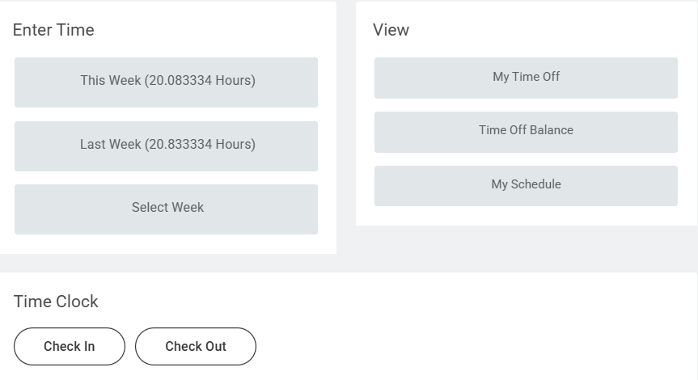
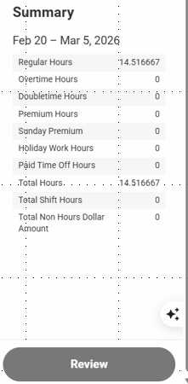
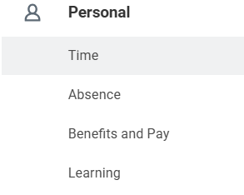
Employee Experience – Submitting Time
After the last shift of the period – Employees and students Review and Submit Time
Notes:
Work with your employees to take responsibility and review / submit their own time. This will reduce the need for rework.
I am now proxied as the student, and this is my last shift of the week – on the web I am able to review my activity for the period and hit Review – Submit ; this is what the student is seeing ;

Slide 13
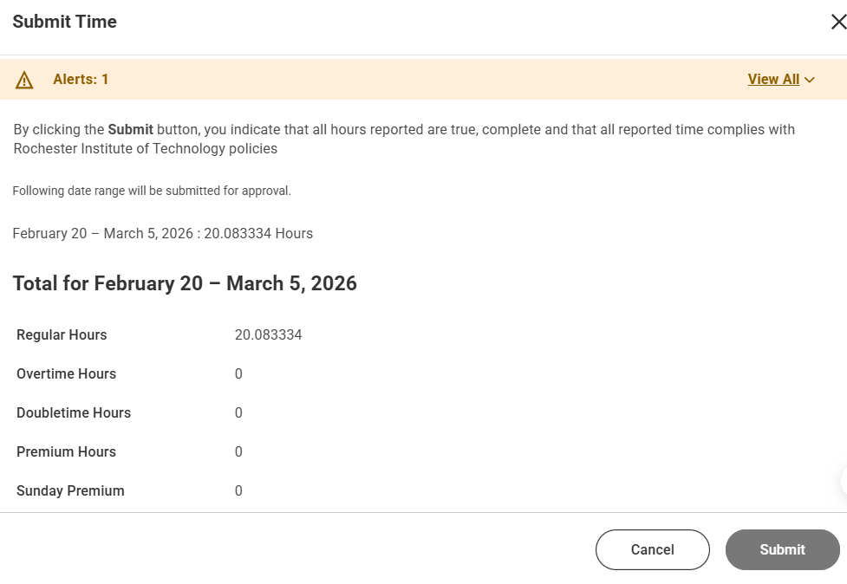
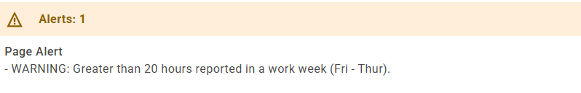
Employee Experience – Submitting Time
Next Up –
Timekeepers and Managers
Notes:
I am now proxied as the student and this is my last shift of the week – on the web I am able to review my timeclock activity for the period and hit Review – Submit ; this is what the student is seeing ;
This time was Reviewed and Submitted
Mass Submit will always occur at 1am on Friday morning following the end of the period – this will trigger notifications to manager and timekeepers
Manager’s manager will no longer be able to approve time - not part of bp ; will need timekeeper access and will then receive all notifications

Slide 14
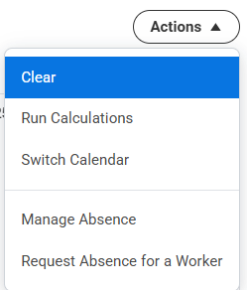
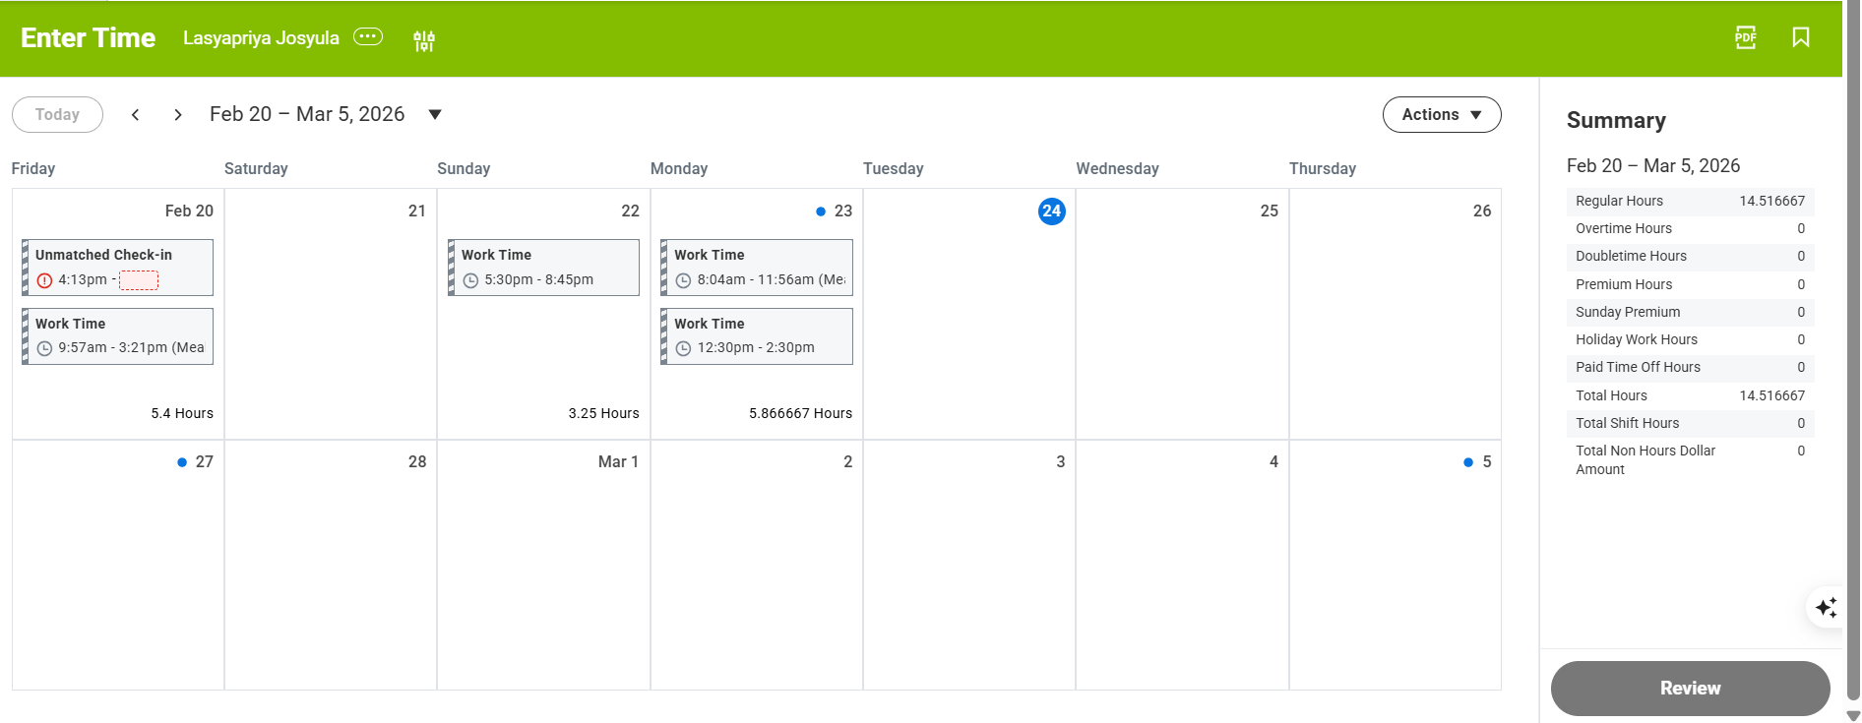
Unsubmitted Timesheet – Biweekly Period View
By Period is the default & Time can only be submitted by the Period
This Time is Unsubmitted
Notes:
An Unsubmitted Timesheet – Your action to Submit this will be the approval Step

Slide 15

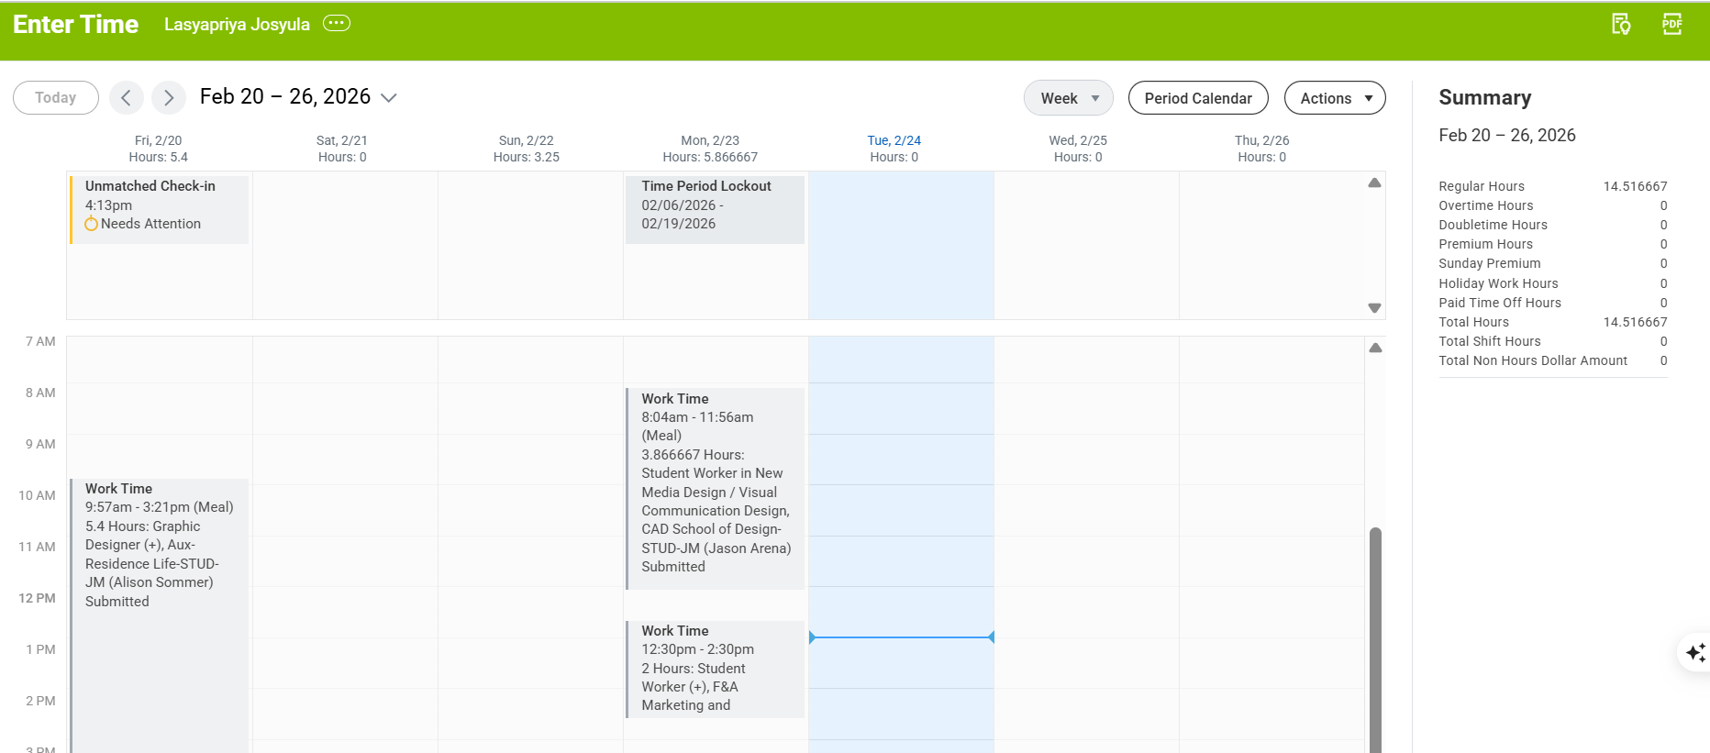
Submitted Timesheet – Weekly View
By Week allows you to see which job the employee is clocking time
This is an Unmatched punch
This Time is Submitted –
The Task is now with 3 different managers’ / timekeepers
Notes:
This is the weekly view and by selecting Actions – Switch Calendar, you can now see that this student worked on 3 different Jobs.

Slide 16
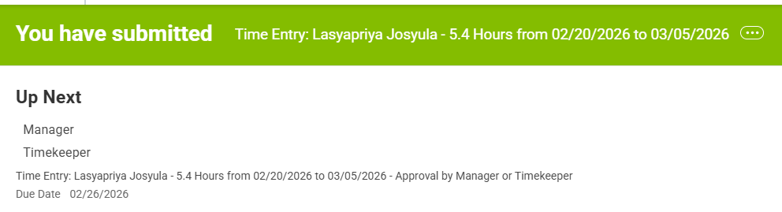

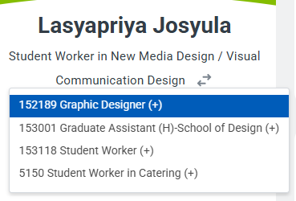
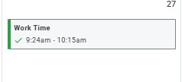
Penelope Peach
Multiple Jobs = Multiple Business Processes
Submitting a Timesheet initiates 4 separate Business processes
Job 4 Manager & Timekeeper
Penelope Peach
Job 3 Manager & Timekeeper
Primary Job Manager & Timekeeper
Job 2 Manager & Timekeeper
Approved Time block
Notes:
While during the Time review process you have the ability to see all jobs for the employee you cannot approve these hours. Worth noting here as well that when reviewing the employee profile, managers are unable to see the multiple positions active.
If hours were submitted to your job in error, you should contact the student to ask which job these belong to. The approving manager can then change the job to the correct job and resubmit the timesheet - this will trigger a new task for the manager of the correct job for that time block.
While students are unable to edit their own timesheets, the responsibility to review and submit time can easily be requested by all workers.

Slide 17
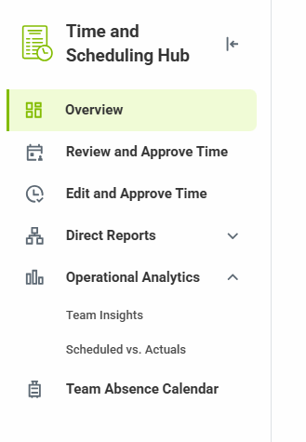
Reviewing/ Approving / Correcting Time
Directly from the Task
Edit and Approve –
Ability to act/ update from report view
Assumes work week is Sunday to Monday
Best to use for reviewing exceptions prior to Approving
Review Time
A cleaner view
Allows you to toggle through timesheets
Best use after acting on alerts, to do approvals in one place
Notes:
I must approve an invoice for 45$ - it is critical that time is approved ;
Review Time or Edit and Approve Time
Refer to prior period to confirm any updates that employees or timekeeper did not approve
Long shifts – Hours total for the day and the next day will be the indicator
Open timesheets in a separate Tab where there may be exceptions to review – You can have multiple tabs open (be careful)
Correct or Delete Missed Punches
Payroll will mass approve all timesheets that are unapproved – including those in the “Send back” status -
Employees must Submit the correction to initiate the approval to managers’
Managers must Review – Approve prior period corrections to be paid
Mass Approve will not occur for time not in the current processing period.

Slide 18
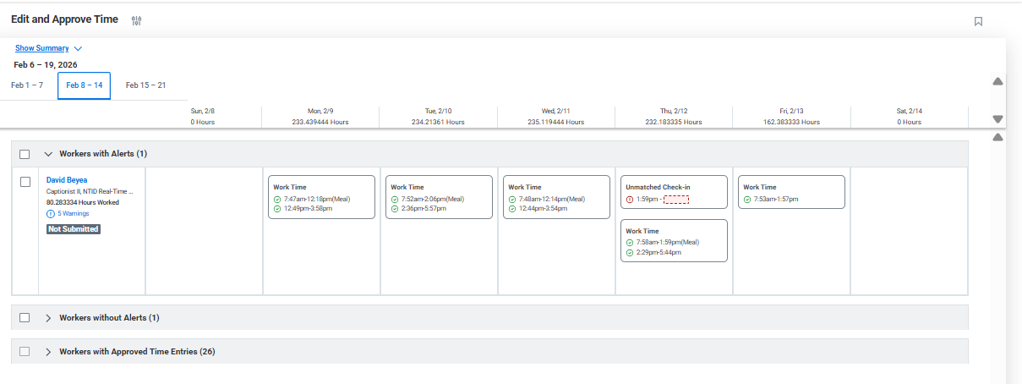
Edit and Approve Time
Notes:
I have to approve an invoice for 45$ - it is critical that time is approved
Review Time or Edit and Approve Time
Refer to prior period to confirm any updates that employees or timekeeper did not approve
Long shifts – Hours total for the day and the next day will be the indicator
Open timesheets in a separate Tab where there may be exceptions to review – You can have multiple tabs open (be careful)
Correct or Delete Missed Punches
Payroll will mass approve all timesheets that are unapproved – including those in the “Send back” status -
Employees must Submit the correction to initiate the approval to managers’
Managers must Review – Approve prior period corrections to be paid
Mass Approve will not occur for time not in the current processing period.

Slide 19
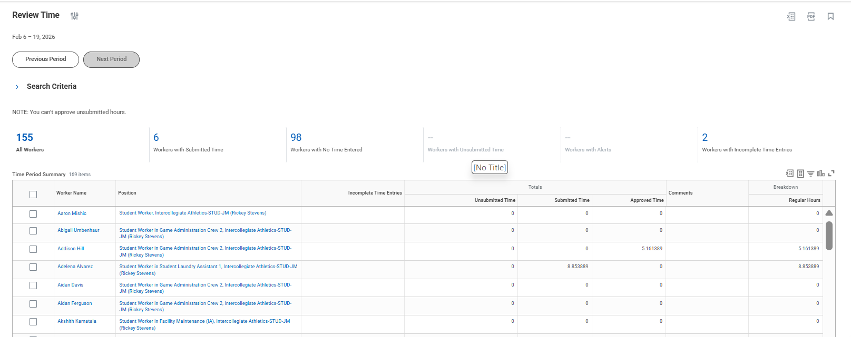
Review Time
Notes:
With Review time we have the ability to Toggle through timesheets and see a summary of hours – this view will allow you to select at date in the period and always pull in by period Friday - Thursday
Payroll will mass approve all timesheets that are unapproved – including those in the “Send back” status -
Employees must Submit the correction to initiate the approval to managers’
Managers must Review – Approve prior period corrections to be paid
Mass Approve will not occur for time not in the current processing period.

Slide 20
Time Sheet Totals
Regular Hours | Sunday Premium OT Adjustment Training Premium Training Premium Sunday Work Time
Overtime Hours | Training Premium OT Weekly Overtime >40
Doubletime Hours | 7th Day Consecutive Double Time 7th Day Consecutive Double Time Training Premium Doubletime
Premium Hours – Managers and eligibility only | Emergency Hours – Not always on NTID Overload Short Week Premium
Sunday Premium | Sunday Premium
Holiday Work Hours | Holiday Work Time
Total Shift Hours | BC - 7th Day Consecutive Double Time BC Shift 4pm to 8am BC Shift Adjustment BC Shift Sunday Premium BC Shift - Weekly Overtime >40 C Shift 12am to 8am .75/hour Student C Shift - Weekly Overtime >40
Total Non-Hours Dollar Amount | FMS Scheduling Adjust Gratuity Student Differential
Paid Time Off Hours | Approved Absence With Pay Bereavement Building Closure Holiday Hours Jury Duty Pay Continuance Prenatal Sick Leave Sick/Personal Exempt Sick/Persona Non Exempt Sick Bank Student-Adjunct Sick Vacation
Notes:
Time Types at the clock are currently unable to be restricted to groups – unfortunate and on the Workday updates list to be done

Slide 21
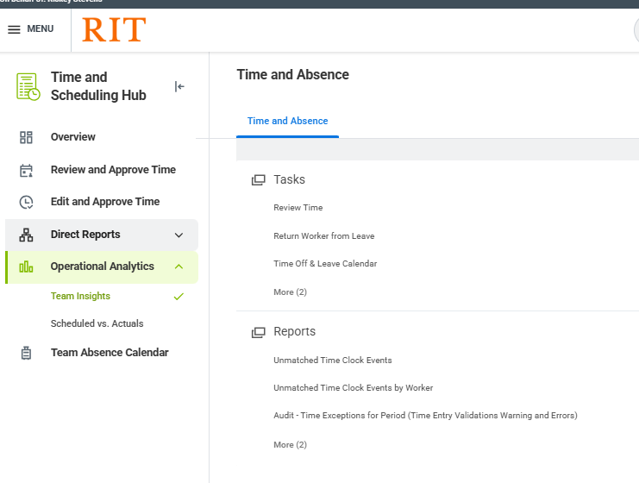
Reporting
Keep an eye on the Time and Scheduling Hub – Operational analytics
Additional Report you may find helpful
RIT Time Block Audit (Timekeepers accessible)
Continuing to focus on building this out for teams

Slide 22
Thank You

